Slide 2
Fertilizer Recommendations and Costs
2025 Canola and Wheat Outlook
Dr. Brady Goettl
Assistant Professor of Extension Soil Science

Slide 3
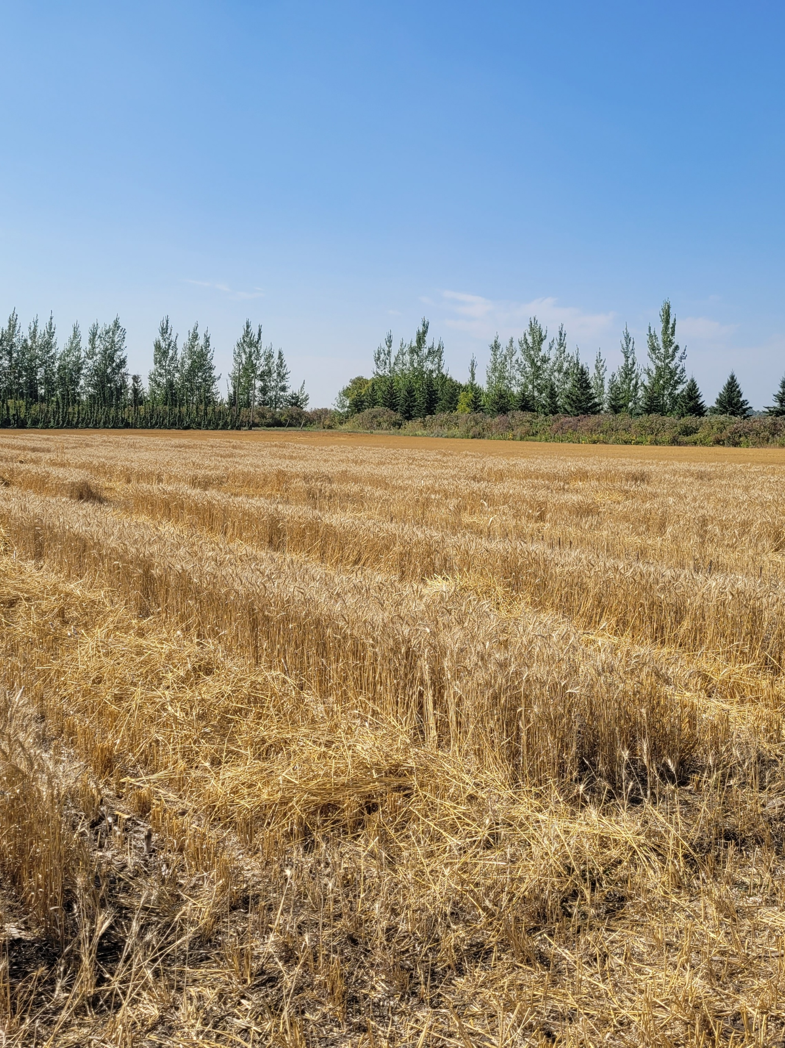

Topics to Cover
Finding publications and resources
2025 nutrient deficiencies
Making economic fertilizer decisions
What awaits us in 2026?

Slide 4

Finding Resources
Brady’s SNRS Directory Page

Slide 5

Source: https://golfcourselawn.store/cdn/shop/articles/Lawn_Fertilizer_Numbers_Explained_900x.jpg?v=1710419362

Slide 6
  (N_{f} = n(Y_{GOAL}) – N_{credits})
Notes:
When soil test N and previous crop credit are included, the R2 improves and the data tightens, especially at lower N rates. Our data from 1970-2008 are represented in this figure. The black dots are the individual data points for each study, and the black curve represents the regression curve for the trend line. Note that it is a curve- that wheat yield is not totally controlled by N- environment and soils are also big factors that prevent a straight line relationship. Most nutrient response curves follow the “law of diminishing returns”. This is especially true for P and K, but also for N most of the time. The most profitable responses to N are the increments of N at the left of the scale. As we approach N rates close to maximum yields, the economic return for added N decreases. Note that to go from 20 bu/a to 40 bu/a takes about 100 lb N (which is our current recommendation). To go from 40 bu/a to 50 bu/a takes another 100 N/a. This is twice the rate of N as it took to increase yields the same amount at lower yield potential. Also note that our current recommendation (in yellow) under-estimates N recommendations at high yield potential and over estimates N recommendations at lower yield potential.
6

Slide 7
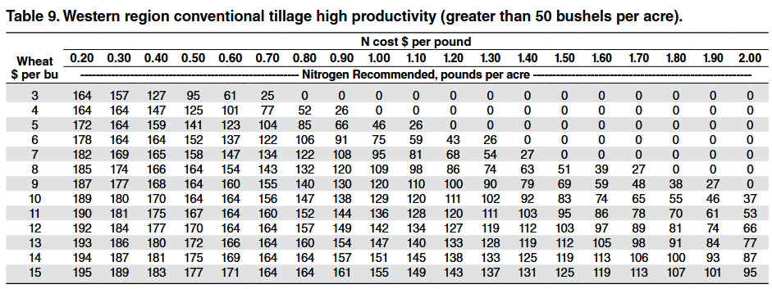

Slide 8
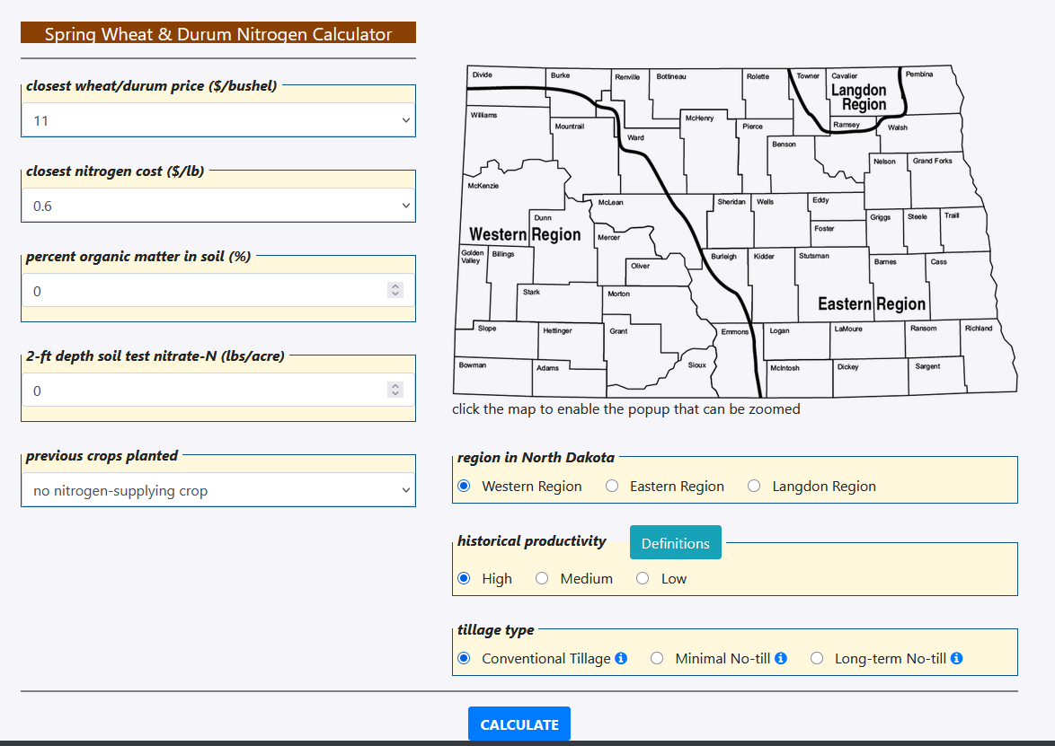
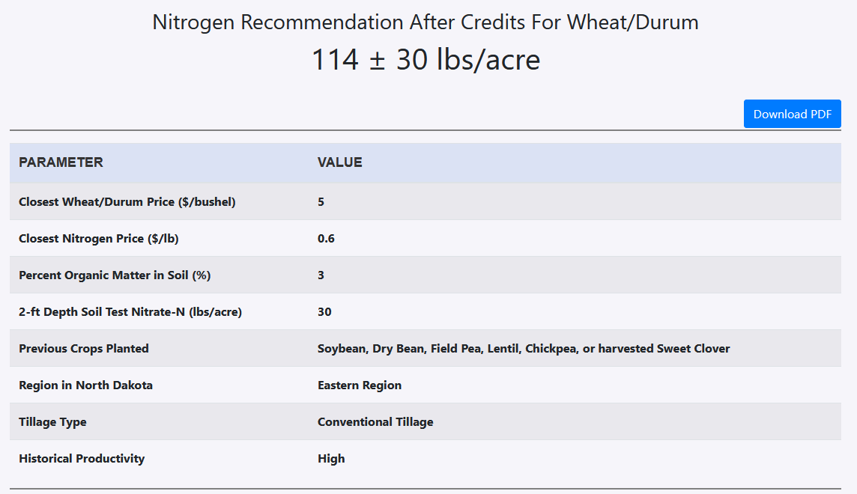

Slide 9
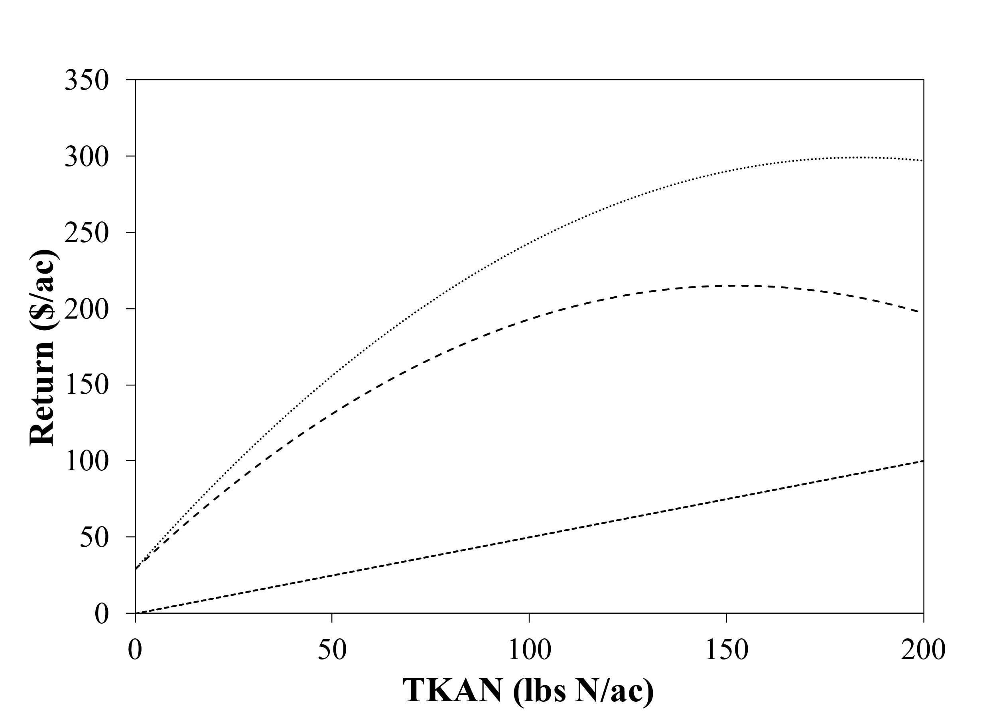
A Tale of Two N Rates
137
40
45
52
Rec Rate: lbs TKAN/ac
Legume Credit: lbs N/ac
Soil Nitrate-N: - lbs N/ac
Fertilizer: lbs N/ac
Barley: $5/bu
Fertilizer: $0.50/lb N
Gross Return ($)
Net Return ($)
137 lb N/ac
186 lb N/ac
186 lbs TKAN/ac → $200/ac
137 lbs TKAN/ac → $213/ac
Fertilizer Cost ($)

Slide 10
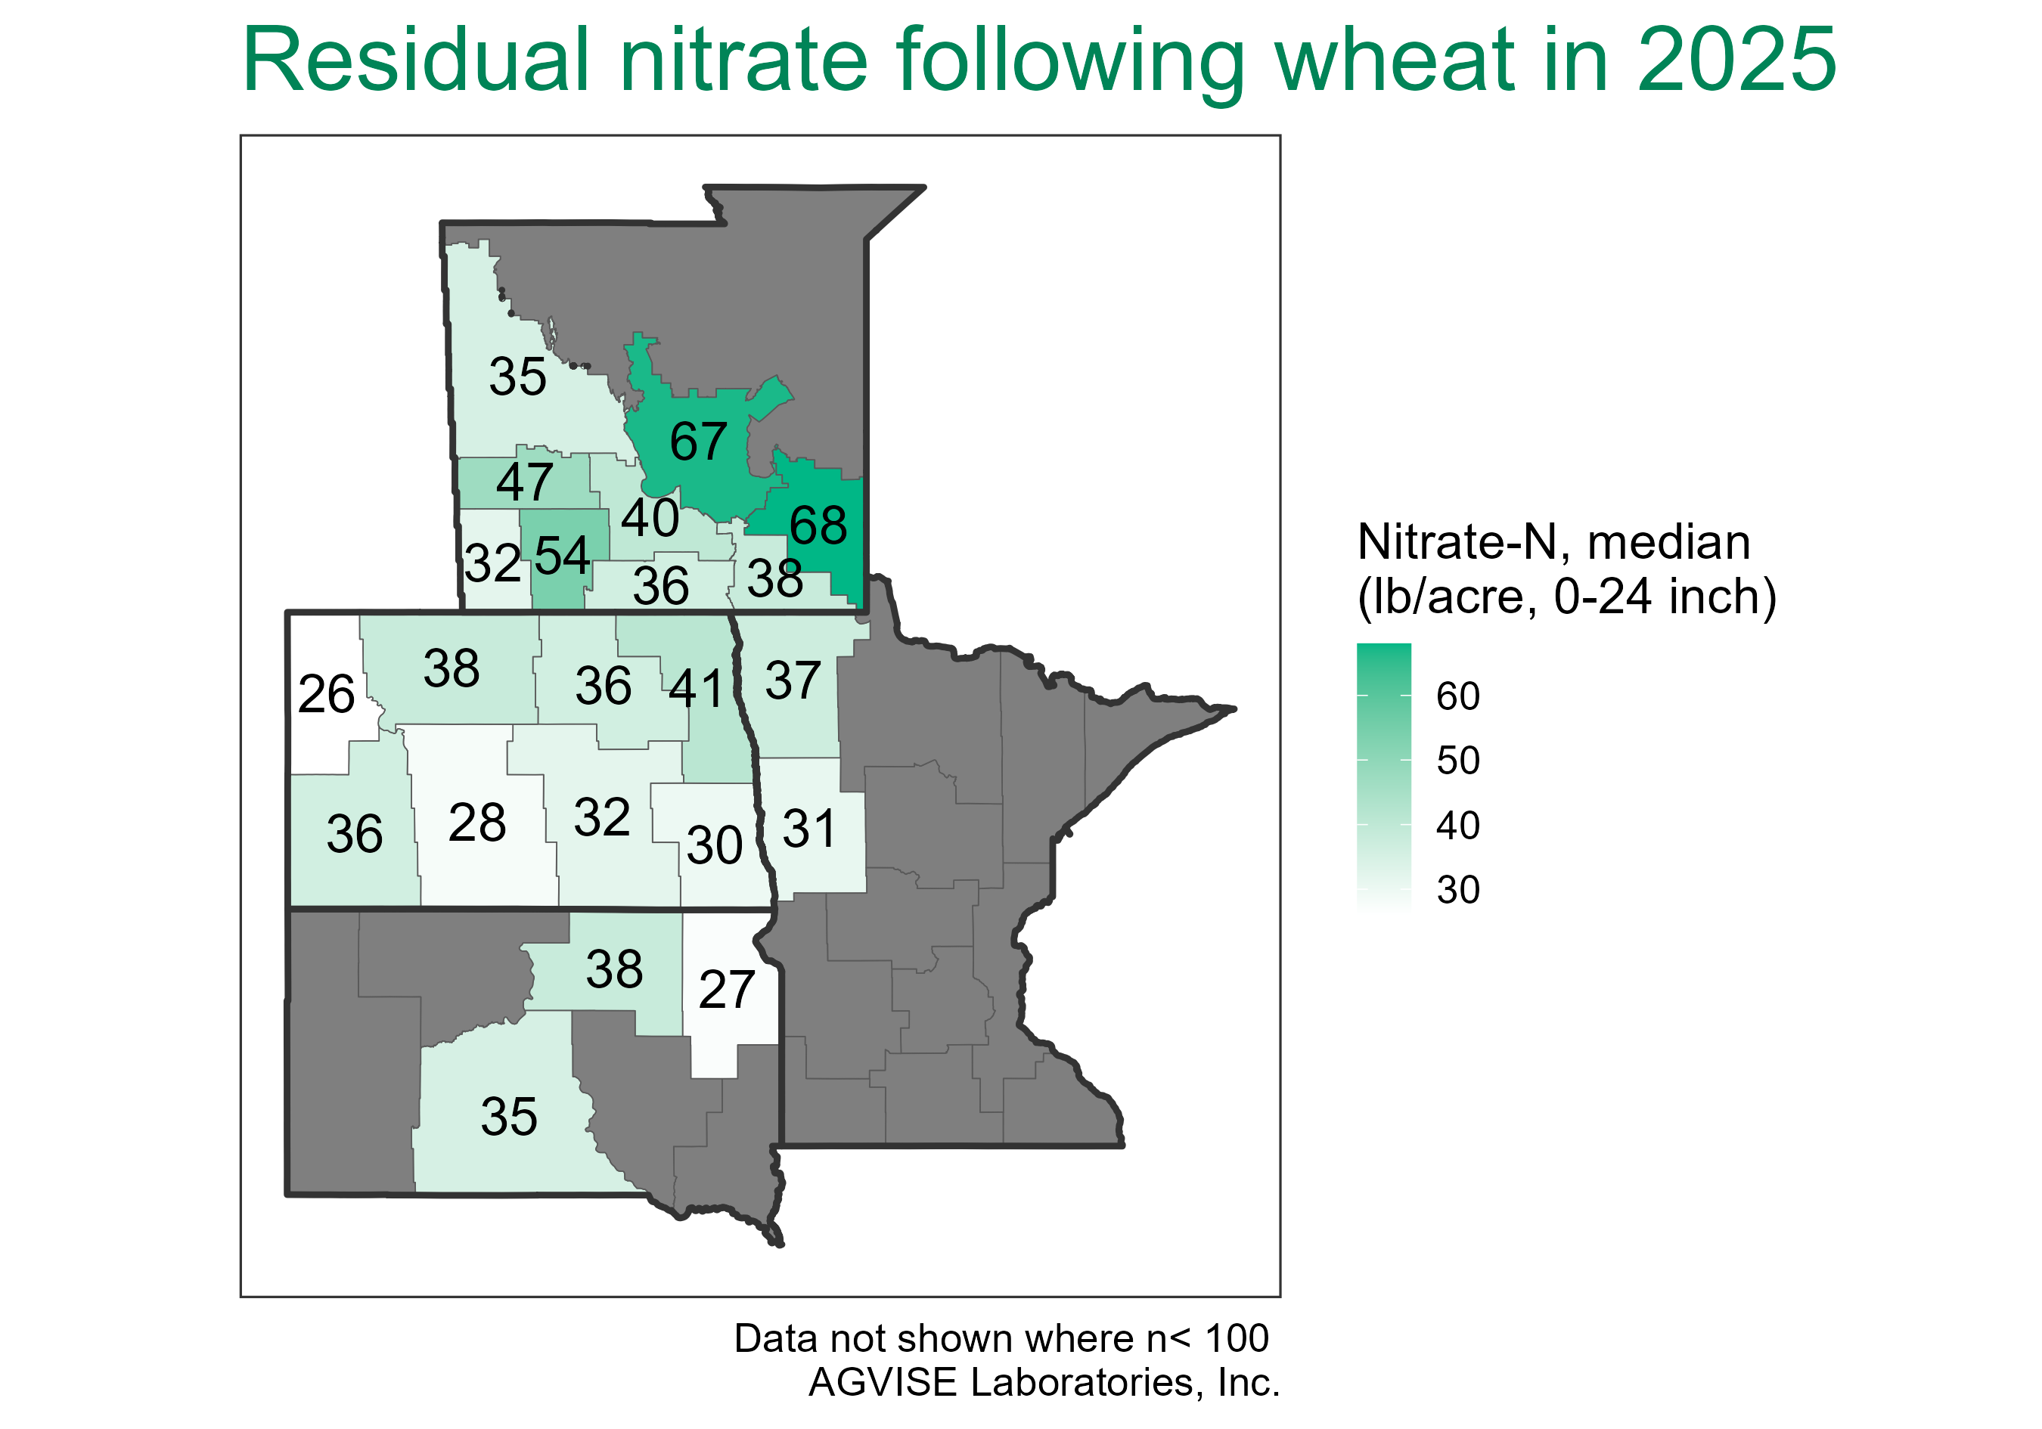
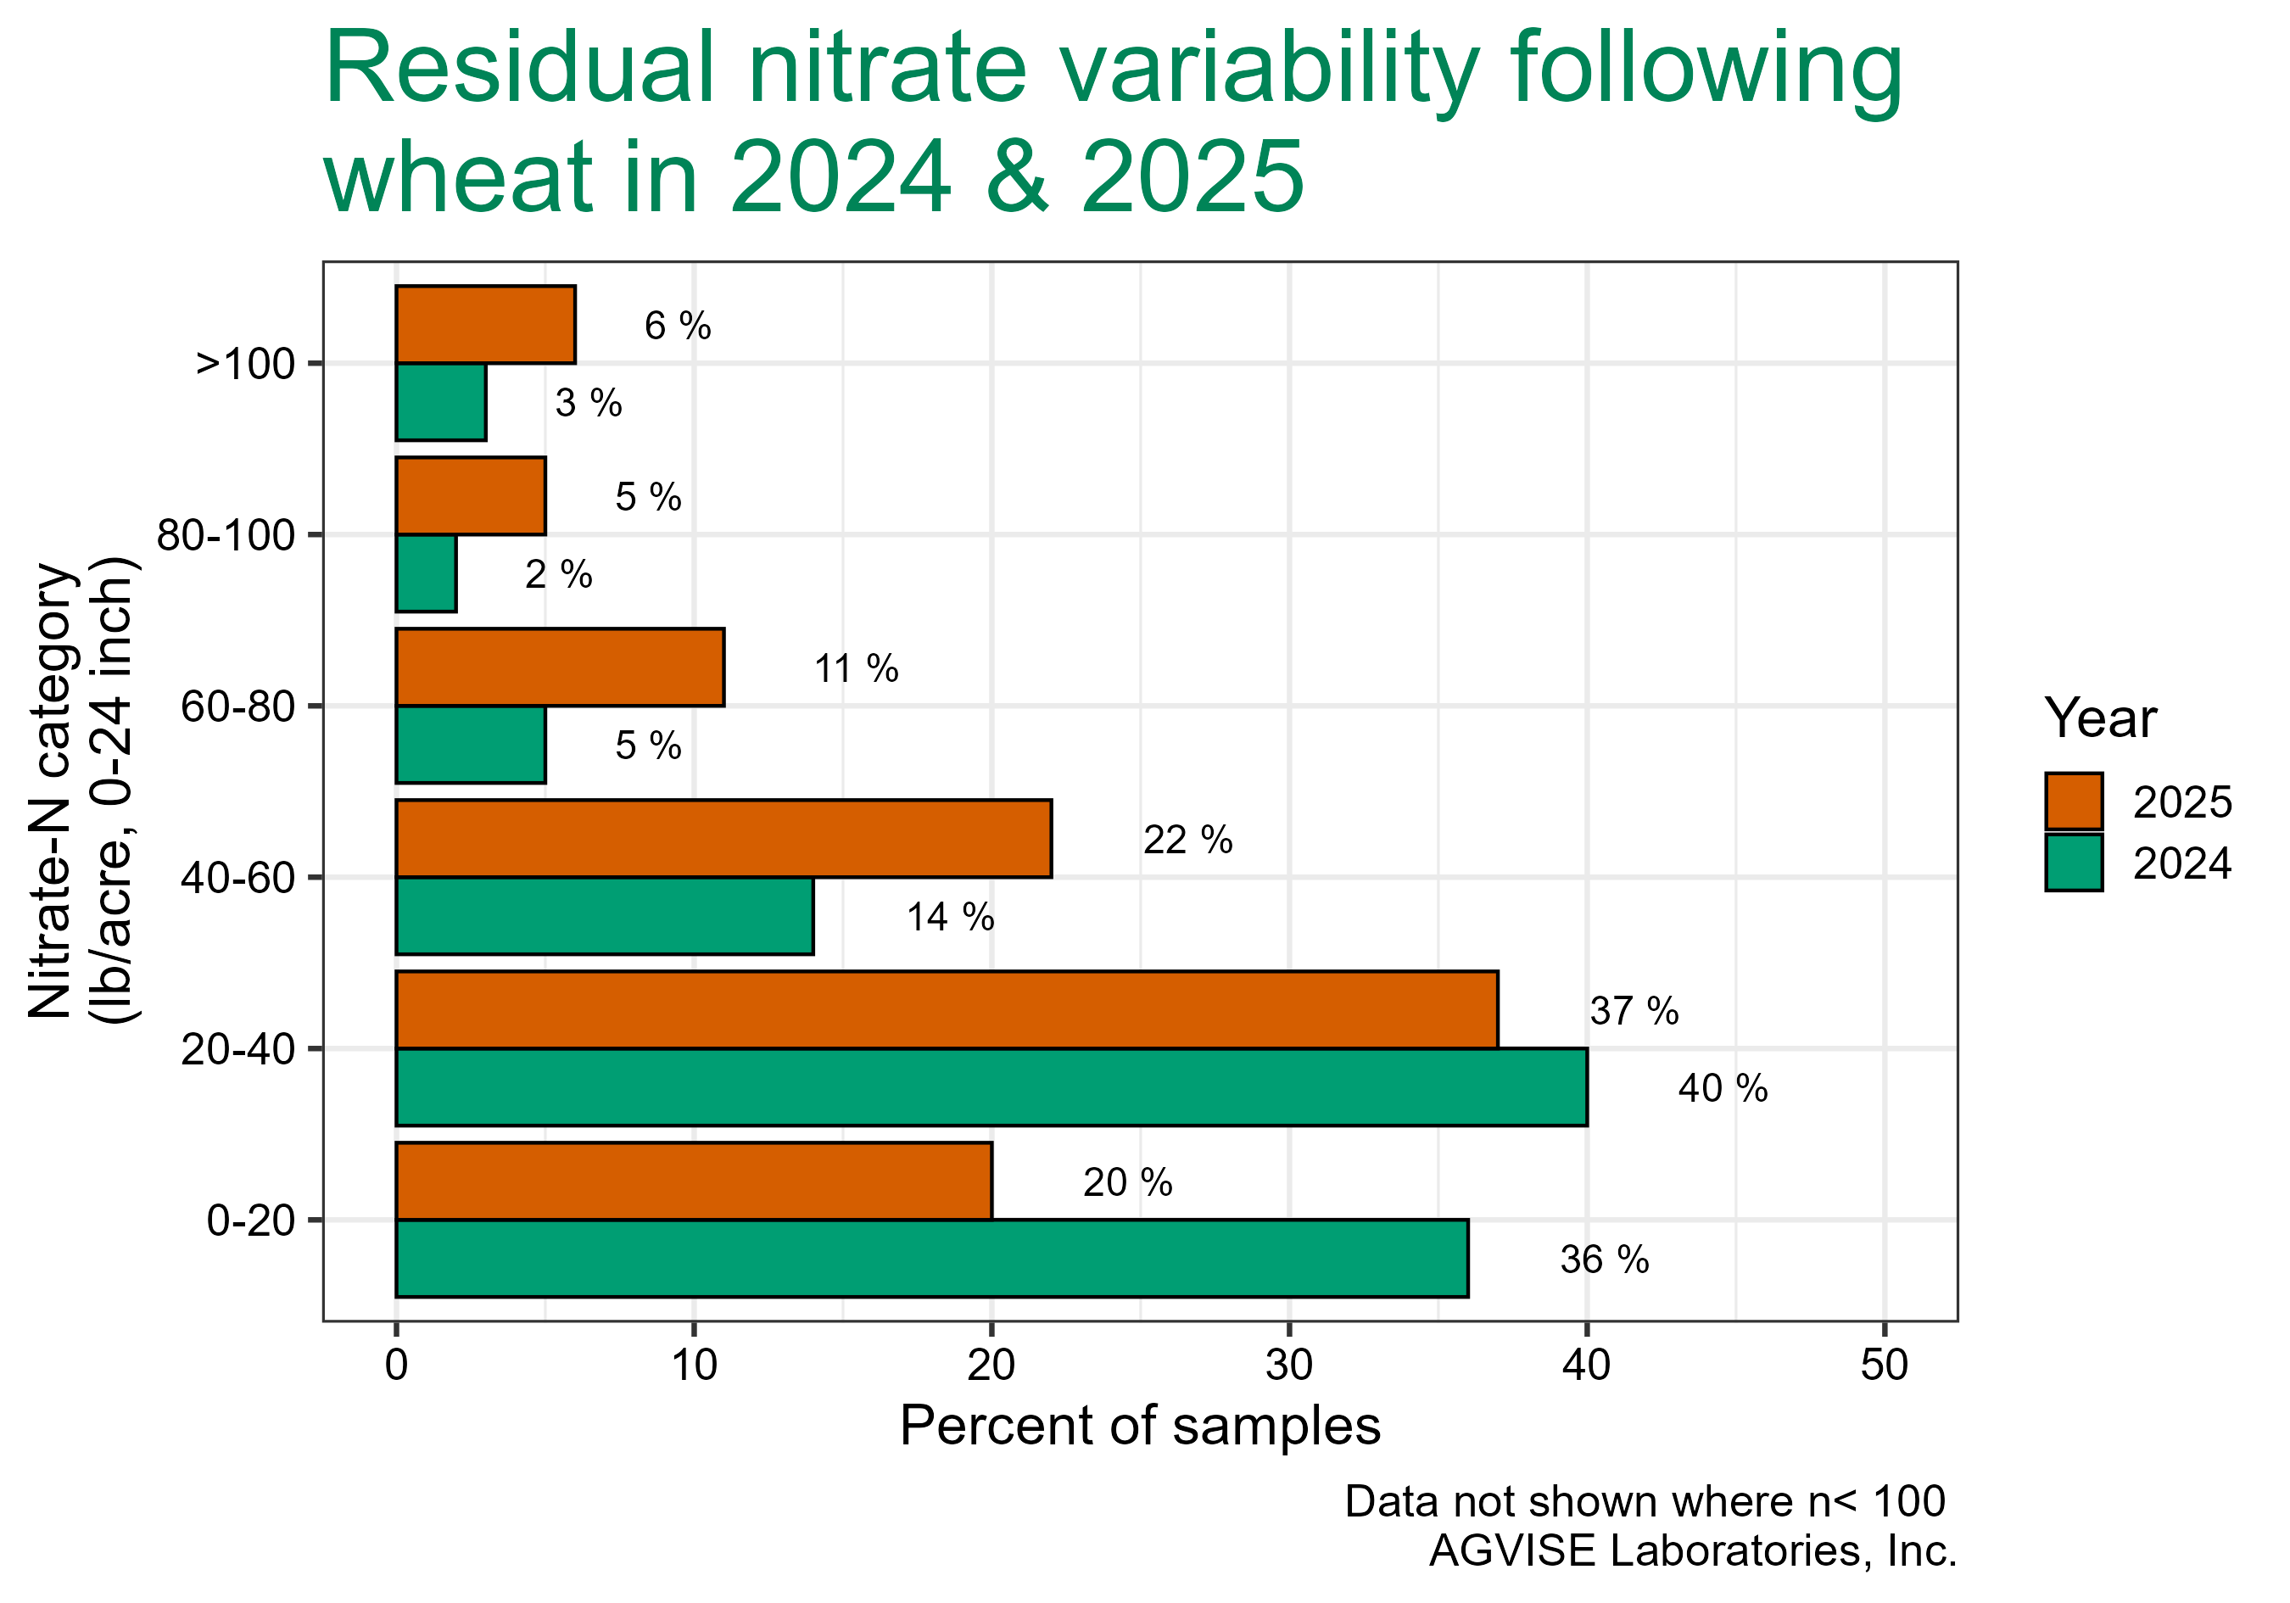
Notes:
1995-2024 average = high 20s

Slide 11
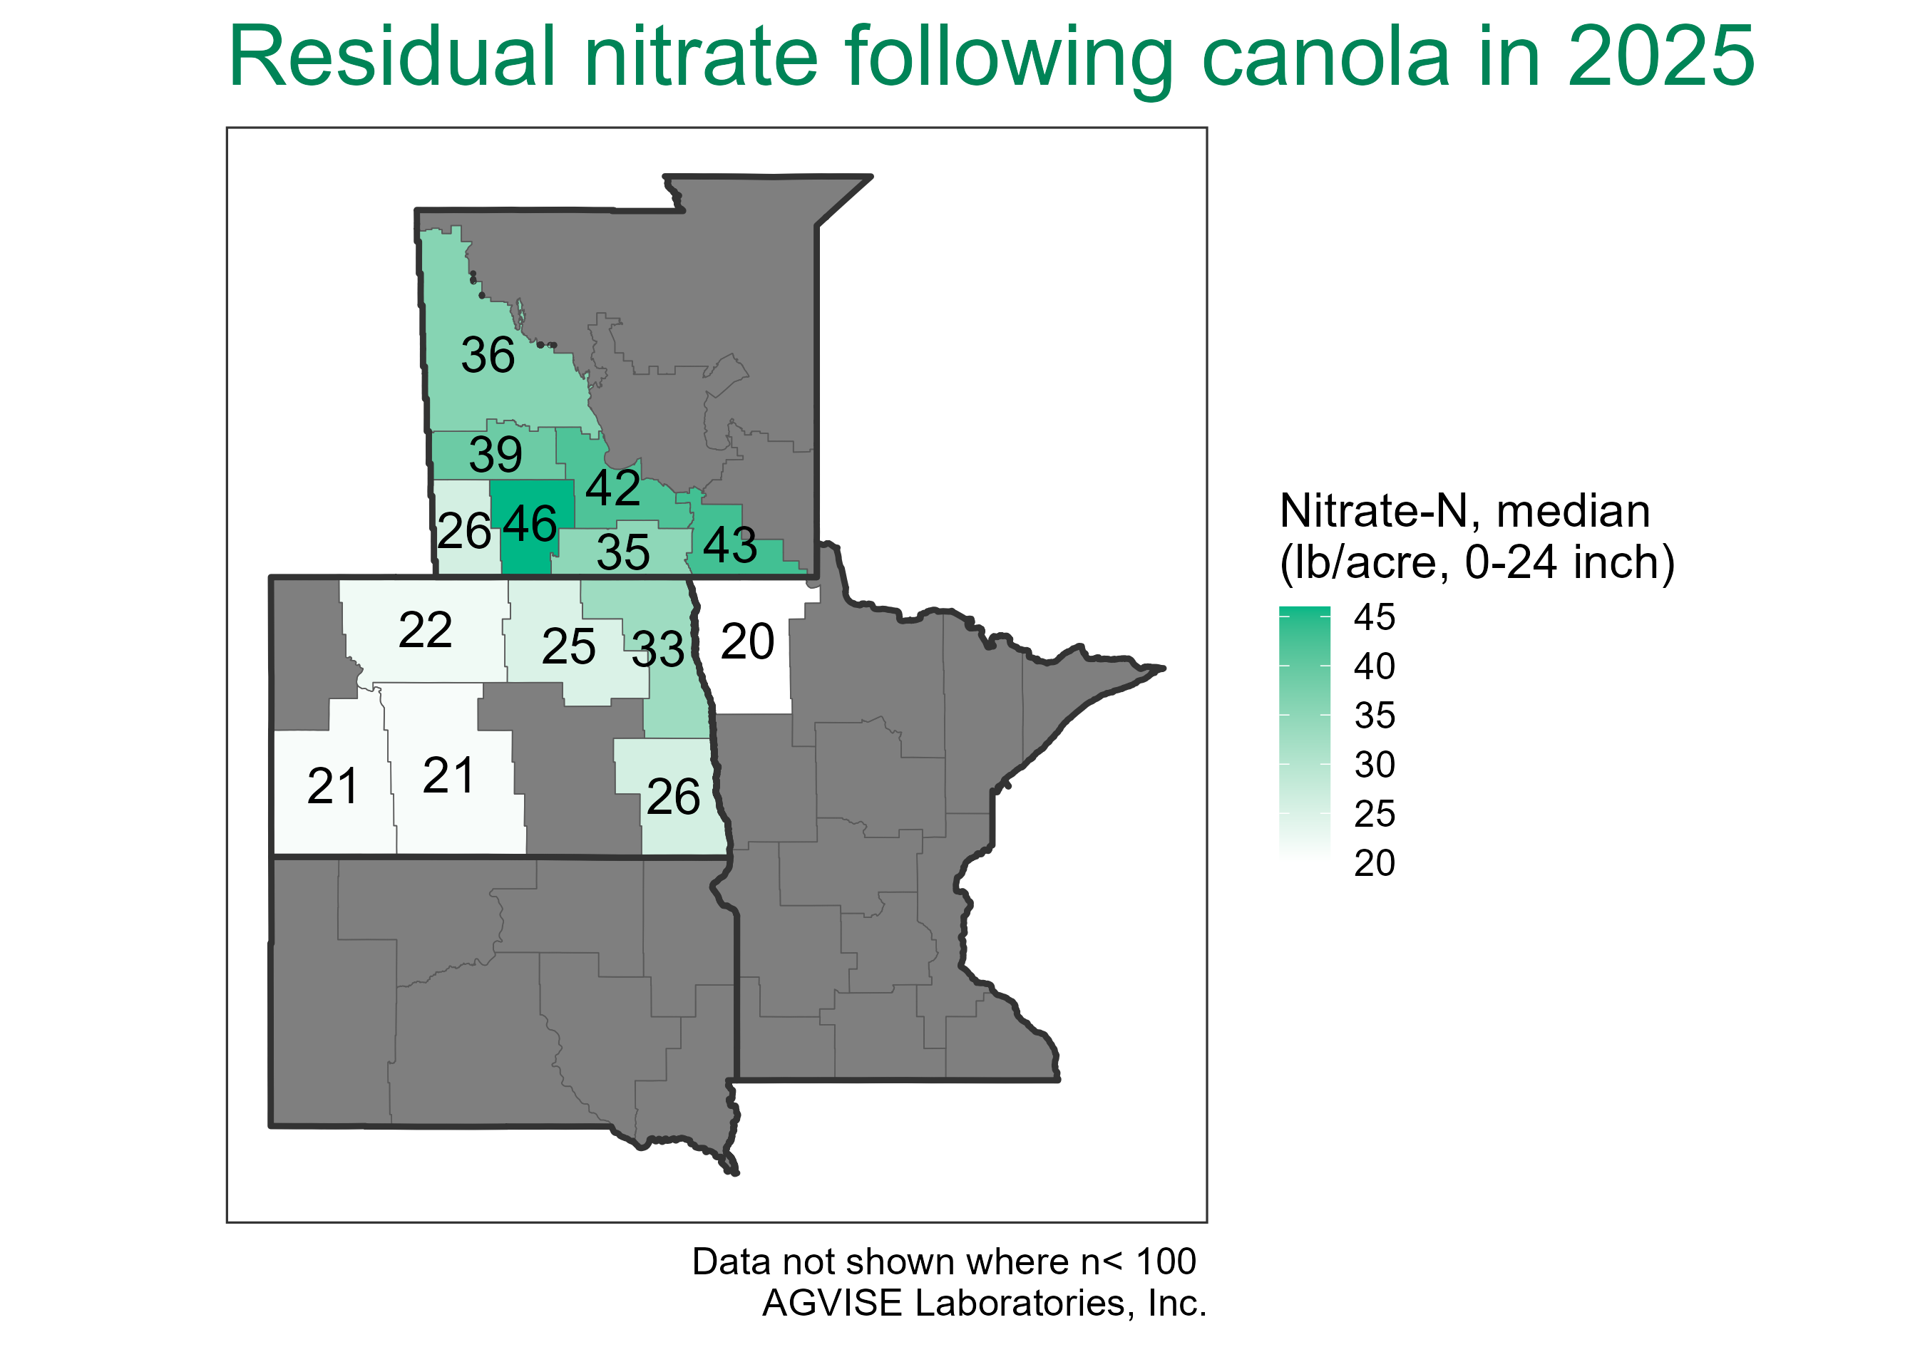
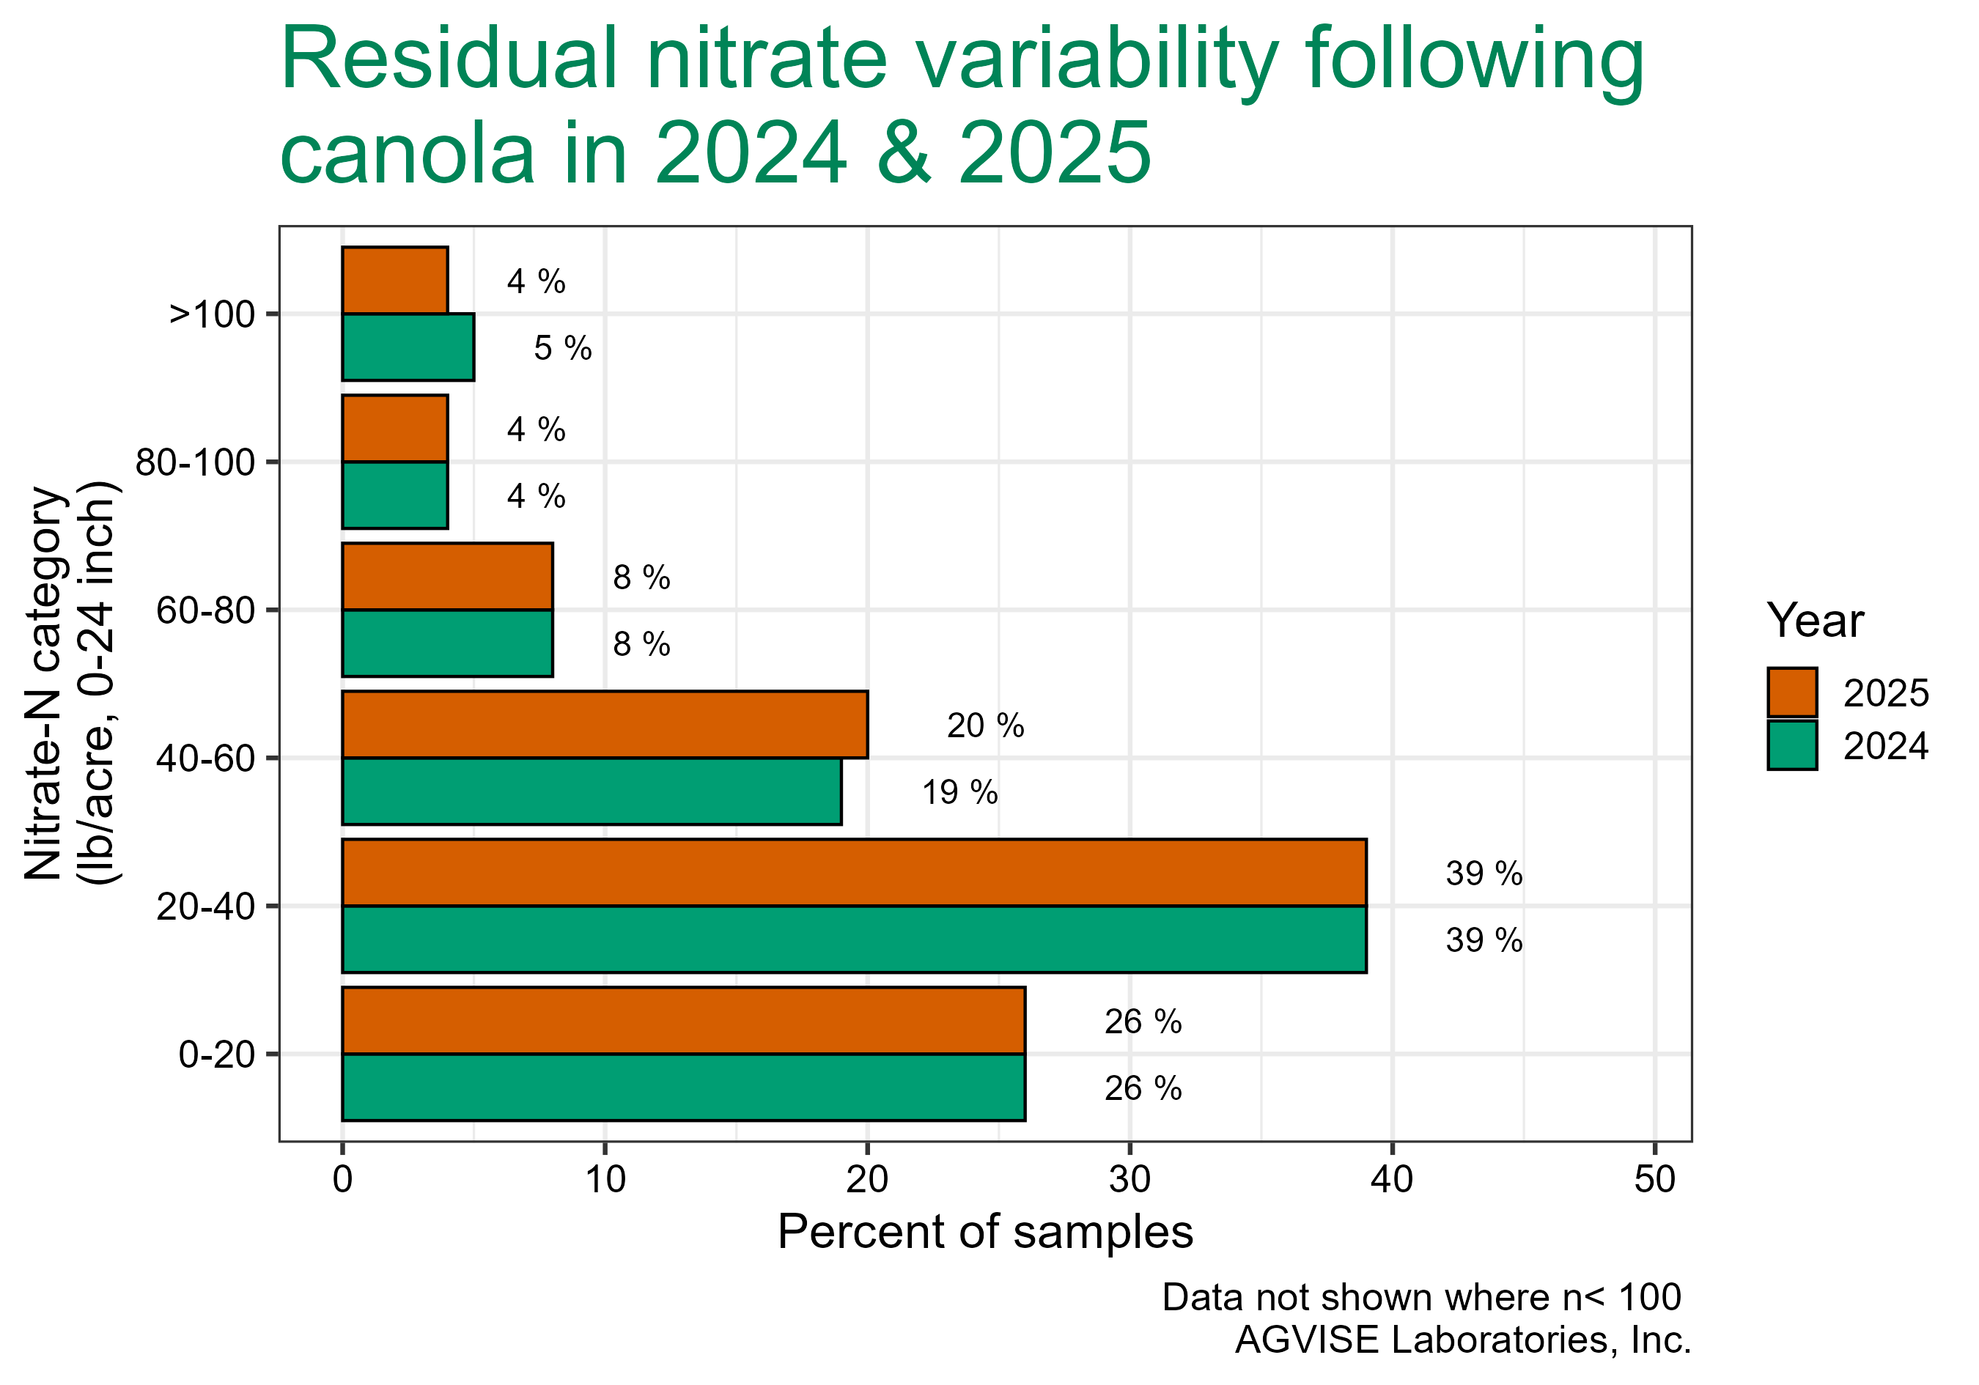
Notes:
1995-2024 average ~30

Slide 12
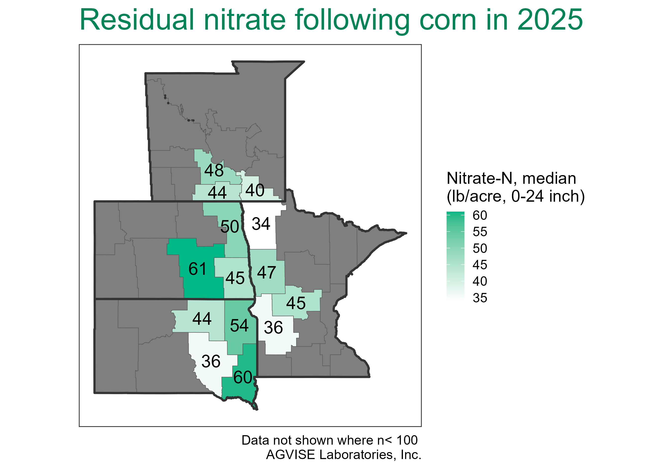
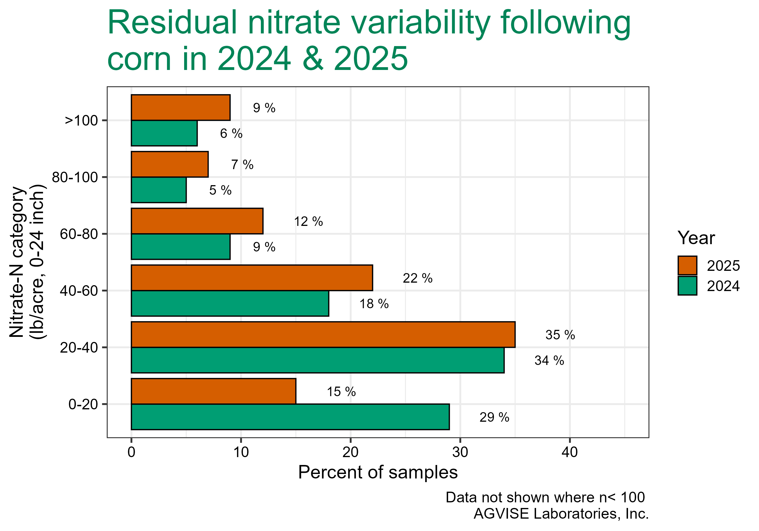
Notes:
1995-2024 average ~40

Slide 13
Late Season Nitrogen
Why are residual levels high?
  N fertilizer rate was too high for the crop yield
  Legume and/or organic matter rate adjustment not considered
  N mineralization from organic matter and residue
    Warm, moist growing season promoted mineralization

Slide 14
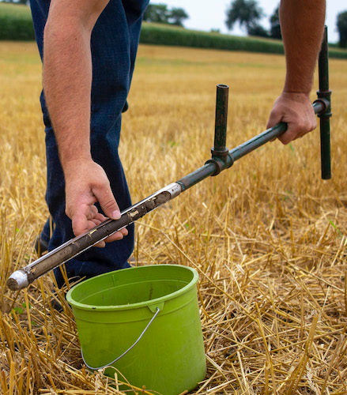
“Soil sampling makes dollars and sense”
Photo Credit: No-Till Farmer

Slide 15
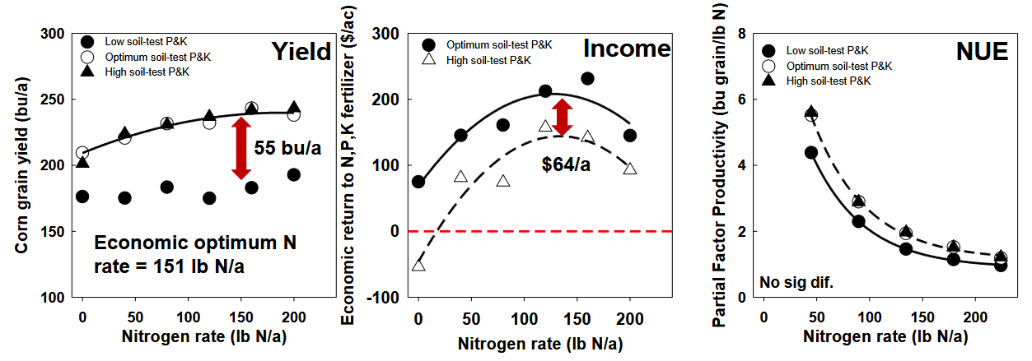
Maximizing Efficiency
Optimum P and K levels are required to maximize N efficiency
Source: https://cropsandsoils.extension.wisc.edu/files/2023/01/05_Jones_Improved-Phosphorus-and-Potassium-Management.pdf

Slide 16
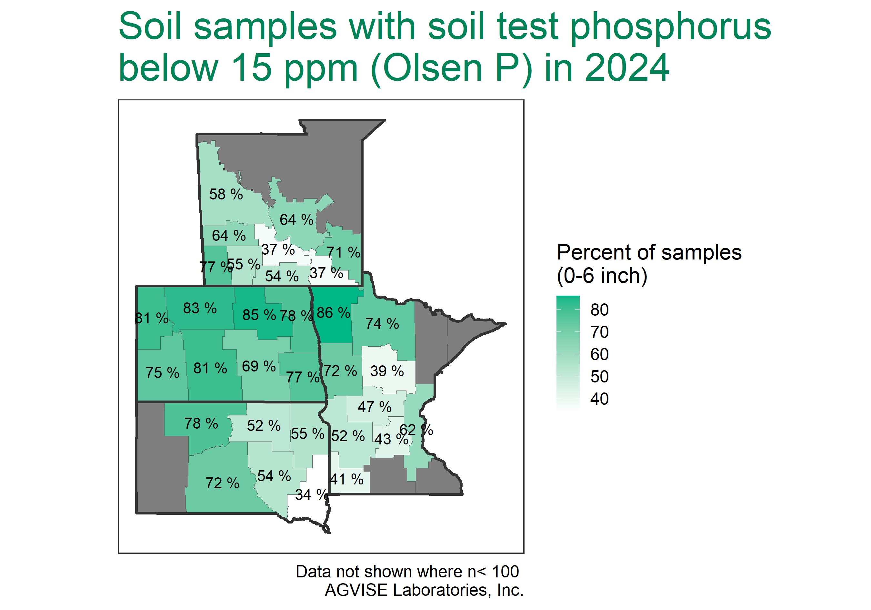

Slide 17
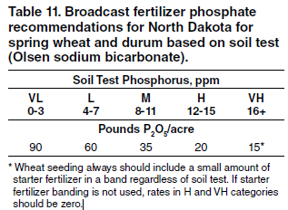
Wheat/Durum Phosphorous Fertility
Published recommendations are for broadcast application
  Banded P: reduce rates by 1/3 for similar crop response (will not build up low soil test levels!)
Source: NDSU-Extension Publication SF712

Slide 18
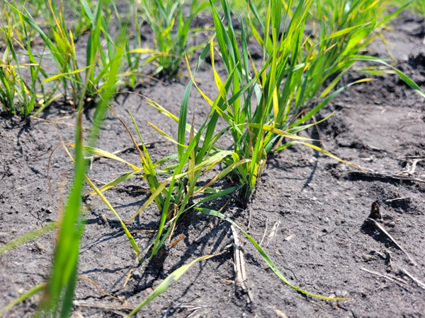
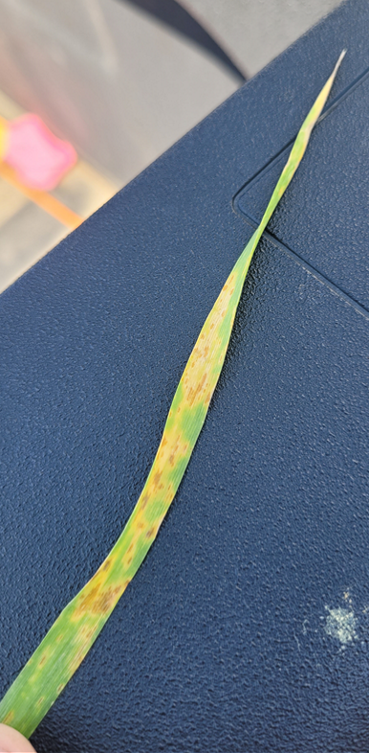
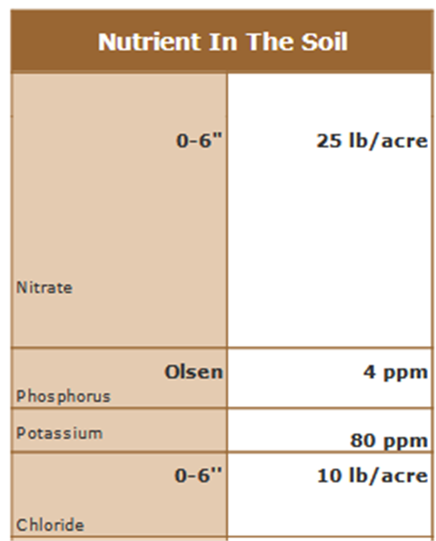
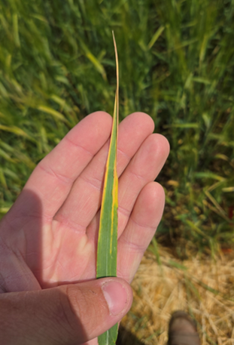
Potassium and Chloride Deficiency in Wheat,
Nelson County, 2025

Slide 19
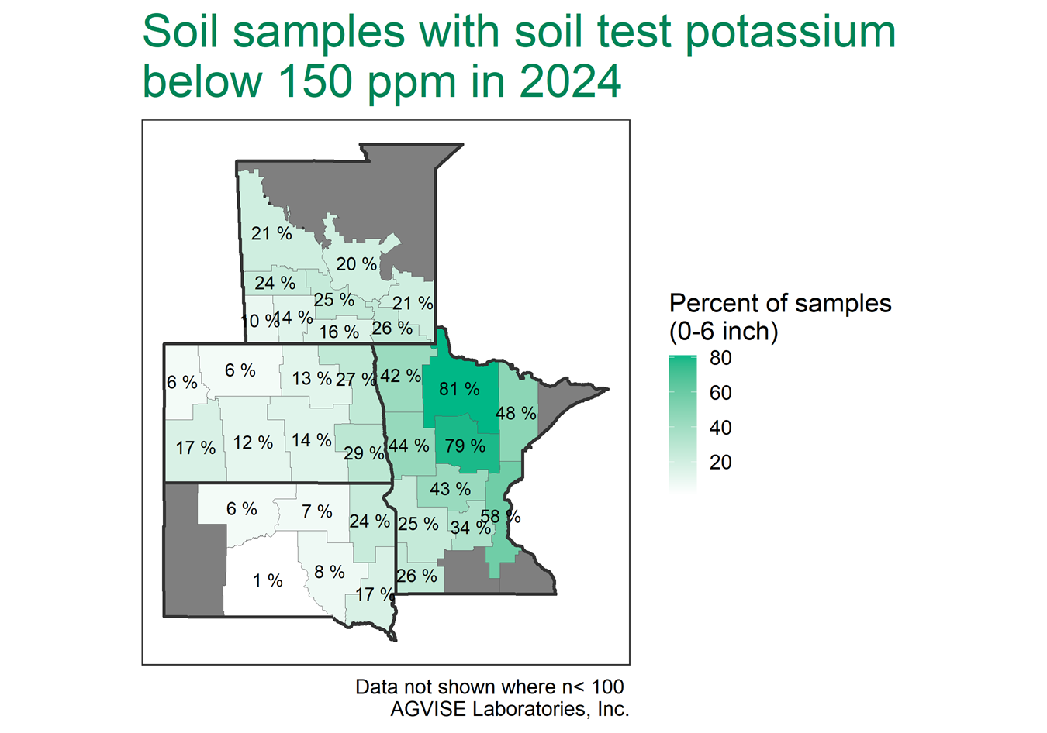

Slide 20
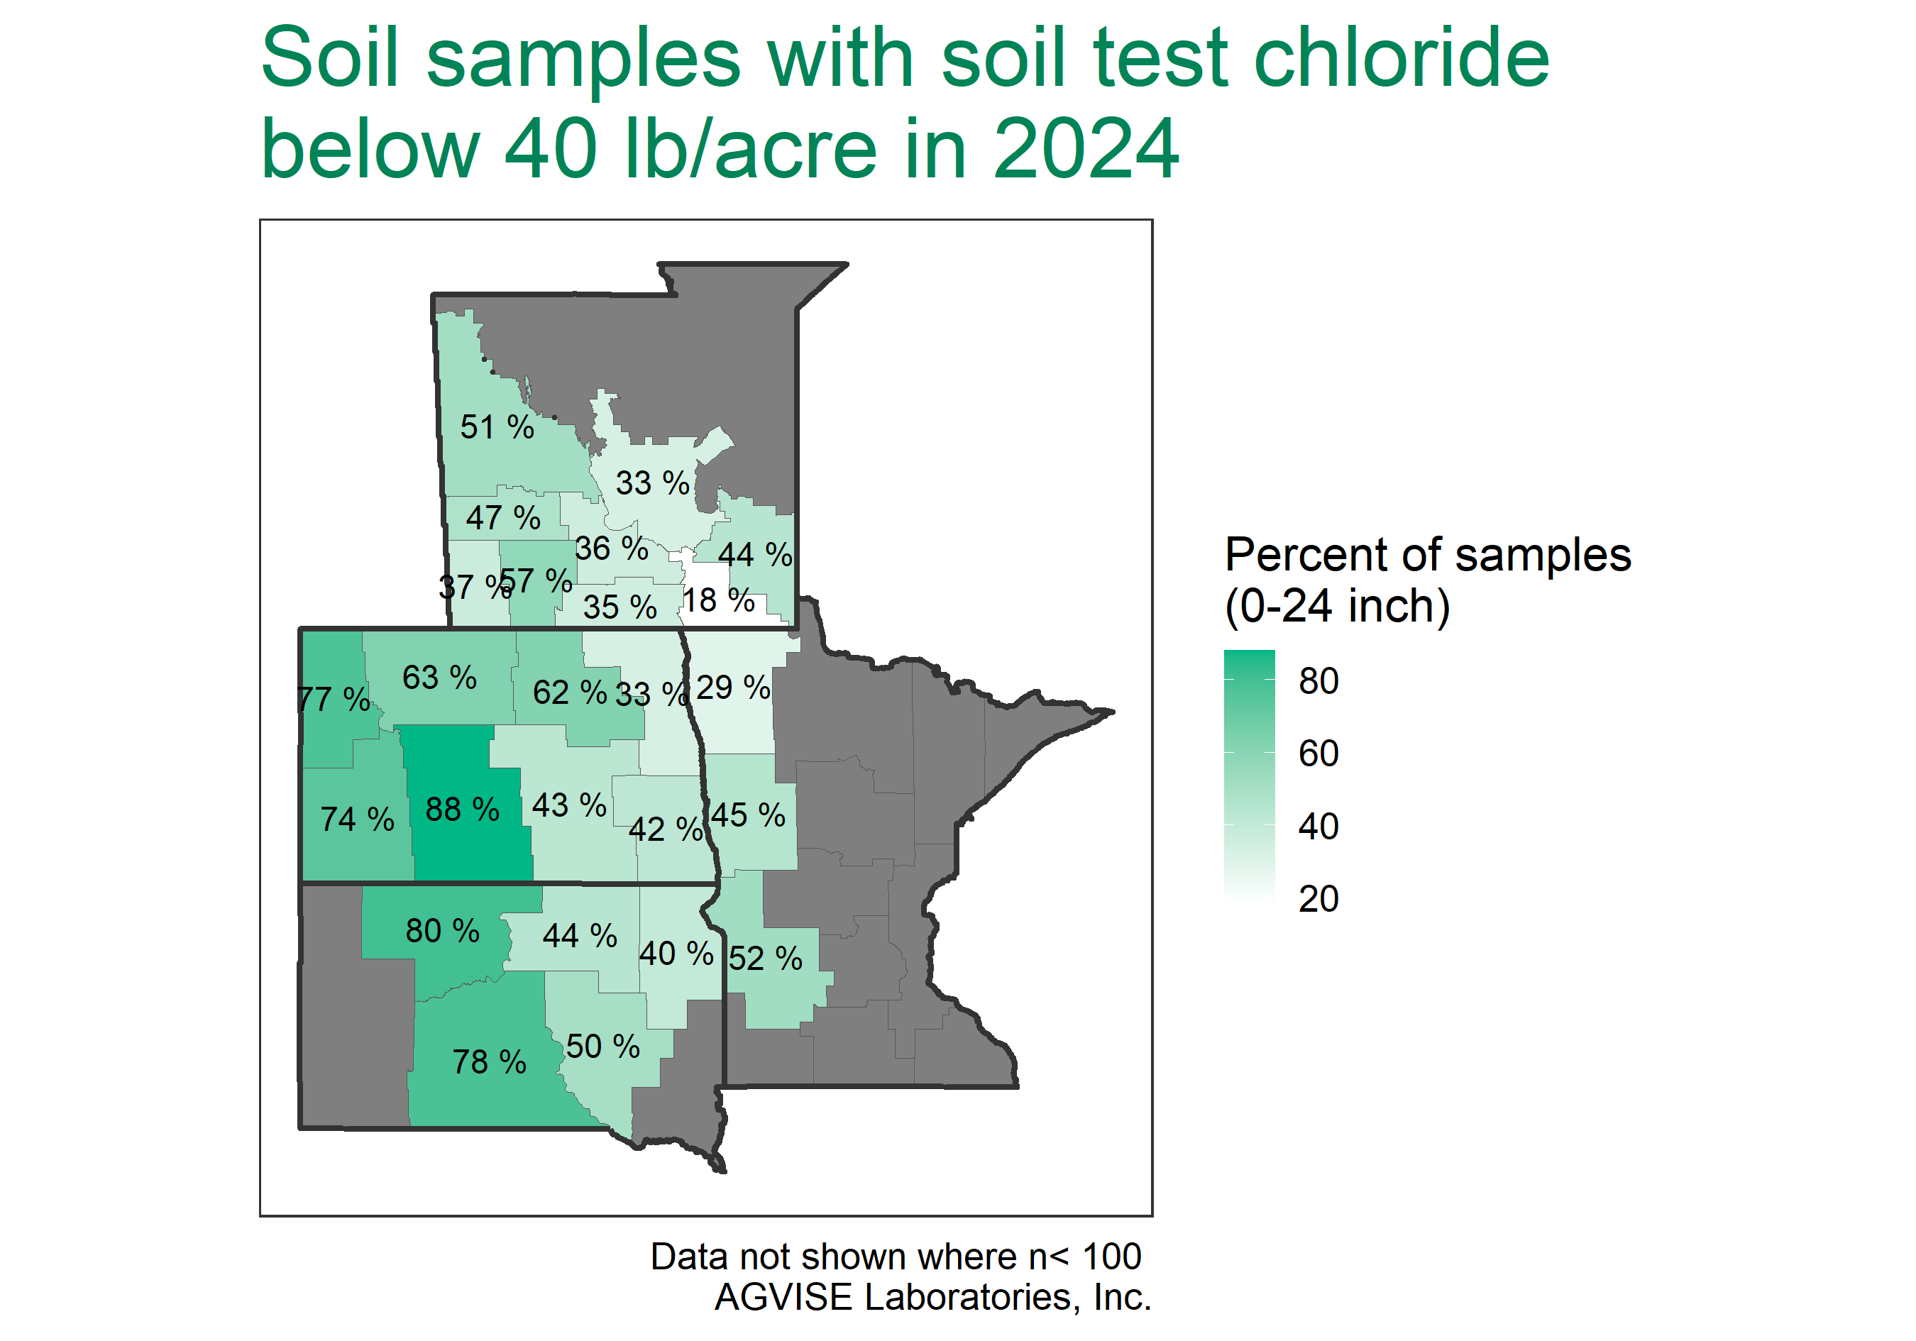

Slide 21
Wheat/Durum Potassium Fertility
Some benefit of added K fertilizer (potash) at high soil test levels comes from additional Cl
K response is likely when:
  Soil test levels are below 100 ppm K
  Soils are sandy
  Soybeans are in the rotation
Source: NDSU-Extension Publication SF712

Slide 22
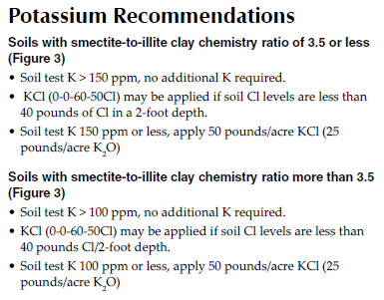
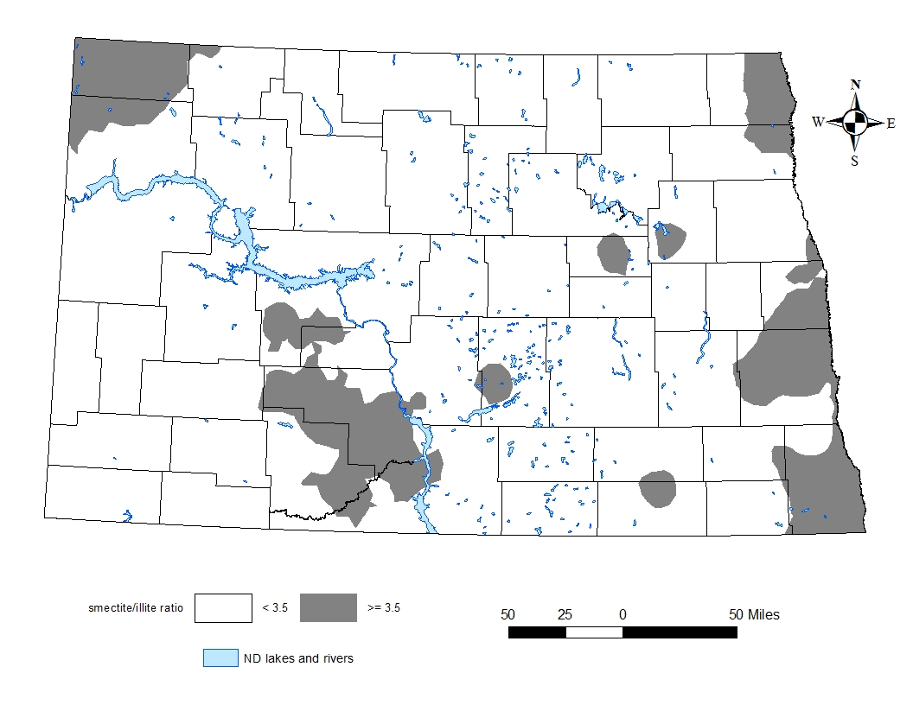
Wheat/Durum Potassium Fertility
Source: NDSU-Extension Publication SF712

Slide 23
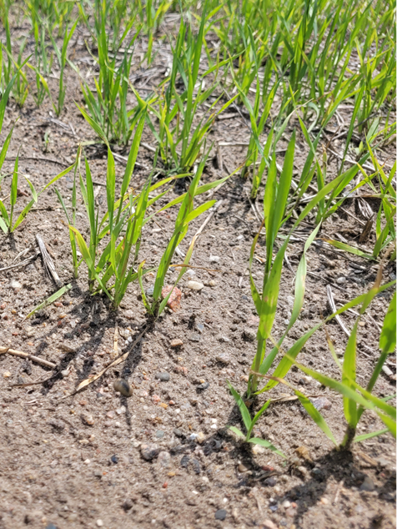
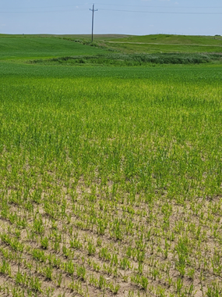
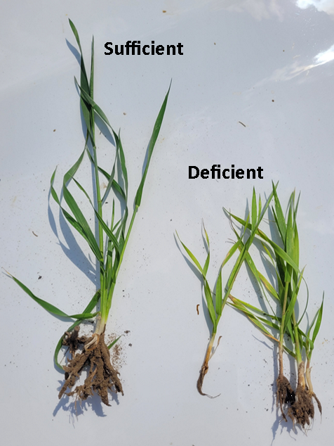
Sulfur Deficiency in Wheat, Griggs County, 2025

Slide 24
Sulfur: The Fourth Major Nutrient
Sulfate test is not a good predictor of S response
Aggravating factors of S deficiency:
  above average rainfall,
  sandy soil,
  low organic matter (<3%)
10 lb/ac sulfate-S for wheat, 30 lb/ac for canola
  AMS or gypsum with seed
  Broadcast ATS (do not apply ATS with the seed!)

Slide 25
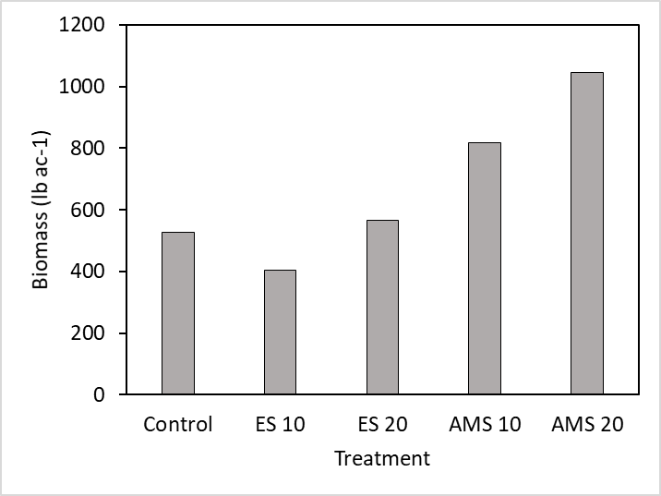
Are all S sources created equal?
No. This was a perfect year to illustrate this point…
Elemental sulfur (ES) and AMS were applied pre-flagleaf to deficient wheat near Carrington at the rates of 10 and 20 lb S/ac
a
ab
c
bc
c

Slide 26
Sulfur Response in ND
Severe S deficiency became evident in early 1990s with the introduction of canola
S rate (lb/ac) | S source | Canola Yield (lb/ac)
 |  | Hilltop | Slope | Footslope
0 |  | 30 | 240 | 1460
20 | AMS | 1650 | 1670 | 1720
40 | AMS | 1800 | 1860 | 2170
40 | Elemental | 620 | 1060 | 1630
6,000% Yield Increase!
Source: Deibert et al., 1996
Notes:
6000% increase!

Slide 27
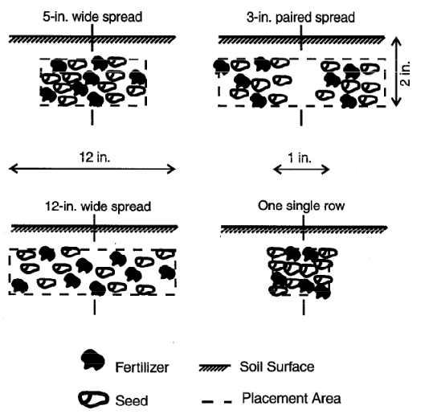
Remember!
Safe amount of banded/seed applied fertilizer depends on:
  Amount of N and K
  Soil texture
  Proximity of fertilizer to seed
Consult Fertilizer Application With Small-grain Seed at Planting (SF1751)
Source: NDSU-Extension Publication SF1751

Slide 28


What awaits us in 2026?
Photo Sources: x.com/DesignUXUI/status/758101772409765888/photo/1, www.yahoo.com/news/mystery-solved-inside-magic-8-ball-202010631.html

Slide 29
Going into Winter…
Until mid-October, the fall was NOT fit for N application
Keep stubble standing to capture snow
  Increase soil water
  Decrease erosion
Avoid fall tillage, but if necessary keep the surface rough

Slide 30
Fertilizer Outlook
Mostly up from last year, but down from 2022
Anhydrous is going up: “Ammonia inventory in the Midwest is tighter than most realize.”
Urea trending downward, but up from last week
  Urea $0.65/lb N, anhydrous $0.51/lb N, and UAN32 $0.73/lb N.
MAP and DAP holding steady to slight increase
Potash down, but could change rapidly
Notes:
From last year:
Potash is now 8% higher,
10-34-0 is 10% more expensive,
MAP is 15% higher,
anhydrous and urea are both 20% more expensive,
DAP is 25% higher,
UAN32 is 28% more expensive and
UAN28 is 31% higher.

Slide 31
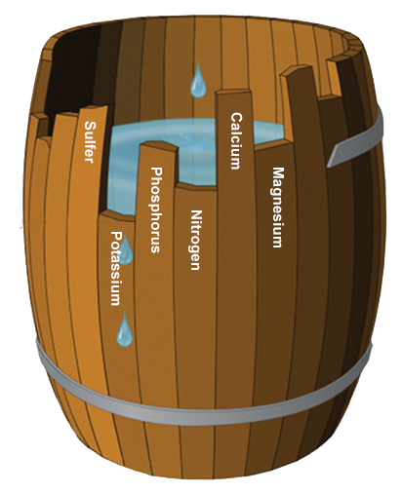
Thinking about management…
Put residual N to good use
  Makes economic sense
Remember the Law of the Minimum
  If deficiency was noted last year, they are not going to fix themselves
Focus on products with proven response
https://nutrien-ekonomics.com/news/liebigs-law-of-the-minimum/

Slide 32


Slide 33


Brady Goettl, PhD, CCA
Extension Soil Science Specialist brady.goettl@ndsu.edu
School of Natural Resource Sciences
NORTH DAKOTA STATE UNIVERSITY

