Slide 1
2025 HRS and Durum Harvest Summary and Outlooks
North Dakota
#1 HRS
#1 Durum
Erica Olson
Director of Research and Marketing
North Dakota Wheat Commission

Slide 2
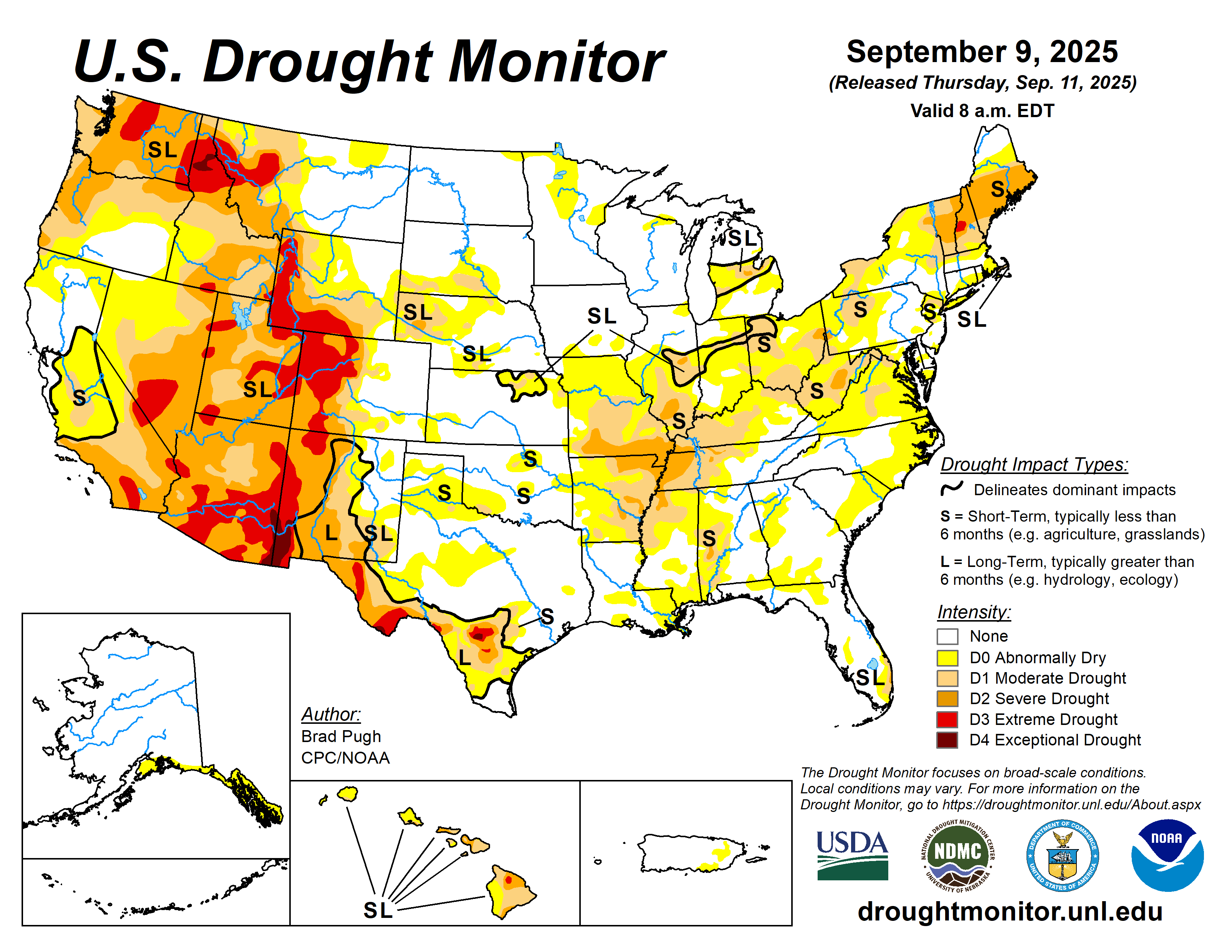
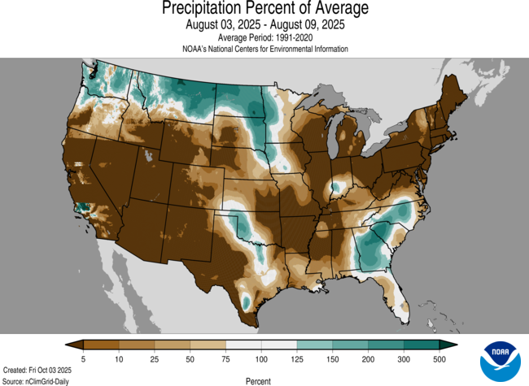
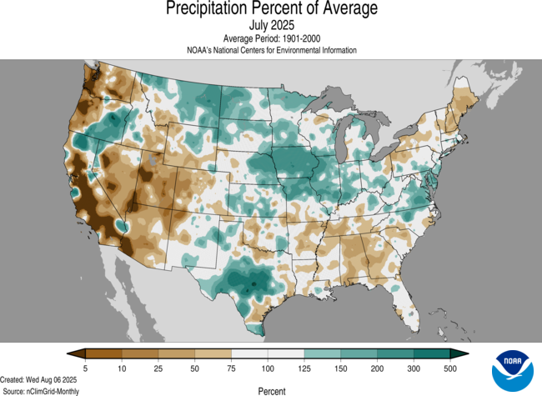
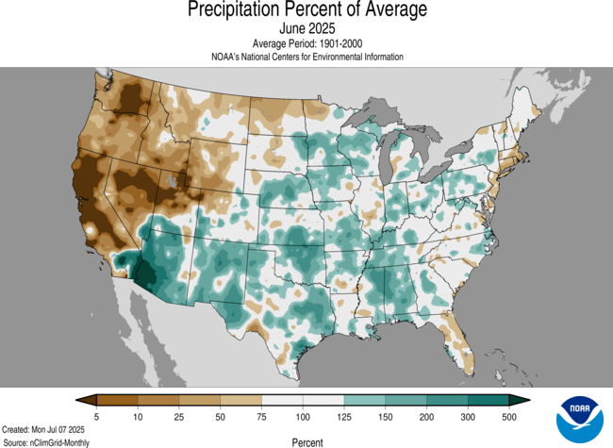
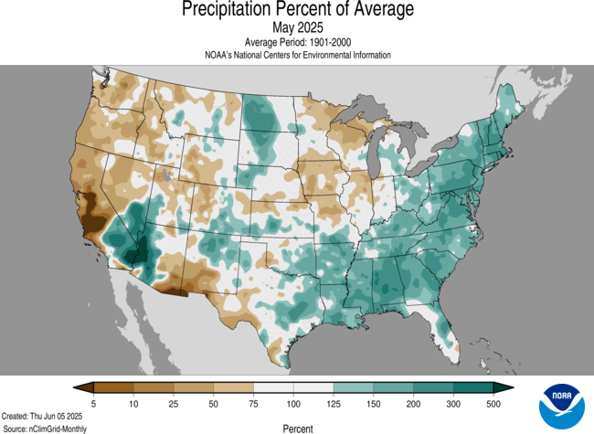
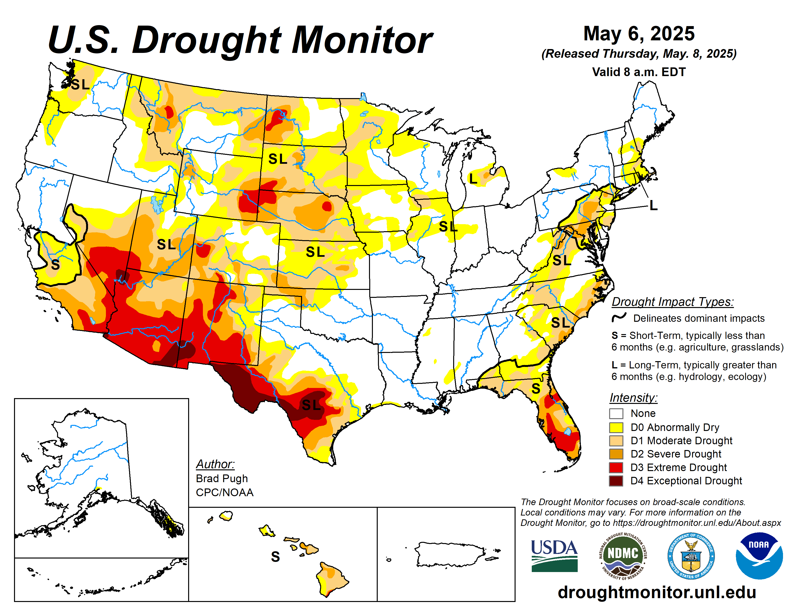

Slide 3
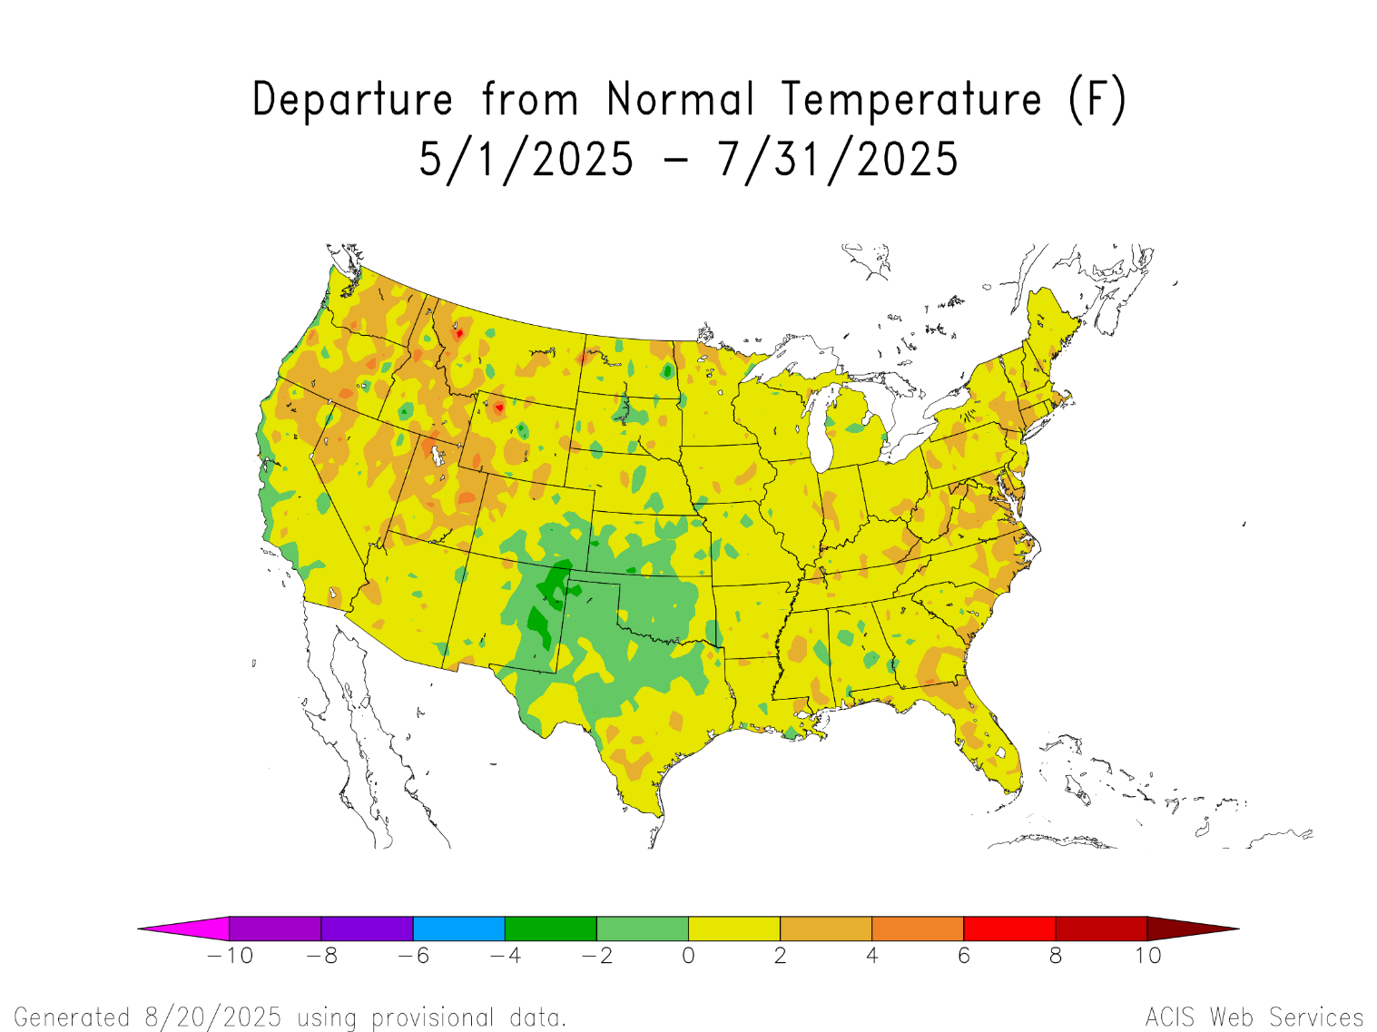

Slide 4

U.S. Durum Plantings by State
Million Acres
U.S. durum acres estimated at 2.19 million (890,000 hectares) up 6%.

Slide 5
Historical Durum Yields

Slide 6
2025 Durum Grades
Quality data – samples collected throughout harvest from producers/elevators in North Dakota and Montana and analyzed at NDSU wheat quality lab
Last 15% or so of 2025 crop not included due to severe harvest delays

Slide 7
2025 Northern Durum Quality
 | 2025 | 2024 | 5-Year Avg.
Test Weight (lbs/bu.) | 61.9 | 60.8 | 61.3
1000 KWT (g) | 43.6 | 35.3 | 40.9
Damage (%) | 1.8 | 0.6 | 0.4
Shrunken & Broken (%) | 0.5 | 0.7 | 0.8
Vitreous Kernels (%) | 84 | 83 | 86
Protein (12% moisture) | 14.2 | 14.3 | 14.2
Falling Number (seconds) | 325 | 463 | 427
DON (ppm) | 0.6 | 0.3 | 0.1

Slide 8
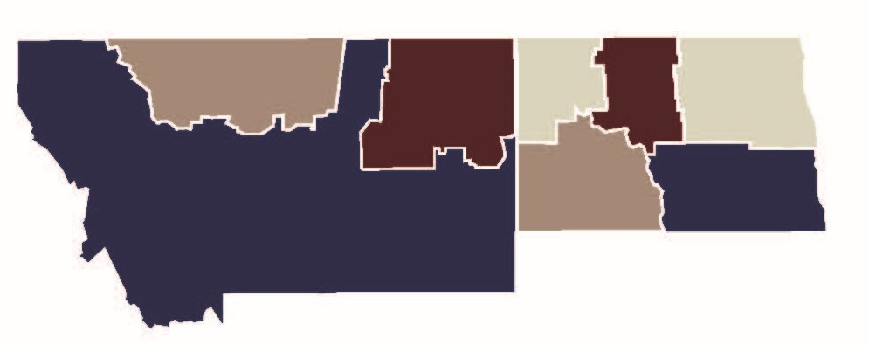
Vitreous Kernel Content by Area
89
91
80
87
82
75

Slide 9
Wheat Falling Number Distribution
Notes:
Overall falling number values are lower this year. Still about two-thirds of the crop is 350 seconds or higher, buyers need to be aware that some is in the lower segments.
Note – generally domestic industry starts discounting at 320 or 330. 350 is considered acceptable for pasta products.

Slide 10
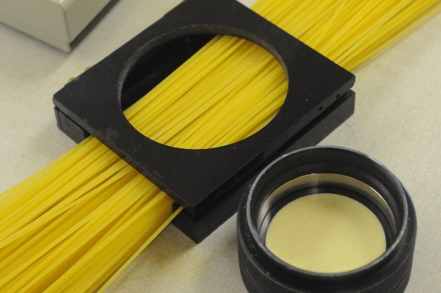
2025 Northern Durum Pasta Data
 | 2025 | 2024 | 5-Yr Avg
Semolina Color Score (*b yellow) | 28.7 | 30.0 | 30.4
Cooked Weight (g) | 32.1 | 30.1 | 31.0
Cooked Loss (%) | 6.9 | 7.2 | 7.3
Cooked Firmness (g cm) | 8.4 | 6.7 | 4.7
13.2%
13.5%
13.1%
13.4%
13.1%
14.4%

Slide 11
U.S. Durum Supply and Demand
Million Bushels
 | 22-23 | 23-24 | 24-25 | Prj 25-26 | Change
Beg Stocks | 24 | 28 | 21 | 28 | +33%
Production | 64 | 59 | 80 | 87 | +9%
Imports | 51 | 45 | 51 | 40 | -22%
Tot Supply | 139 | 132 | 152 | 155 | +2%
Food Use | 85 | 83 | 88 | 85 | -3%
Feed & Residual | 3 | 2 | 17 | 8 | -53%
Exports | 23 | 27 | 19 | 25 | +32%
Tot Use | 111 | 111 | 124 | 118 | -5%
End Stocks | 28 | 21 | 28 | 38 | +36%
S/U Ratio | 25% | 19% | 23% | 32%
Source: USDA September 25
Xldata/durum/S&D

Slide 12
Top Markets for U.S. Durum
2024-25
2025-26 (to date)
Million Bushel
Million Ton
Million Bushel
As of last report, durum sales were up 3% on the year

Slide 13
World Durum Situation
Production reached a 9-year high in 2025 after years of production issues in various regions
Supply and demand situation is much more comfortable than in recent years
Very few production related problems
  Weather conditions caused variable quality in U.S., Canada, Russia and Kazakhstan, but not overly concerning given higher production levels
  Mexico’s production impacted by drought
Trade projected to decline, especially in Europe and North Africa where production rebounded
However, food use could hit a record – lower prices incentivizing more durum use. Consumption in general remains fairly consistent
Ending stocks continue to increase

Slide 14
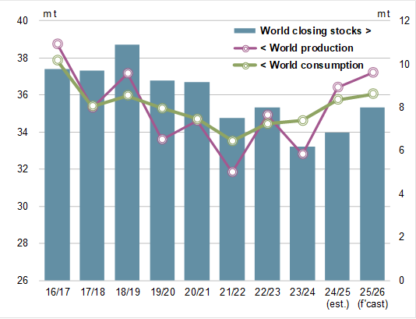
World Durum Situation

Slide 15

World Durum Production
(Million Tons)
Source: Int’l Grains Council/Stats Canada
October 2025

Slide 16
North African Durum Production
Million Tons
Source: Int’l Grains Council

Slide 17
World Durum Trade – Projected Change in Import Demand

Slide 18
World Durum Trade – Exports

Slide 19
Key World Durum Take Aways
The world durum supply and demand situation is much more comfortable than recent years
Import demand will be lower in Europe and North Africa – the top two importing regions
Turkey not likely to export significant quantities of durum….. At this time…..
Mexico will not be an export player
Current market factors don’t support significant price movement, but already talk of lower acres for 2026 and farmer selling has slowed
The supply and demand situation for durum can change rapidly

Slide 20
Average N.D. Hard Red Spring and Durum Wheat Producer Bids
$ per Bushel
$ per Ton
Source: Elevator weekly prices 11/3/25

Slide 21
U.S. Spring Wheat Planted Acreage
Notes:
ND – some acreage gains to durum, barley, sunflower, corn
MT – check HRW trends

Slide 22
Historical HRS Yields by State
U.S. average yield 51.7 bu./acre, higher than the average of 45.2 bu./acre
MN
ND
SD
MT

Slide 23
U.S. HRS Supply and Demand
Million Bushels
 | 22-23 | 23-24 | 24-25 | Prj 25-26 | Change
Beg Stocks | 142 | 155 | 190 | 218 | +15%
Production | 446 | 465 | 503 | 458* | -9%
Imports | 56 | 63 | 79 | 65 | -18%
Tot Supply | 644 | 683 | 772 | 732 | -5%
Dom Use | 275 | 258 | 304 | 286 | -6%
Exports | 214 | 235 | 250 | 240 | -4%
Tot Use | 489 | 493 | 554 | 526 | -5%
End Stocks | 155 | 190 | 218 | 207 | -5%
S/U Ratio | 32% | 39% | 39% | 39%
Source: USDA September 25
Xldata/HRS/S&D
*USDA Small Grains Summary

Slide 24
Export Pace for U.S. Wheat
(Shipments and Sales as of Sept. 18, 2025)
Million Bushels
Million Tons

Slide 25
Top Export Markets for U.S. HRS
Top HRS Export Markets 2024-25 - Million Bushels
USDA Export Inspections
Xldata/Both/Exports/Top 10 & 5 yr avg

Slide 26
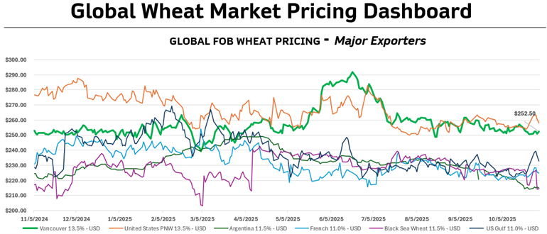
Source: Sask Wheat

Slide 27
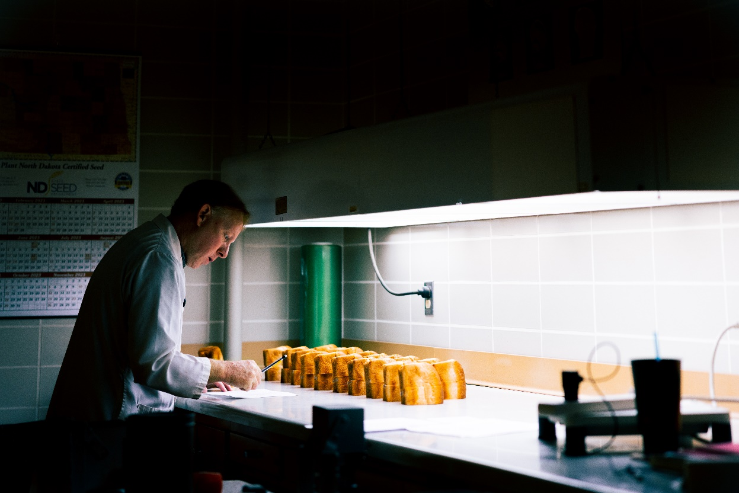
2025 HRS Quality
Quality data – samples collected throughout harvest from producers/elevators and analyzed at NDSU wheat quality lab
Overall crop quality looks comparable to average years
Main issue is HVAC levels (vitreous kernel levels)

Slide 28
2025 Quality Characteristics
 | 2025 | 2024 | 5 Year Avg.
Test Weight (lb./bu.) | 61.8 | 61.3 | 61.6
Total Damage (%) | 0.5 | 0.6 | 0.2
Shrunken & Broken (%) | 0.5 | 0.7 | 0.7
Vitreous (%) | 60 | 66 | 70
Grade | 1NS | 1NS | 1NS
Thousand Kernel Weight (g) | 34.1 | 32.5 | 32.1
Protein (%) | 14.2 | 13.9 | 14.4
Falling Number | 405 | 401 | 393

Slide 29
HRS: Protein Content Distribution
Percent

Slide 30
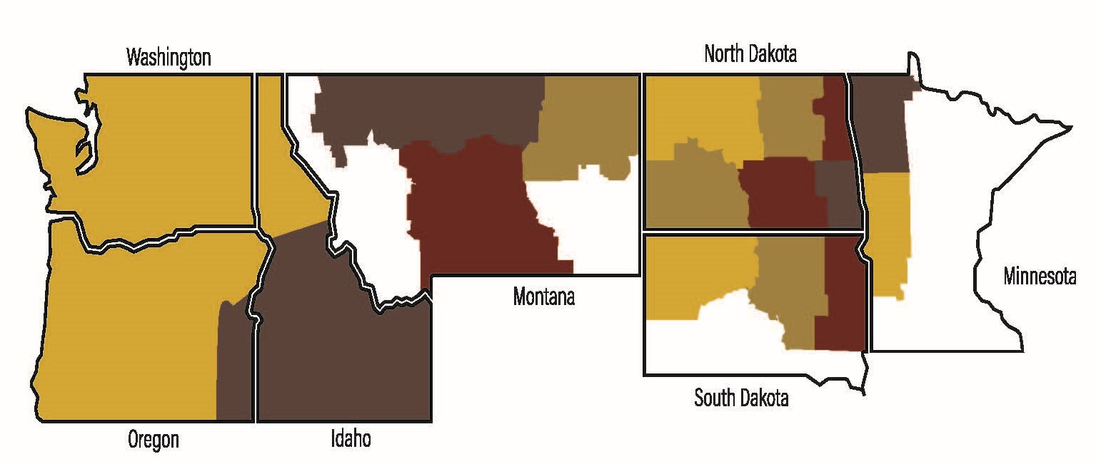
Vitreous Kernel by Region (%)
62
75
71
60
58
59
93
1%
48
56
55
75
59
33
43
48
96
Notes:
To the left of the yellow bar is the western (PNW-exportable) and to the right is eastern (Gulf/Great Lakes-exportable).

Slide 31
HRS: Vitreous Kernel Content Distribution
Percent

Slide 32
2025 Quality Characteristics
 | 2025 | 2024 | 5 Year Avg.
Flour Extraction (%) | 68.4 | 69.0 | 68.2
Farinograph Absorption (%) | 63.6 | 61.6 | 62.4
Farino Stability (min) | 11.5 | 11.7 | 13.5
Baking Absorption (%) | 64.7 | 64.3 | 66.8
Loaf Volume (cc) | 942 | 960 | 951

Slide 33
HRS – Protein Premiums
Export Price Levels
U.S. Wheat Price Report

Slide 34
PNW Protein Premiums with HVAC Specs

Slide 35
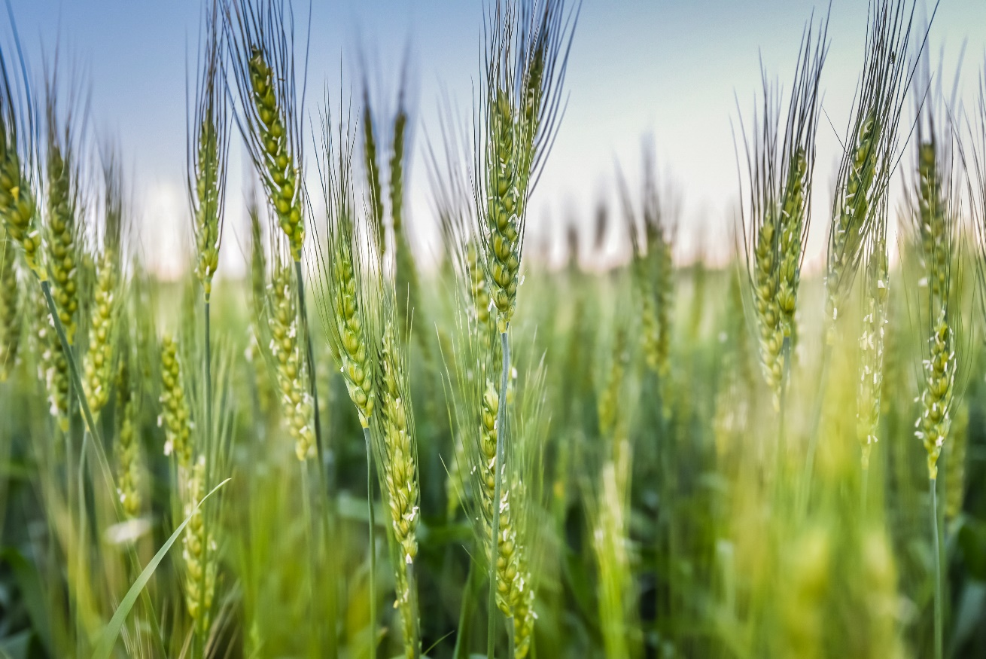
QUESTIONS?

Slide 36

HRS Crop Progress and Conditions
Planting done timely with some delays
Growing season was quite variable – damaging storms, dry conditions, wet conditions, cold, hot
Scattered disease pressure
Precipitation varied, temperatures were average
Harvest challenging at times due to wet conditions and humidity that occurred off and on during the season

Slide 37
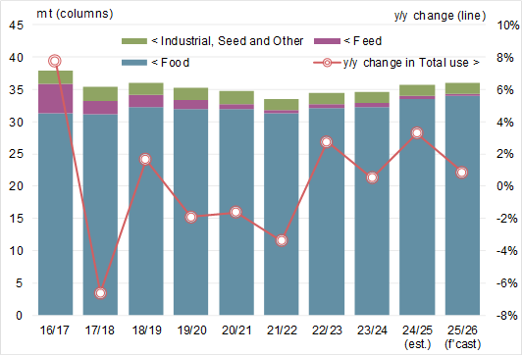
World Durum Usage

Slide 38
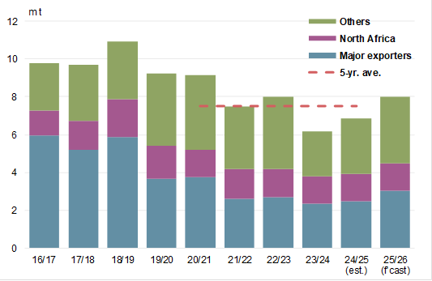
World Durum Stocks

Slide 39
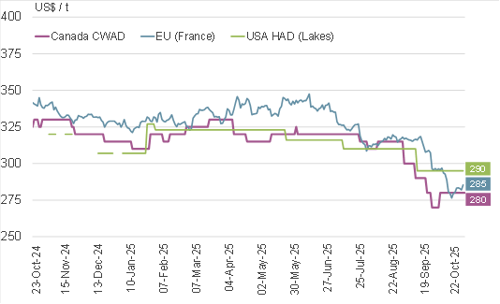
World Durum Prices

