Slide 1


Slide 2
Seeding innovation in Canola
Singulation vs Drill
Dr. Leo Bortolon
Research Agronomist - NCREC

Slide 3
Canola acreage – 25 years

Slide 4
Canola acreage – 25 years

Slide 5
Canola acreage – 25 years
300% increase
1999 – 2024

Slide 6
Canola acreage – 10 years
200 % increase 2014 – 2024

Slide 7
Canola yield – 25 years

Slide 8
Canola yield – 25 years
40% increase
1999 – 2024

Slide 9
Canola yield – 25 years

Slide 10
Canola yield – 25 years

Slide 11
Canola yield – 25 years
0% increase
2014 – 2024

Slide 12
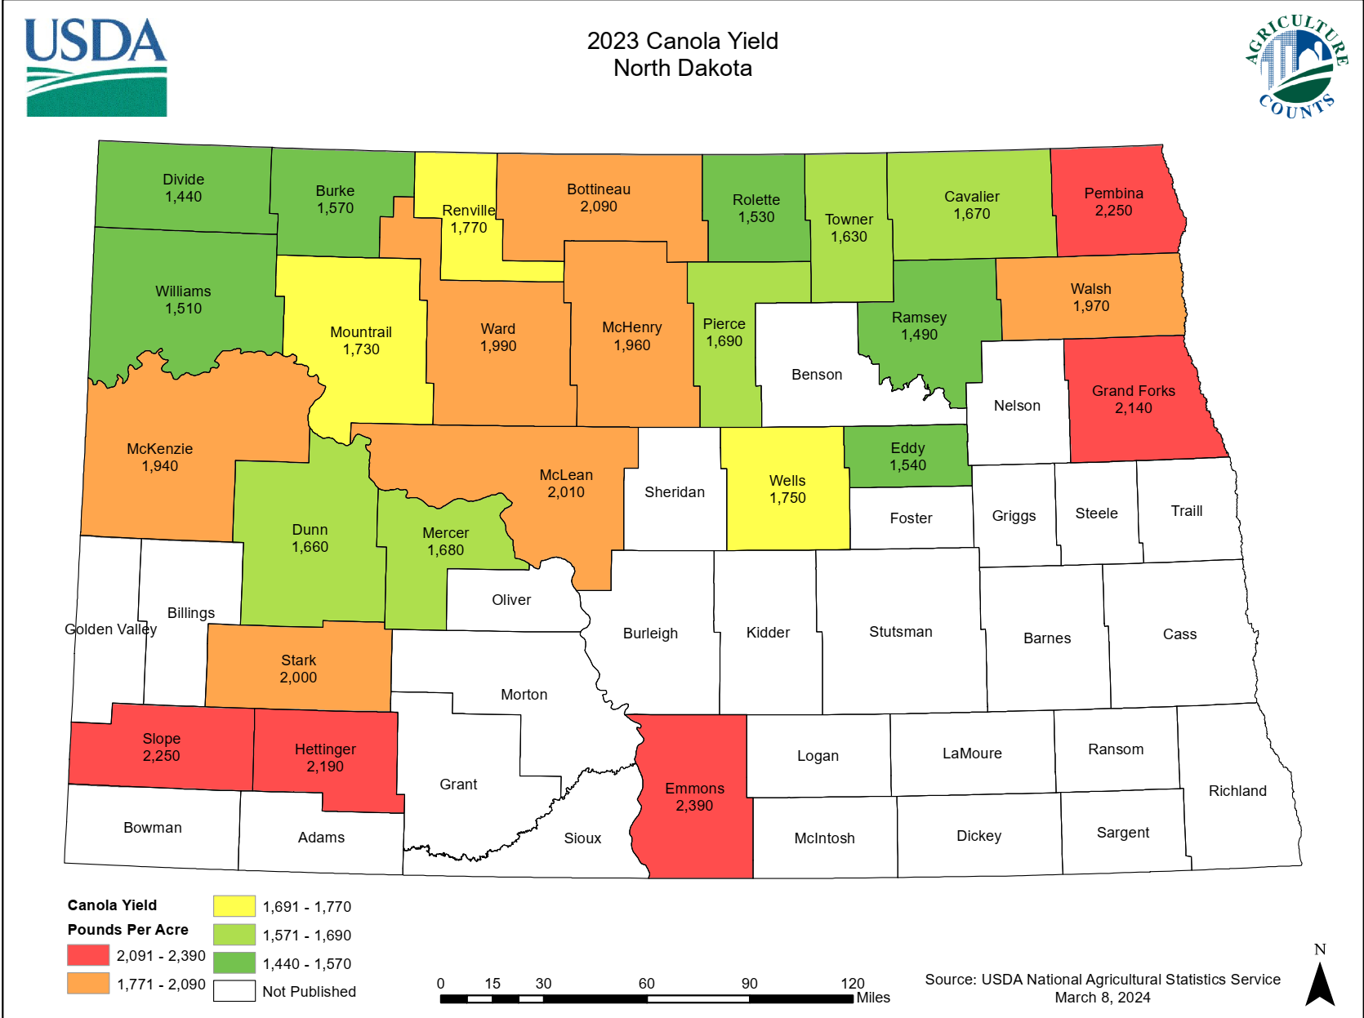
2023 canola yield
State Average
1,810 lbs/a

Slide 13
2023 canola yield
State Average
1,810 lbs/a

Slide 14
2023 canola yield
State Average
1,810 lbs/a
NCREC VT
2,640 lbs/a

Slide 15
2023 canola yield
State Average
1,810 lbs/a
NCREC VT
3,349 lbs/a
NCREC VT
2,640 lbs/a
NCREC VT
2,442 lbs/a

Slide 16
2023 canola yield
State Average
1,810 lbs/a
Yield Gap
NCREC VT
3,349 lbs/a
NCREC VT
2,640 lbs/a
NCREC VT
2,442 lbs/a

Slide 17
Canola yield gap
POTENTIAL
ATTAINABLE
ACTUAL
Canola Yield

Slide 18
Canola yield gap
POTENTIAL
ATTAINABLE
ACTUAL
7,000
Canola Yield
Yield Potential

Slide 19
Canola yield gap
POTENTIAL
ATTAINABLE
ACTUAL
7,000
4,000
Canola Yield
Yield Potential
Trials Yields

Slide 20
Canola yield gap
POTENTIAL
ATTAINABLE
ACTUAL
7,000
4,000
Canola Yield
3,000
Yield Potential
Trials Yields
Maximum
Farmer Yields

Slide 21
Canola yield gap
POTENTIAL
ATTAINABLE
ACTUAL
7,000
4,000
Canola Yield
3,000
1,810
Yield Potential
Trials Yields
Maximum
Farmer Yields
Farmer Yields

Slide 22
Canola yield gap
POTENTIAL
ATTAINABLE
ACTUAL
7,000
4,000
Exploitable yield gap
Canola Yield
3,000
1,810
Yield Potential
Trials Yields
Maximum
Farmer Yields
Farmer Yields

Slide 23
Questions
How to preserve/maximize the yield potential of the genetics?
What is limiting the attainable yield?
What changes to maximize yield?
How to close the yield gap?

Slide 24
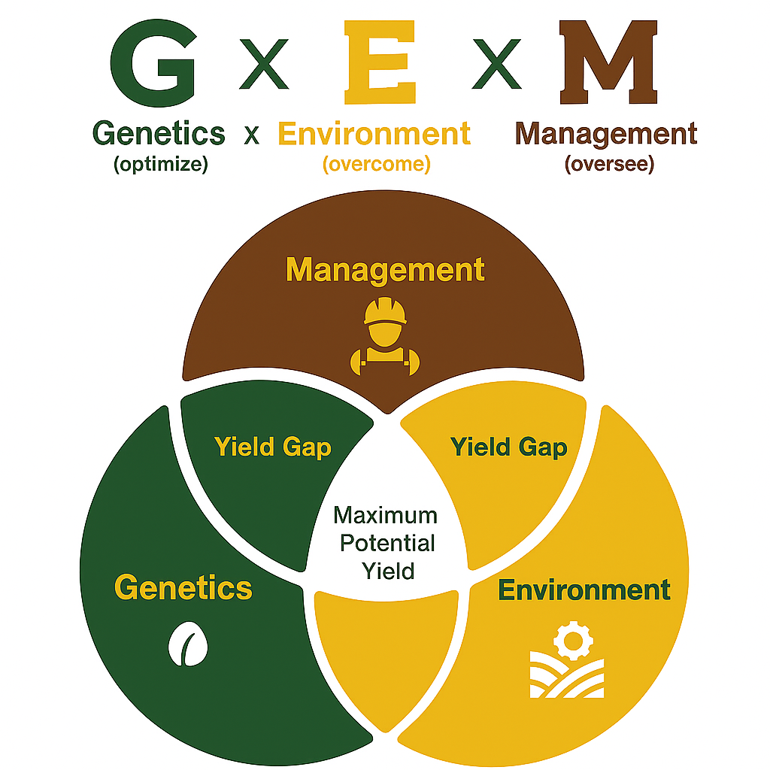

Slide 25
Focus on M aspects to offset the variation in E to allow the G potential to be realized

Slide 26

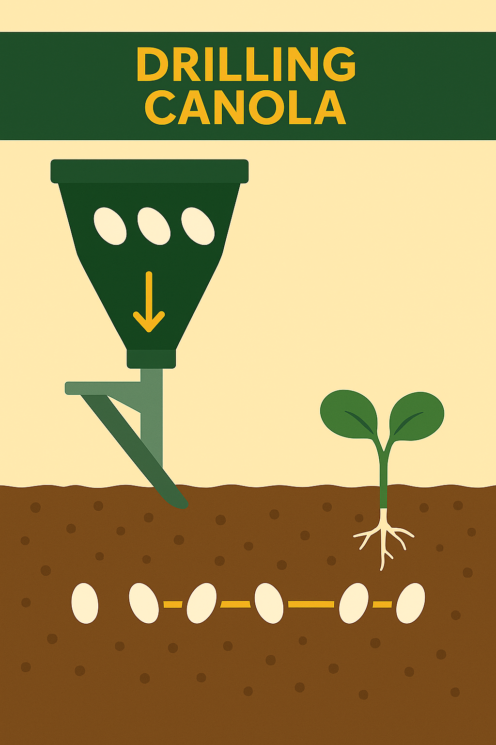
Canola singulation

Slide 27
Canola - singulation
Improves seed-soil contact and emergence uniformity.
Optimal spacing enhances canopy closure and light use efficiency.
Reduces intra-plant competition, promoting balanced carbon assimilation.
Root symmetry and consistent nutrient uptake

Slide 28
Canola - singulation
Canola compensates for yield losses under reduced density by:
- Increasing branching and pod set
- Enhancing seed weight and extending flowering period
Compensation depends on moisture and temperature conditions.

Slide 29
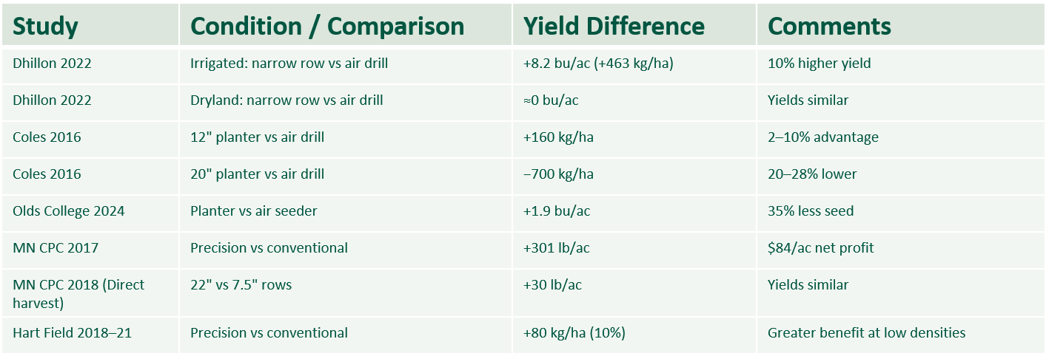
Canola - singulation

Slide 30
Canola - singulation
Research Gap for North Dakota

Slide 31
Canola singulation vs drill
Research Objective
  Canola response to plant density and yield on singulation and drill
Locations
  Minot and Mohall

Slide 32
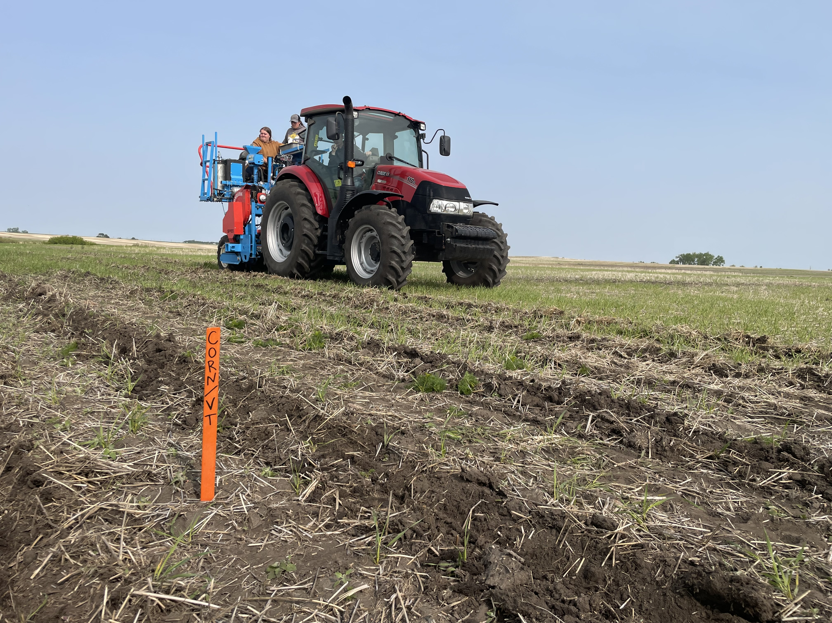
Canola singulation vs drill
Drill - Bourgault
7.5” row spacing
Singulation - Monosem
15” row spacing

Slide 33
Canola singulation vs drill
Seeding rates
  150, 225, 300, 375, 450 k pls/a
  RDB with 6 reps
  No-till in Minot; Minimum till in Mohall
Varieties
  DK400TL; DK401TL; LR344PC; LR354PC
Evaluations
  Plant density;
  NDVI;
  Green cover;
  Flowering date and duration;
  Maturity;
  Yield and oil content;
  ROI

Slide 34
Canola yield
LSD (0.05) = 105
Notes:
No difference between 300 and 375. No difference between 450 and 375. 450 was different than 300

Slide 35
Canola yield
LSD (0.05) = 155
Notes:
No difference from 225 to 450

Slide 36
Canola yield
LSD (0.05) = 209
Notes:
Seed rate within variety.
DK400TL no difference from 300 to 450
DK401TL no difference between 450 and 375.
LR344PC no difference between 450 and 375. No difference between 300 and 375
LR345PC no differene fro, 300 to 450

Slide 37
Canola yield
LSD (0.05) = 209
Notes:
Seed rate within variety.
DK400TL no difference from 300 to 450
DK401TL no difference between 450 and 375.
LR344PC no difference between 450 and 375. No difference between 300 and 375
LR345PC no differene fro, 300 to 450

Slide 38
Canola yield
LSD (0.05) = 209
Notes:
Seed rate within variety.
DK400TL no difference from 300 to 450
DK401TL no difference between 450 and 375.
LR344PC no difference between 450 and 375. No difference between 300 and 375
LR345PC no differene fro, 300 to 450

Slide 39
Canola yield
LSD (0.05) = 209
Notes:
Seed rate within variety.
DK400TL no difference from 300 to 450
DK401TL no difference between 450 and 375.
LR344PC no difference between 450 and 375. No difference between 300 and 375
LR345PC no differene fro, 300 to 450

Slide 40
Canola yield
LSD (0.05) = 209

Slide 41
Canola yield
LSD (0.05) = 209

Slide 42
Canola yield
LSD (0.05) = 209

Slide 43
Canola yield
LSD (0.05) = 209

Slide 44
Canola yield
LSD (0.05) = 209

Slide 45
Canola yield
LSD (0.05) = 310

Slide 46
Canola yield
LSD (0.05) = 310

Slide 47
Canola yield
LSD (0.05) = 310

Slide 48
Canola yield
LSD (0.05) = 310

Slide 49
Canola yield
LSD (0.05) = 310

Slide 50
Canola yield
LSD (0.05) = 310

Slide 51
Canola yield
LSD (0.05) = 310

Slide 52
Canola yield
LSD (0.05) = 310

Slide 53
Canola yield
LSD (0.05) = 310

Slide 54
NDVI vs Yield
Canola Yield (lbs/a)
r = 0.75*
Singulation
NDVI

Slide 55
NDVI vs Yield
Drill
Canola Yield (lbs/a)
r = 0.75*
Singulation
NDVI

Slide 56
NDVI vs Yield
Green Cover vs Yield
Drill
Canola Yield (lbs/a)
r = 0.75*
r = 0.75*
Singulation
Singulation
NDVI
Green cover (%)

Slide 57
NDVI vs Yield
Green Cover vs Yield
Drill
r = 0.51*
Drill
Canola Yield (lbs/a)
r = 0.75*
r = 0.75*
Singulation
Singulation
NDVI
Green cover (%)

Slide 58
Return of Investment

Slide 59
Return of Investment

Slide 60


Thank you!
+ Alexius Holter

Slide 61
Seeding innovation in Canola
Singulation vs Drill
Dr. Leo Bortolon
Research Agronomist - NCREC

Slide 62
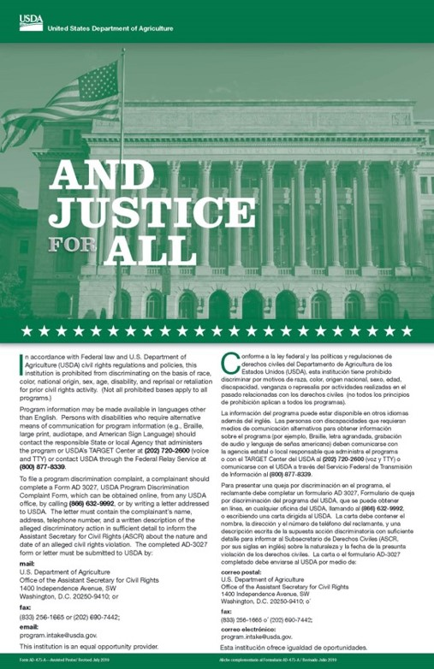

NONDISCRIMINATION STATEMENT
NDSU does not discriminate in its programs and activities on the basis of age, color, gender expression/identity, genetic information, marital status, national origin, participation in lawful off-campus activity, physical or mental disability, pregnancy, public assistance status, race, religion, sex, sexual orientation, spousal relationship to current employee, or veteran status, as applicable. Direct inquiries to Vice Provost, Title IX/ADA Coordinator, Old Main 100, 701-231-7708, ndsu.eoaa@ndsu.edu. This publication will be made available in alternative formats for people with disabilities upon request, 701-231-7881.

