Slide 1
The New Frontiers of U.S. Food Regulation: Make America Healthy Again (MAHA)
Canola/Wheat Outlook & International Durum Forum
November 6, 2025 | Minot, North Dakota

Slide 2

What is MAHA?‎ ‎

Slide 3
MAHA Highlights
November 2024
Donald Trump elected 47th President of the US.
Trump nominates RFK Jr. to for HHS Secretary.
January 15, 2025‎
FDA bans FD&C Red No. 3 (Red 40) from food and ingested drugs, effective 2027 (under Biden Administration)‎.
July 2024
RFK Jr. introduces the "Make America Healthy Again" (MAHA) slogan during his presidential campaign.
March 10, 2025 ‎
RFK Jr. directs FDA to begin eliminating the self-affirmed GRAS pathway and phase out synthetic food dyes.‎
April 22, 2025‎
FDA announces a six-point plan to phase out petroleum-based dyes.‎
August 18, 2025‎
HHS releases MAHA in Action Tracker. ‎‎
May 22, 2025 ‎
MAHA Commission releases first report: "Make Our Children Healthy Again Assessment".‎ ‎
August 12, 2025‎
Deadline for the Commission’s second report: the “Make Our Children Healthy Again Strategy.” Public release ‎delayed.‎‎
September 9, 2025‎
“Make Our Children Healthy Again Strategy.” report released
December 19, 2024
Senator Roger Marshall (R-KS) launches the MAHA Caucus to support the joint mission of President Trump and RFK Jr.
August 23, 2024
RFK Jr. suspends his own campaign for president and endorses Donald Trump.
February 13, 2025‎
RFK Jr. confirmed as HHS Secretary.
Trump signs Executive Order 14212, establishing the President’s MAHA ‎Commission.
March 20, 2025‎
HHS launches the Chemical Contaminants Transparency Tool. ‎
May 9, 2025 ‎
FDA and NIH announce Innovative Joint Nutrition Regulatory Science Program. ‎

Slide 4
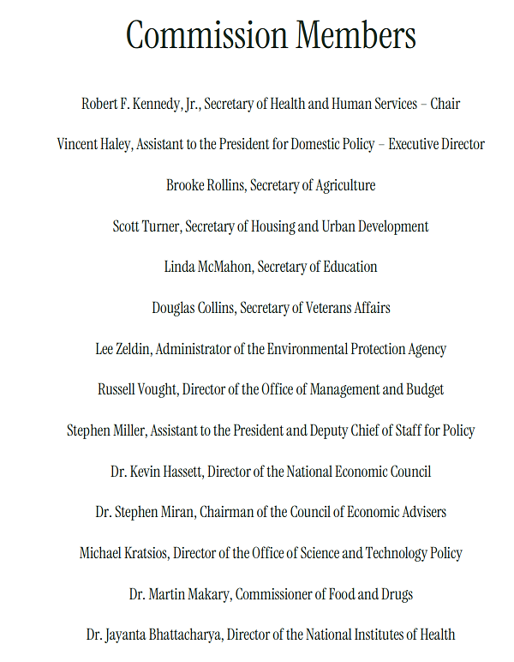
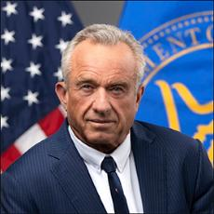
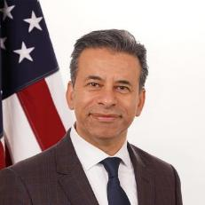
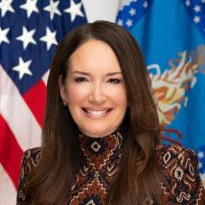
MAHA Commission
Leadership: Political Appointees
Robert F. Kennedy, Jr., J.D.
Health & Human Services (HHS)
HHS Secretary
Dr. Marty Makary
U.S. Food & Drug Administration (FDA)
FDA Commissioner
Brooke Rollins
U.S. Department of Agriculture (USDA)
Secretary of Agriculture

Slide 5
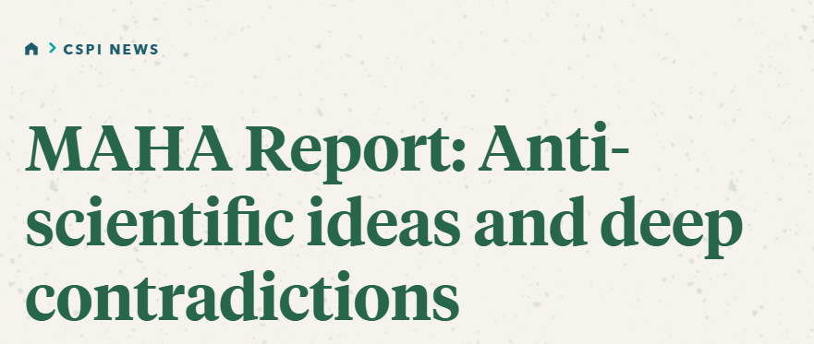
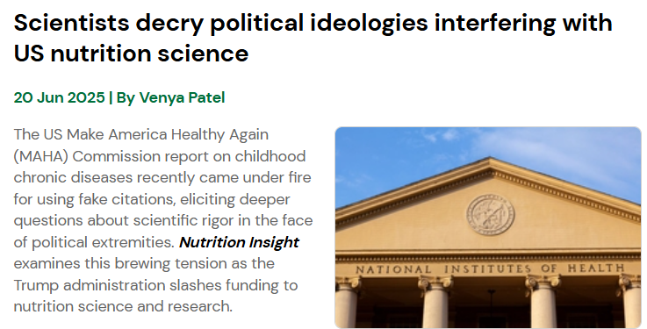
MAHA Assessment Report
Report Criticisms
Use of AI
False citations
Misrepresentation of scientific findings
Key Recommendations Include
Shifting consumption toward “minimally processed” foods
Revising federal dietary guidance and labeling to discourage “ultra-processed” items
Encouraging procurement policies that reward whole, unprocessed foods
https://www.cspi.org/cspi-news/maha-report-anti-scientific-ideas-and-deep-contradictions
https://www.nutritioninsight.com/news/nutrition-science-maha-report-nih.html

Slide 6
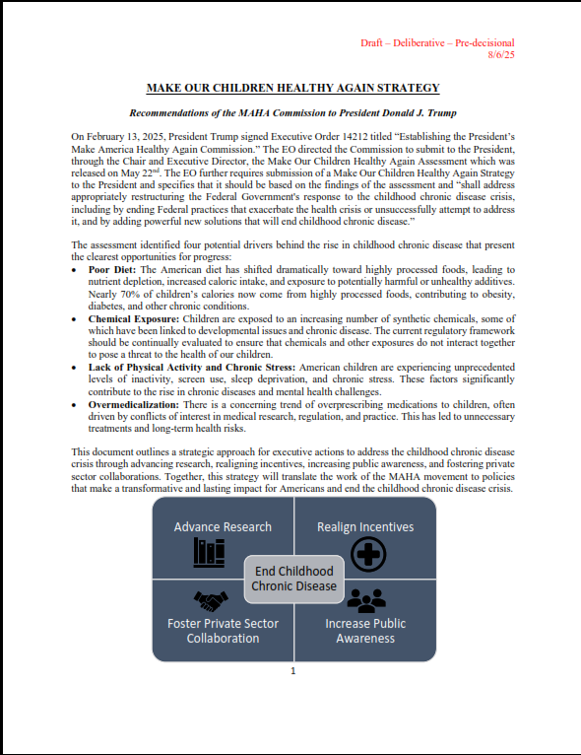
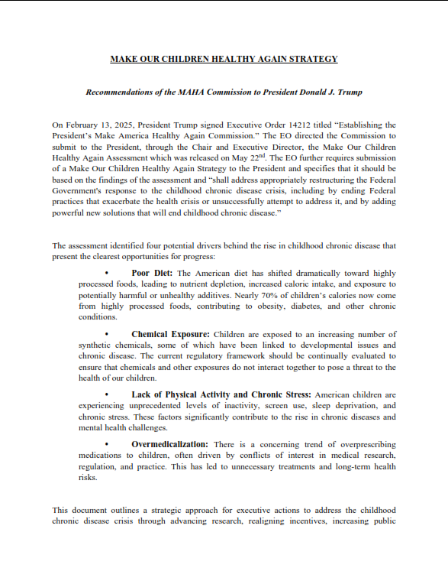
MAHA Strategy Report
Leaked Report Dated August 6, 2025
Leaked Report Dated August 11, 2025

Slide 7
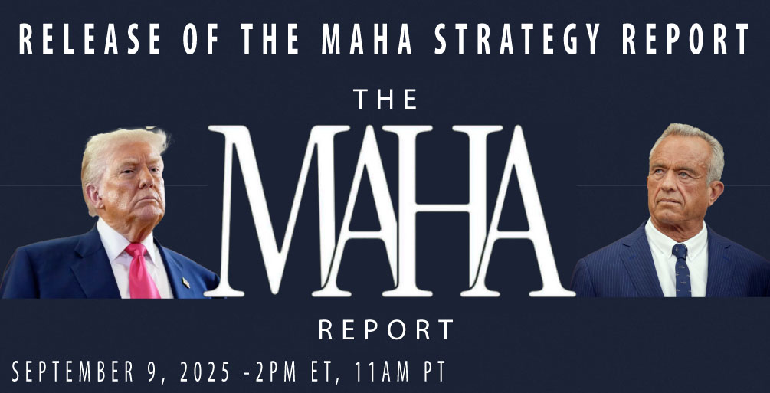
MAHA Strategy Report
Key Policy Recommendations
Ultra-Processed Foods (UPFs)
Food Dyes and Chemicals
Generally Recognized as Safe (GRAS)
Dietary Guidelines (DGAs)
Labeling
USDA’s 16 Nutrition Programs
Marketing and Food Education
Emphasis on Whole Foods
Update Food Industry Regulations
Pest Management and Pesticide Policy

Slide 8
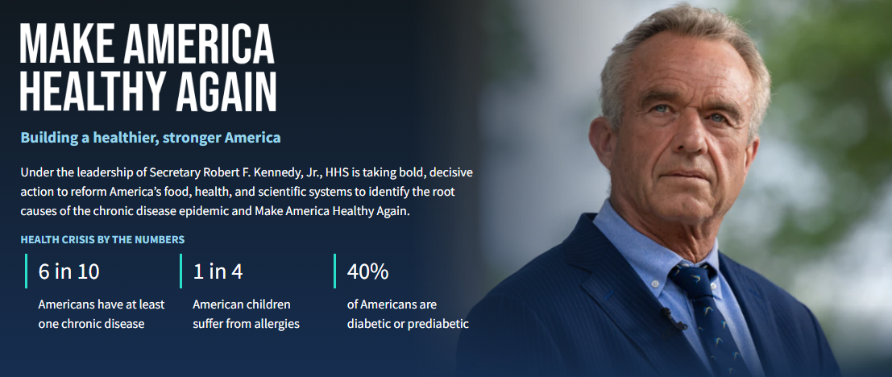
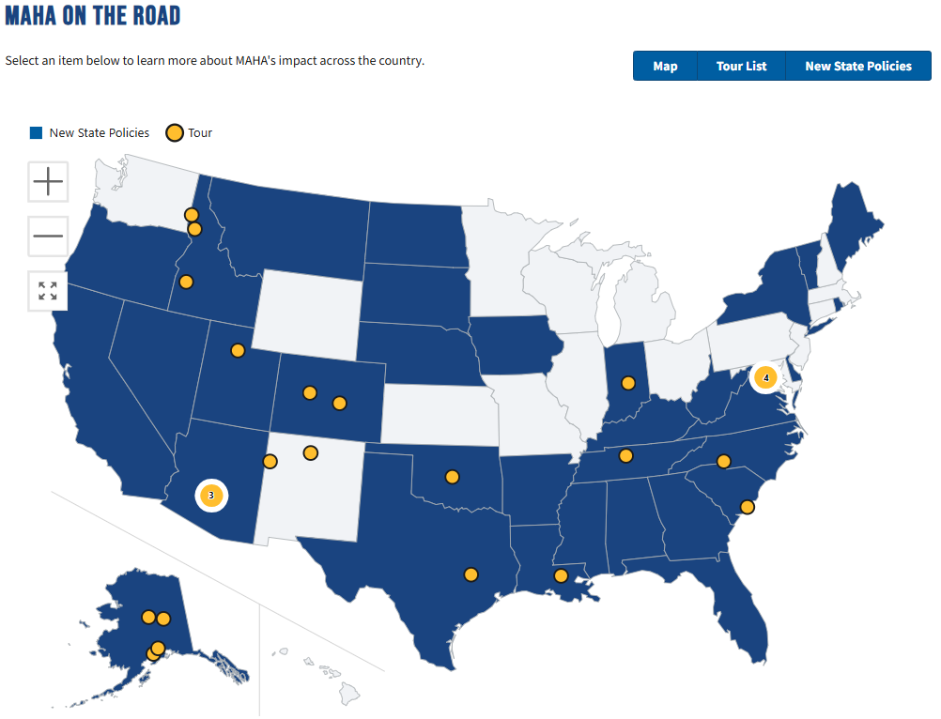
MAHA Impact in the States
MAHA in Action Tracker
“Americans are tired of toxic food, failed science, and chronic disease becoming the norm,” Secretary Kennedy said.
https://www.hhs.gov/maha/index.html

Slide 9
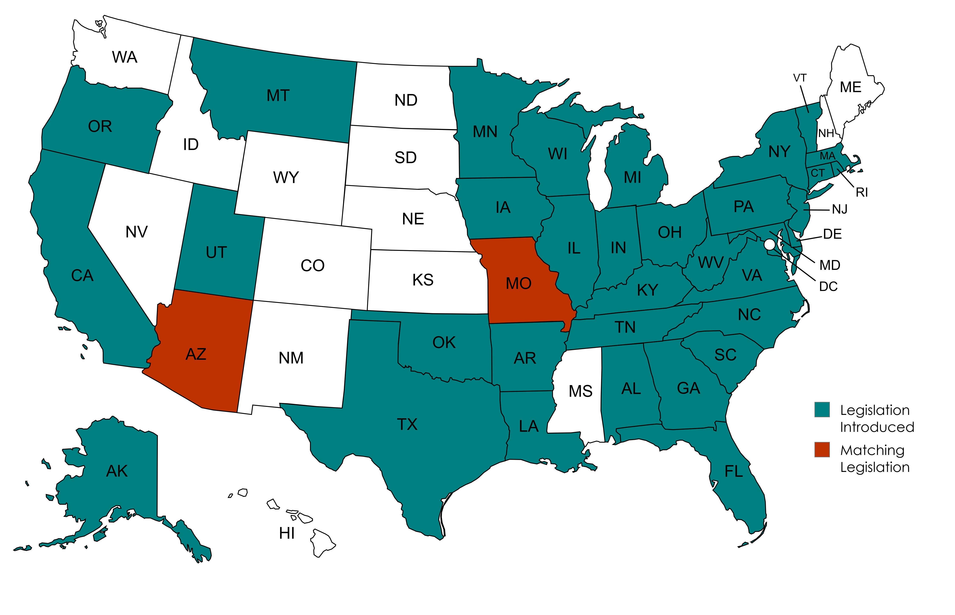
U.S. State Legislative Activity: Food Additives
2025: Over 120 Pieces of Legislation, Only 2 Were Identical

Slide 10
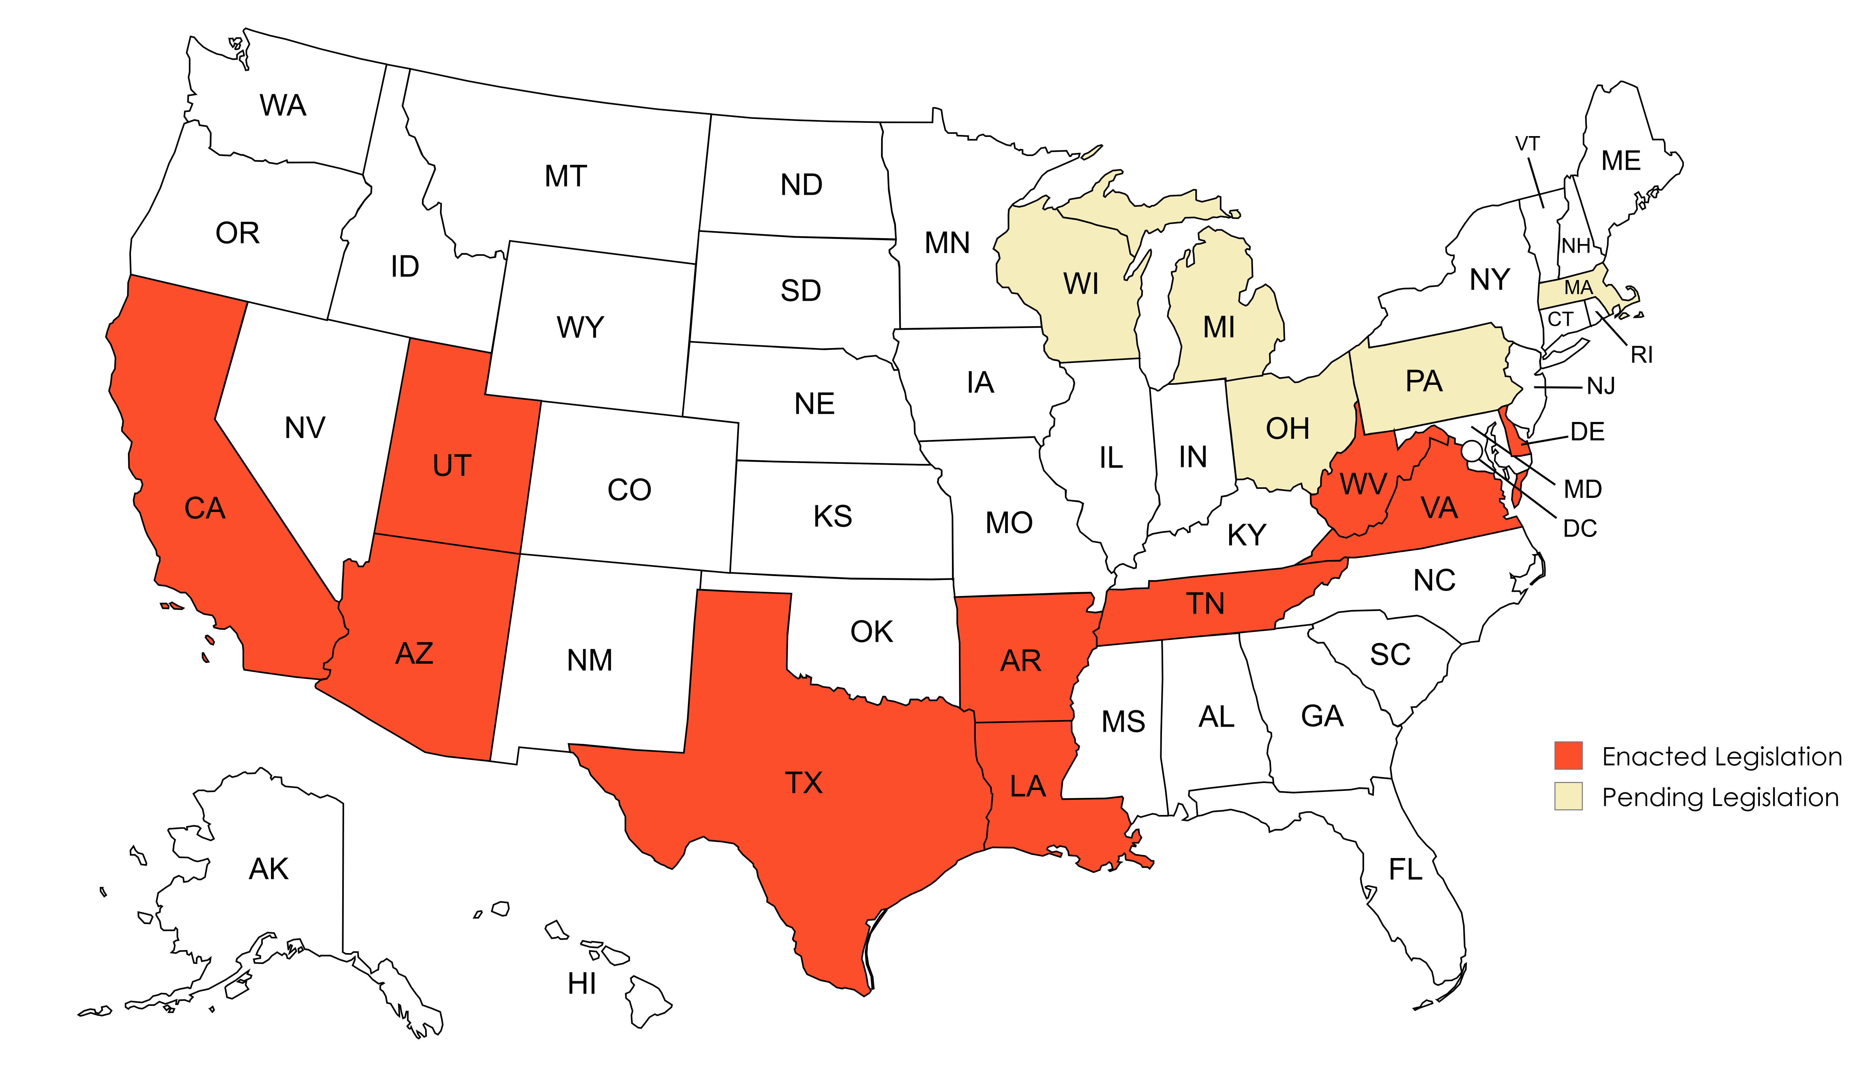
U.S. State Legislative Activity: Food Additives
2025: Enacted & Pending Legislation
Current as of October 22, 2025

Slide 11
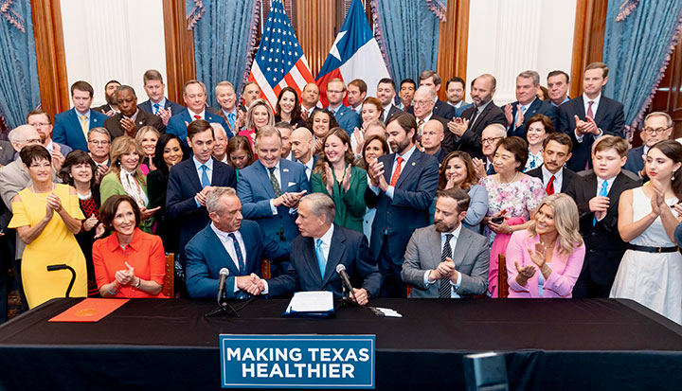
U.S. State Legislative Activity
Texas Senate Bill 25: “Make Texas Healthy Again Act”
Requires human food products containing any of 44 specified ingredients to bear the following warning label:
WARNING: This product contains an ingredient that is not recommended for human consumption by the appropriate authority in Australia, Canada, the European Union, or the United Kingdom.

Slide 12
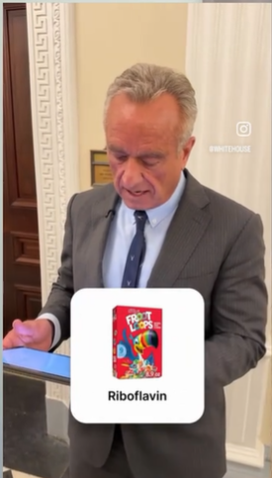
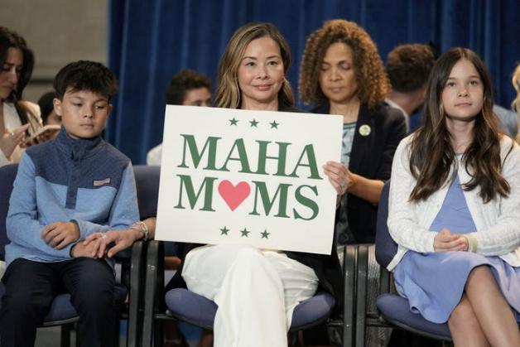
From Source to Shelf: Why It Matters to All Stakeholders ‎
MAHA is Influencing Policy & Perception
Fragmented state approaches creating compliance challenges
Federal policy shifts with wide-reaching effects
Misinformation driving consumer confusion
Rising industry-customer scrutiny and concern
A woman with a sign for MAHA Moms, a group of parents who are vital supporters of RFK Jr. OLIVER CONTRERAS/AFP via Getty Images

Slide 13
Navigating Policy Shifts: NPA’s Strategic Approach
Policy & Advocacy
Promoting Science
Communication

Slide 14
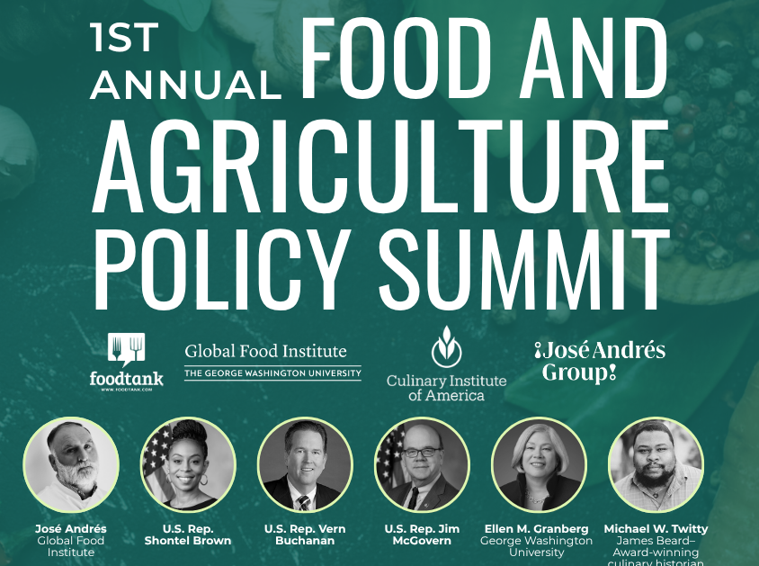
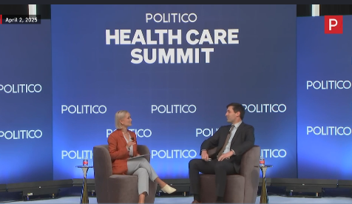
Executing NPA’s Strategic Approach
Representation at Industry Events
Meet & Greet: Congressman Derek Schmidt (KS-02)‎
POLITICO's 2025 Health Care Summit
IFT's Food Policy Impact 2025
Health Affairs Theme Issue Briefing: Food, Nutrition & Health‎
Power Players & Political Shifts: Adapting Advocacy for Trump 2.0‎
Protecting Interstate Commerce: Uniform National Standards for the Food Supply Chain
1st Annual Food and Agriculture Policy Summit‎

Slide 15

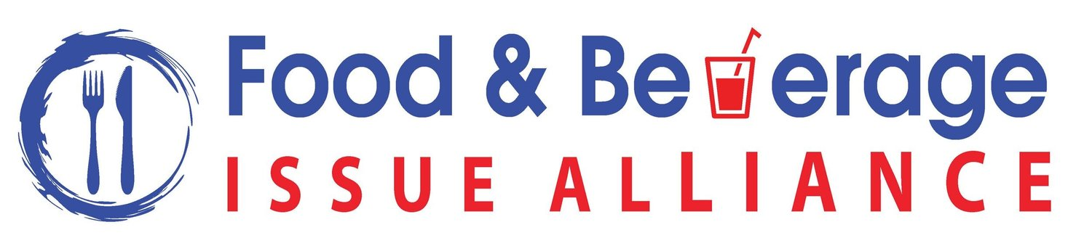

Executing NPA’s Strategic Approach
Coalition and Industry Collaboration

Slide 16
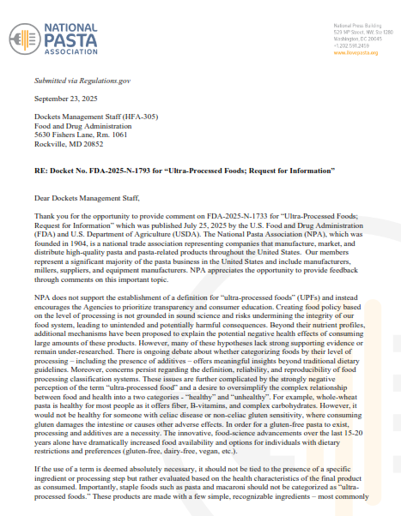

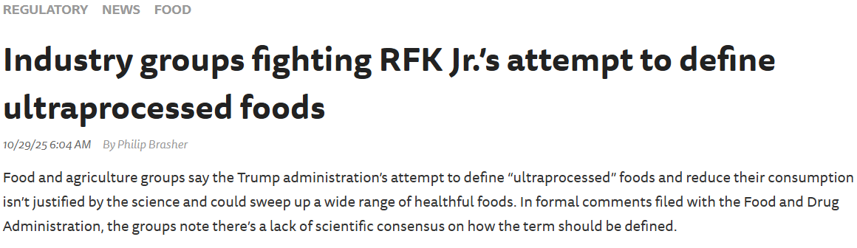
Executing NPA’s Strategic Approach
Agency Communication and Meetings
Comment Letters and Consultation Responses

Slide 17
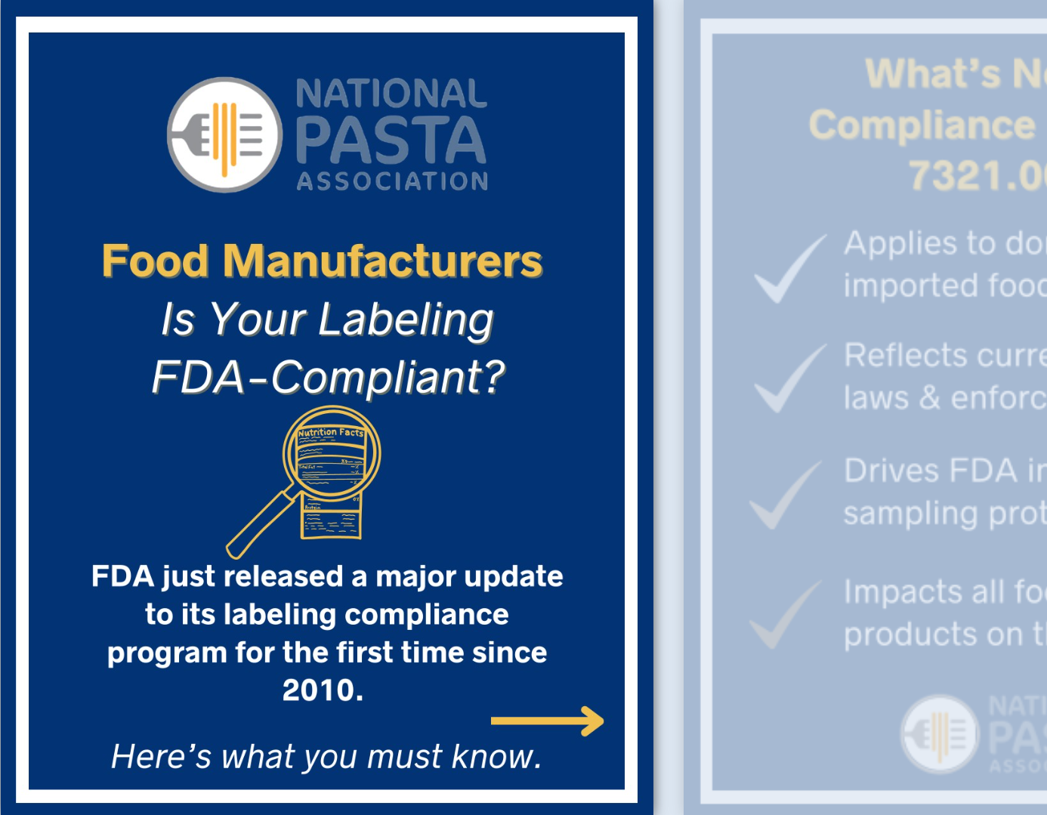
Executing NPA’s Strategic Approach
Multimedia Communications
Industry Intelligence Posts
Government Relations Updates
Media/Press Engagement
Member Only Benefits
Annual Meeting
Monthly Pasta Journal
Pasta Byte Emails
National Nutrition Month Member Toolkit
Webinars
& More!
July 2025 LinkedIn Post:
Food Manufacturers: Are Your Labels Ready for FDA’s Latest Compliance Update?

Slide 18
How You Can Engage
Advocate
Educate
Share
Support

Slide 19
Thank you
Sydni Arnone
Manager, Government Relations | National Pasta Association
202-204-8396 sarnone@ilovepasta.org www.ilovepasta.org

