Slide 1
Boron Fertilization Boosts Canola Production in Western North Dakota
Victor Gomes
Extension Cropping Systems Specialist
NDSU Dickinson REC

Slide 2
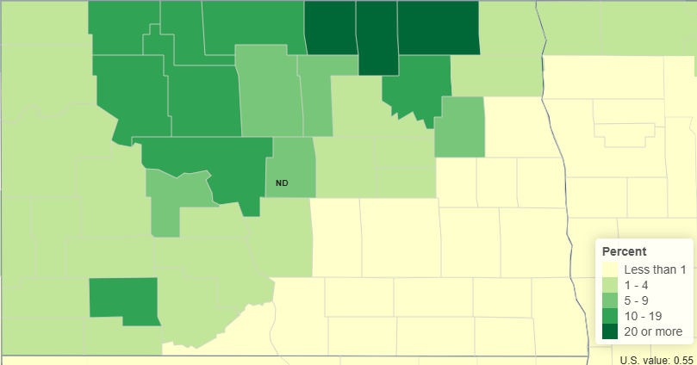
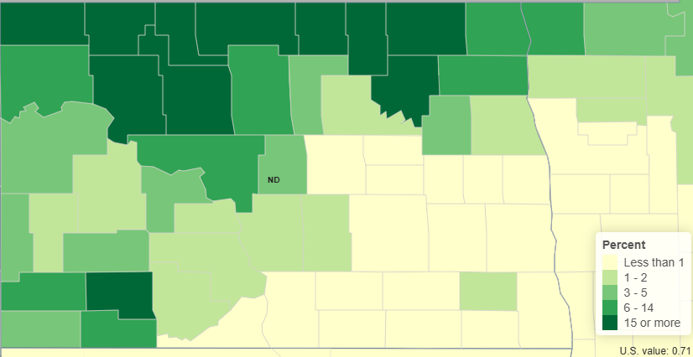
Introduction
2012
2022

Slide 3
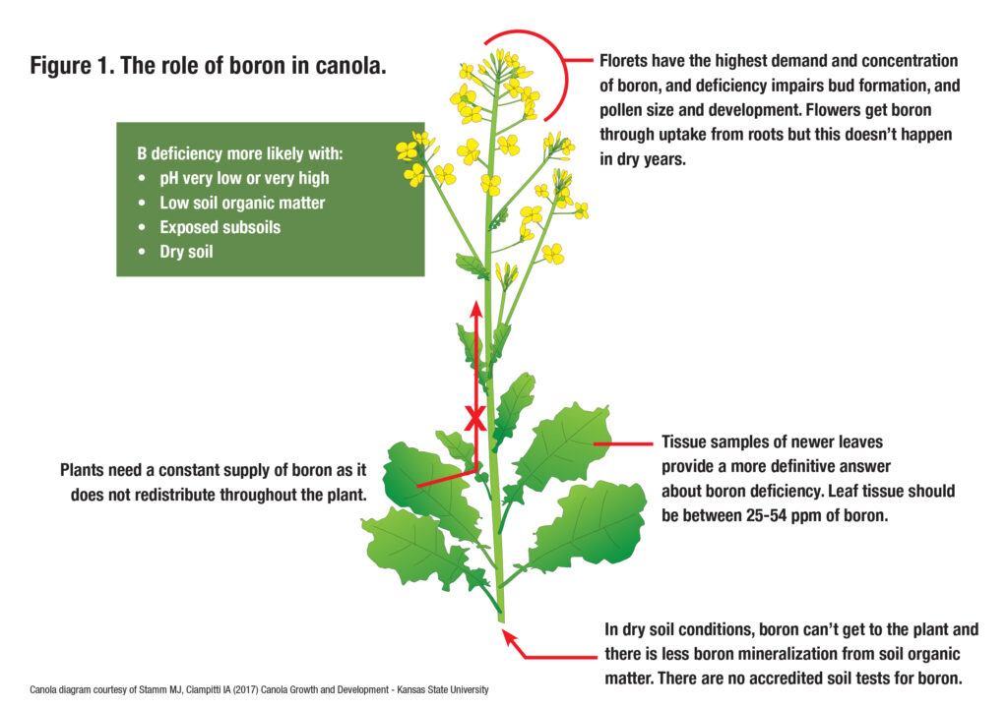
Introduction

Slide 4
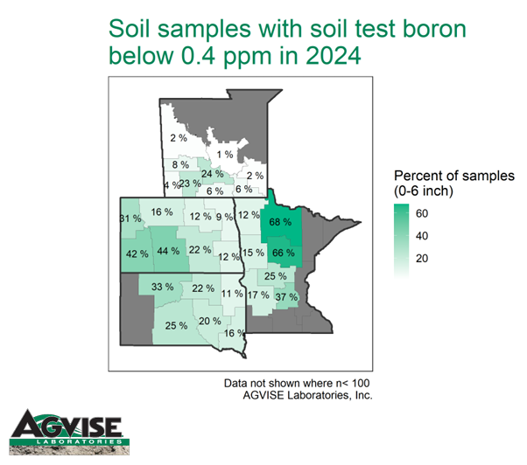
Introduction

Slide 5
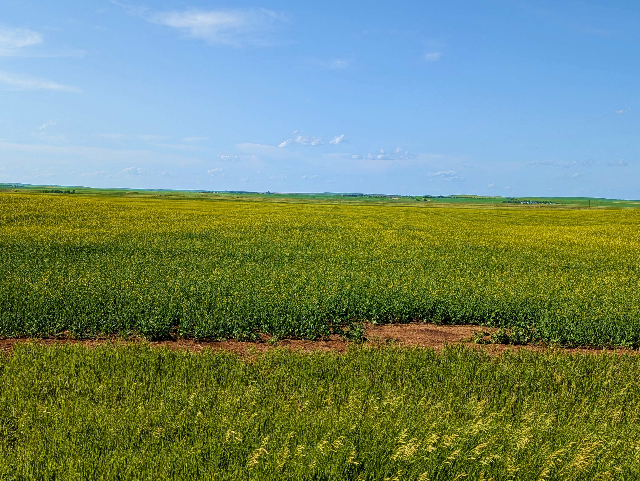
Objectives
The objective of this study was to evaluate the effects of different rates, timings and modes of application of Boron fertilization on the yield and seed quality of canola in western North Dakota.

Slide 6
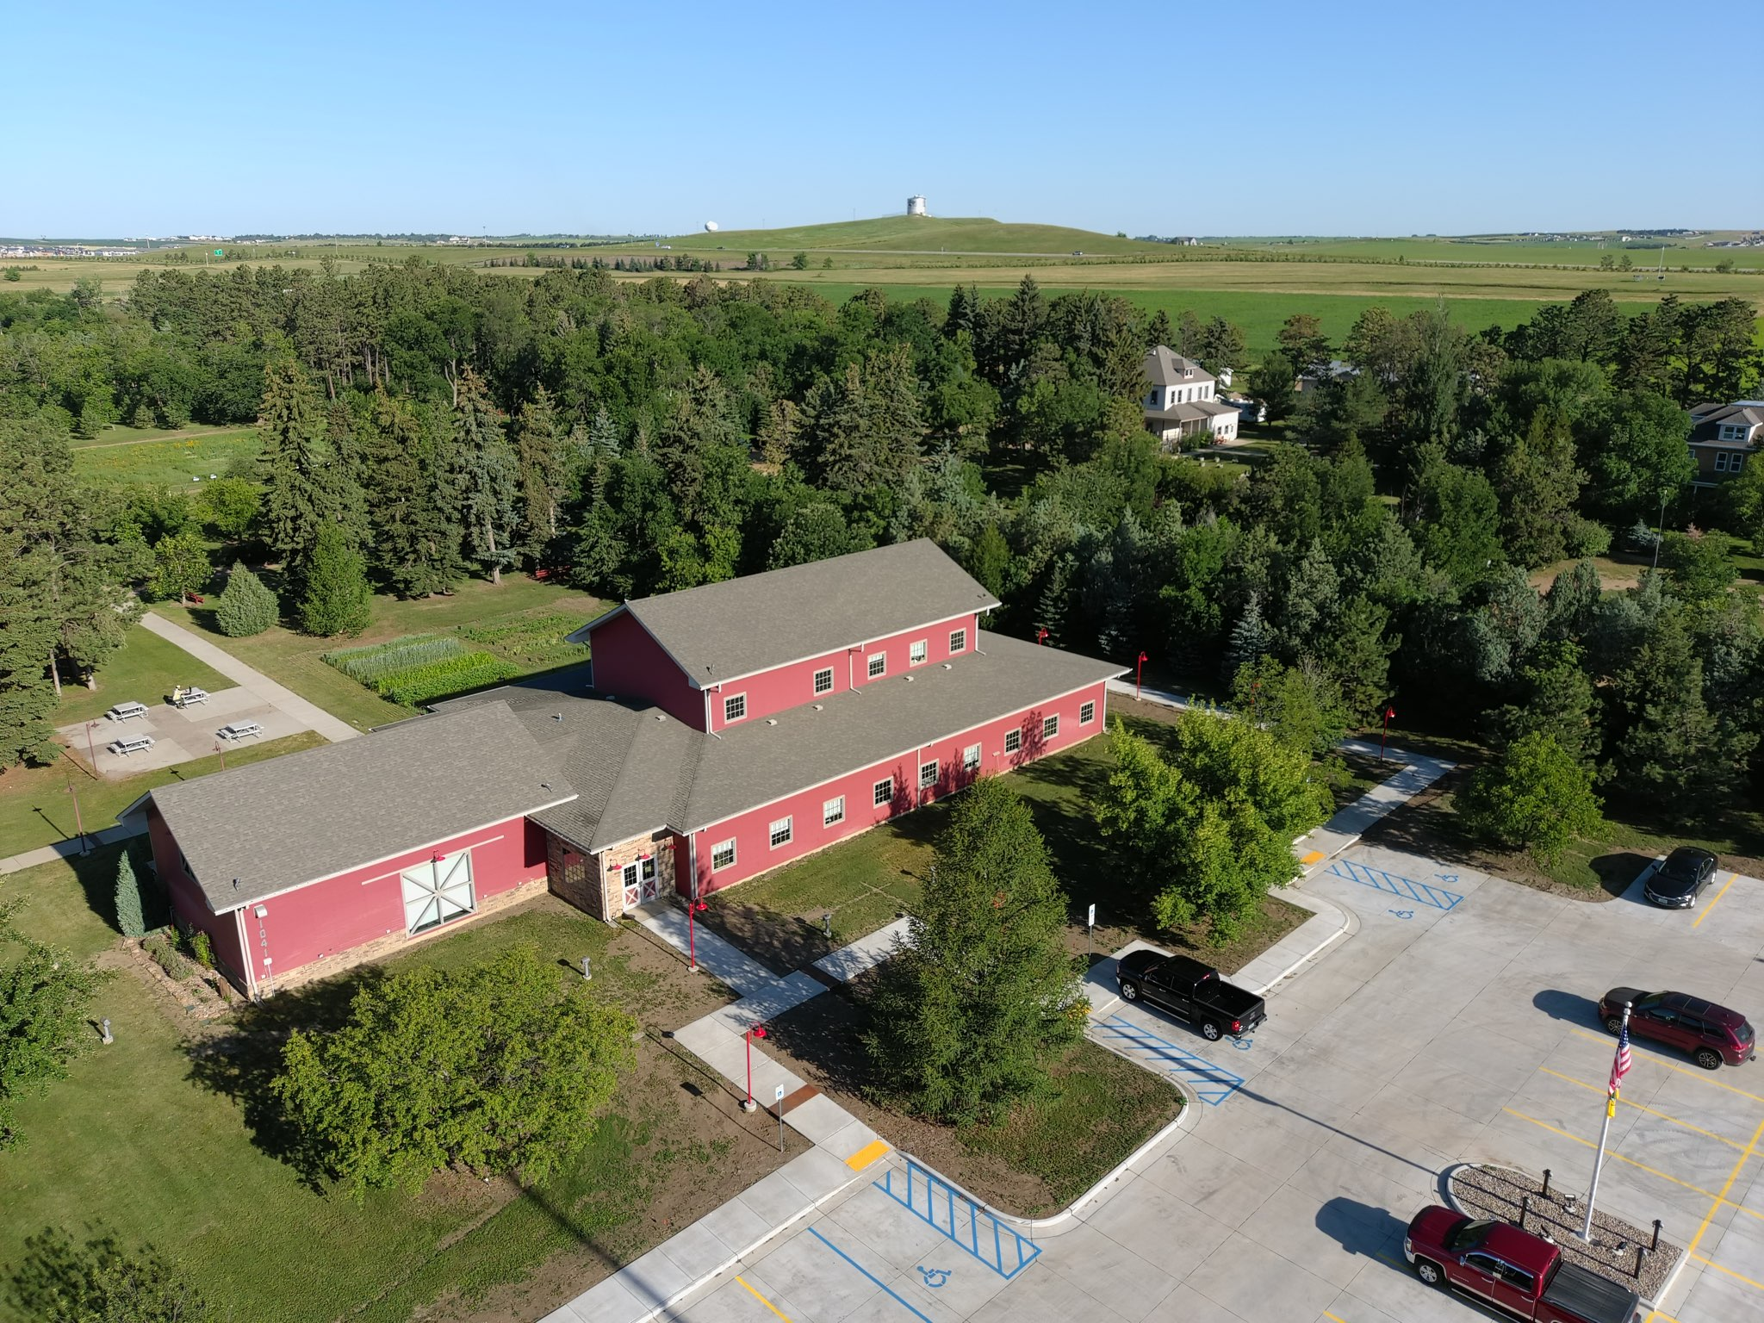


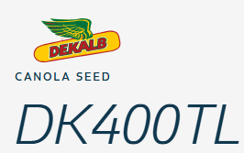
Material & Methods
Dickinson – Seeding:
  4/29/2025
  Hybrid - L345PC;
  Seeding rate – 600k pls/a
  Minot – Seeding:
  5/9/2025
  Hybrid DK400TL
  Seeding rate – 450k pls/a

Slide 7
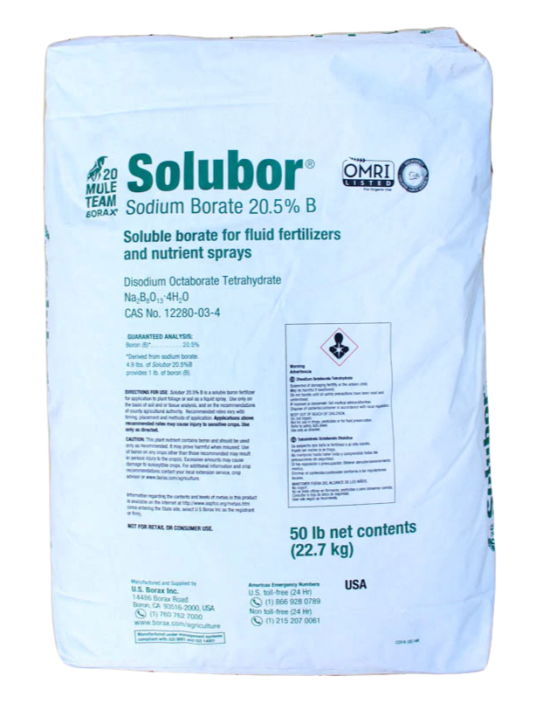
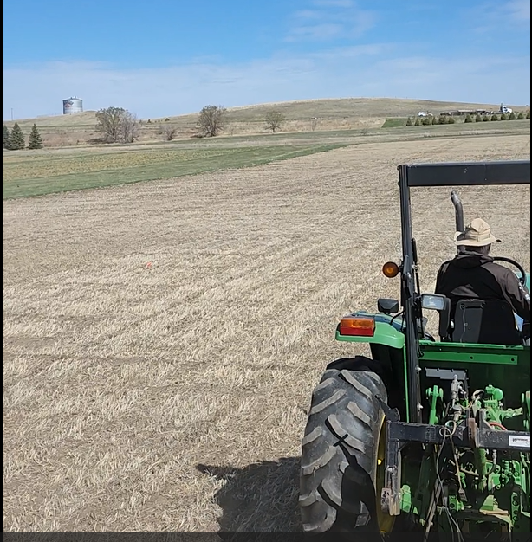
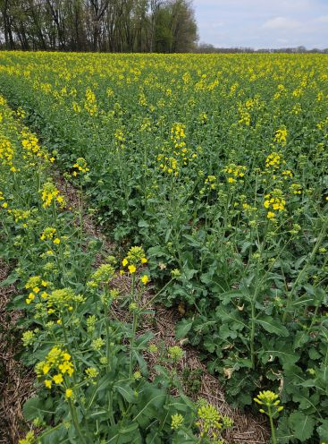
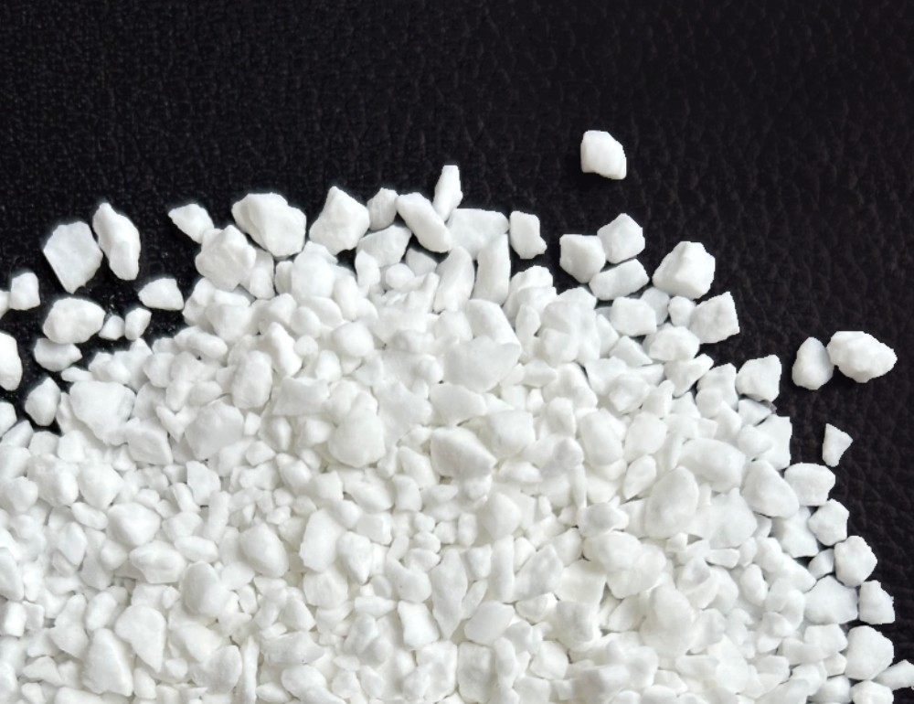
Material & Methods
Sources
Timing
Rates
Application
2, 5 and 10 lbs B ac⁻¹
0.25, 0.50 and 1 lbs B ac⁻¹
0.25 lbs B ac⁻¹
0.50 lbs B ac⁻¹
Dickinson – Broadcast
Minot – Band applied
1 lbs B ac⁻¹

Slide 8
Results - Weather Dickinson

Slide 9
Results - Weather Minot

Slide 10
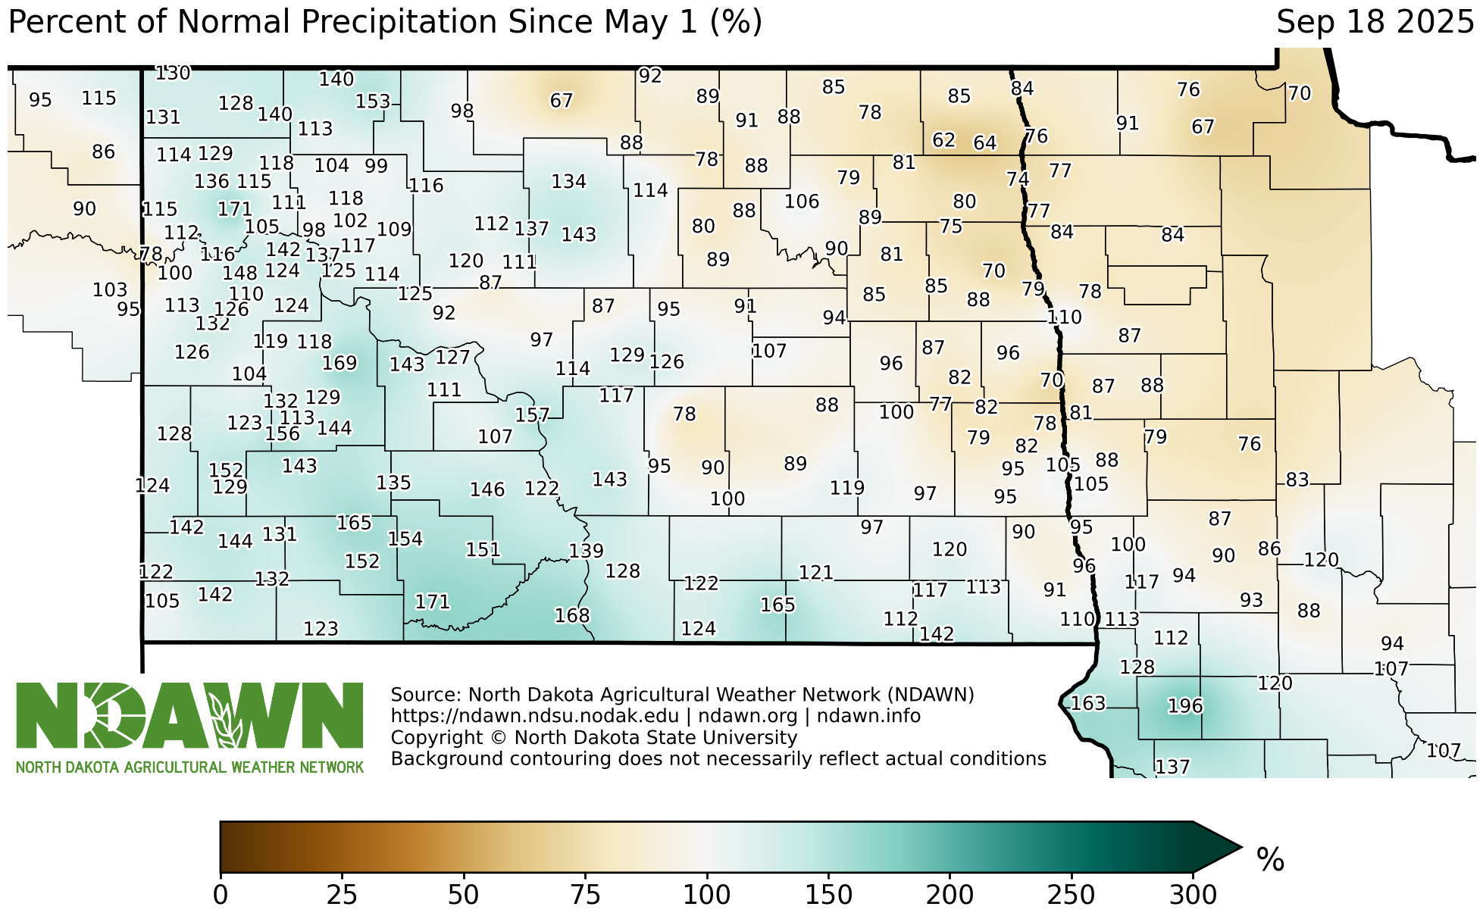
Results

Slide 11
Results - Dickinson
Plant Stand (Dickinson) – 317,462 plants/acre
(52.95% of the target plant population)

Slide 12
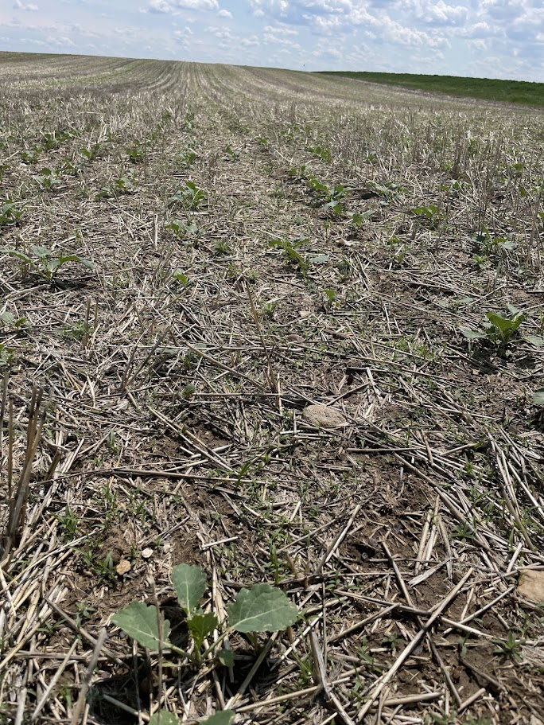
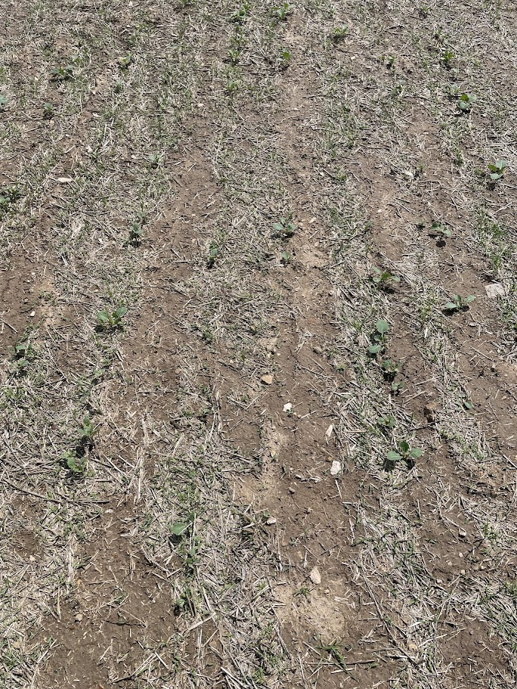

Slide 13
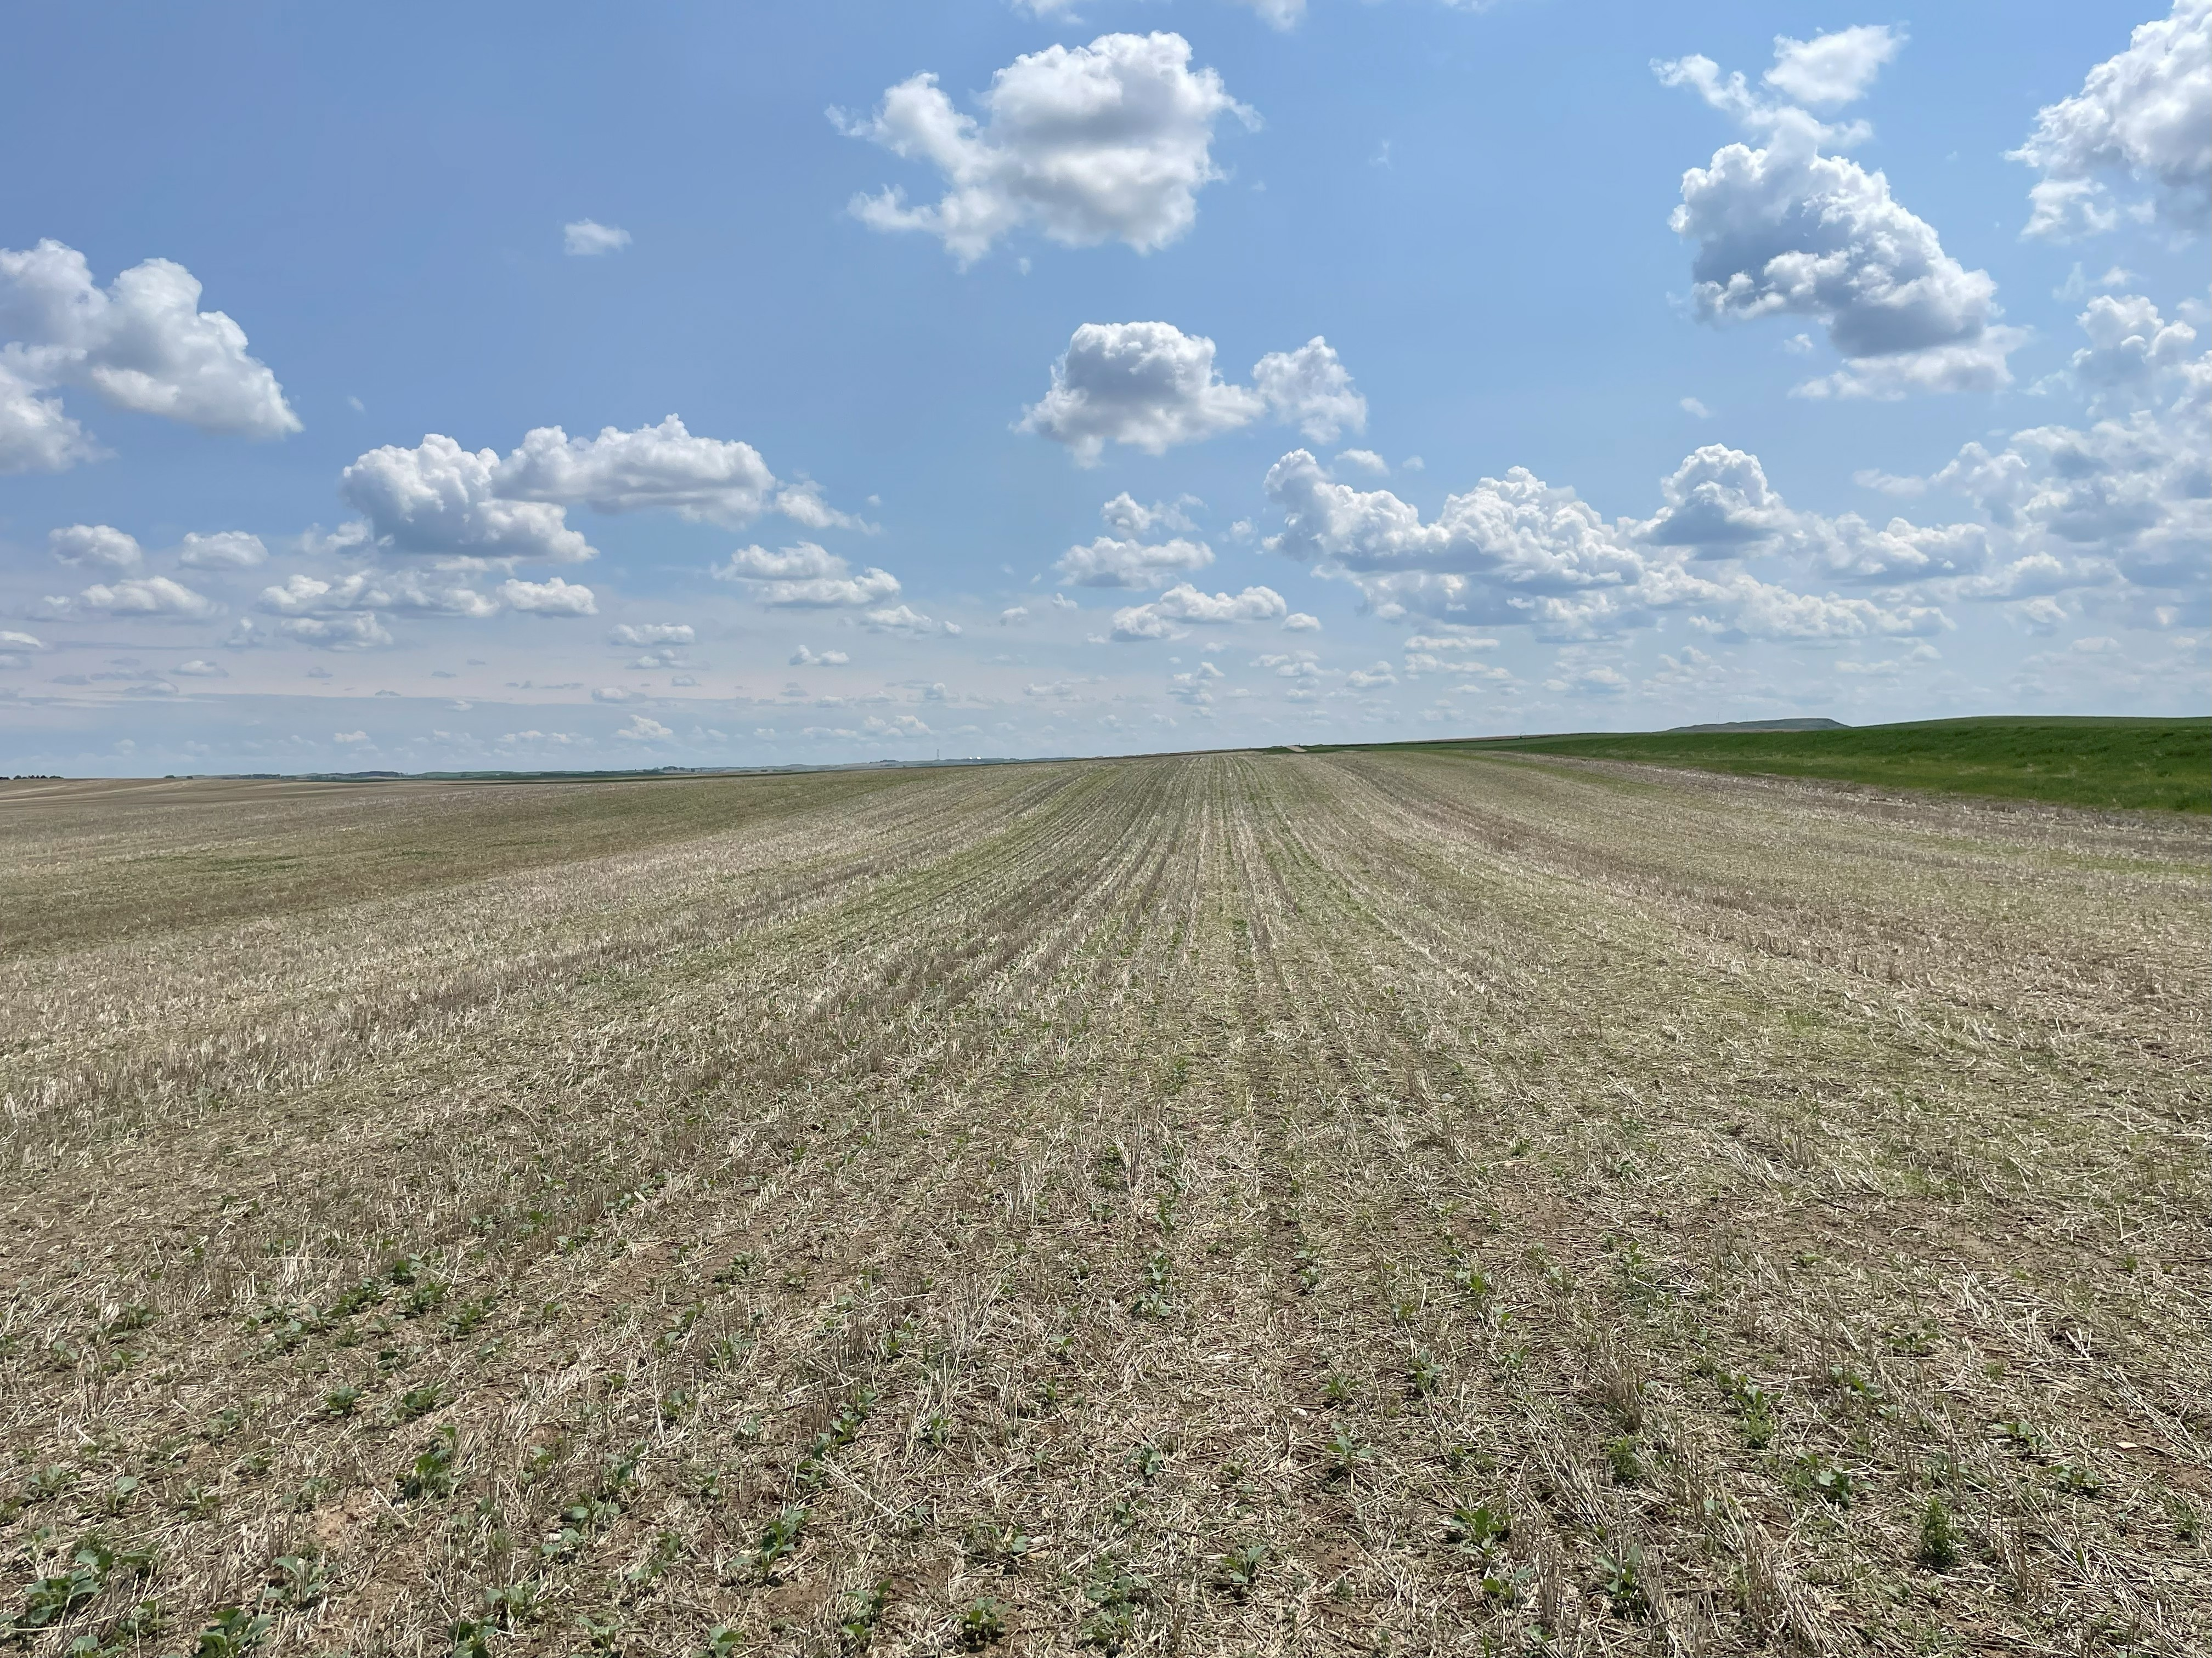

Slide 14
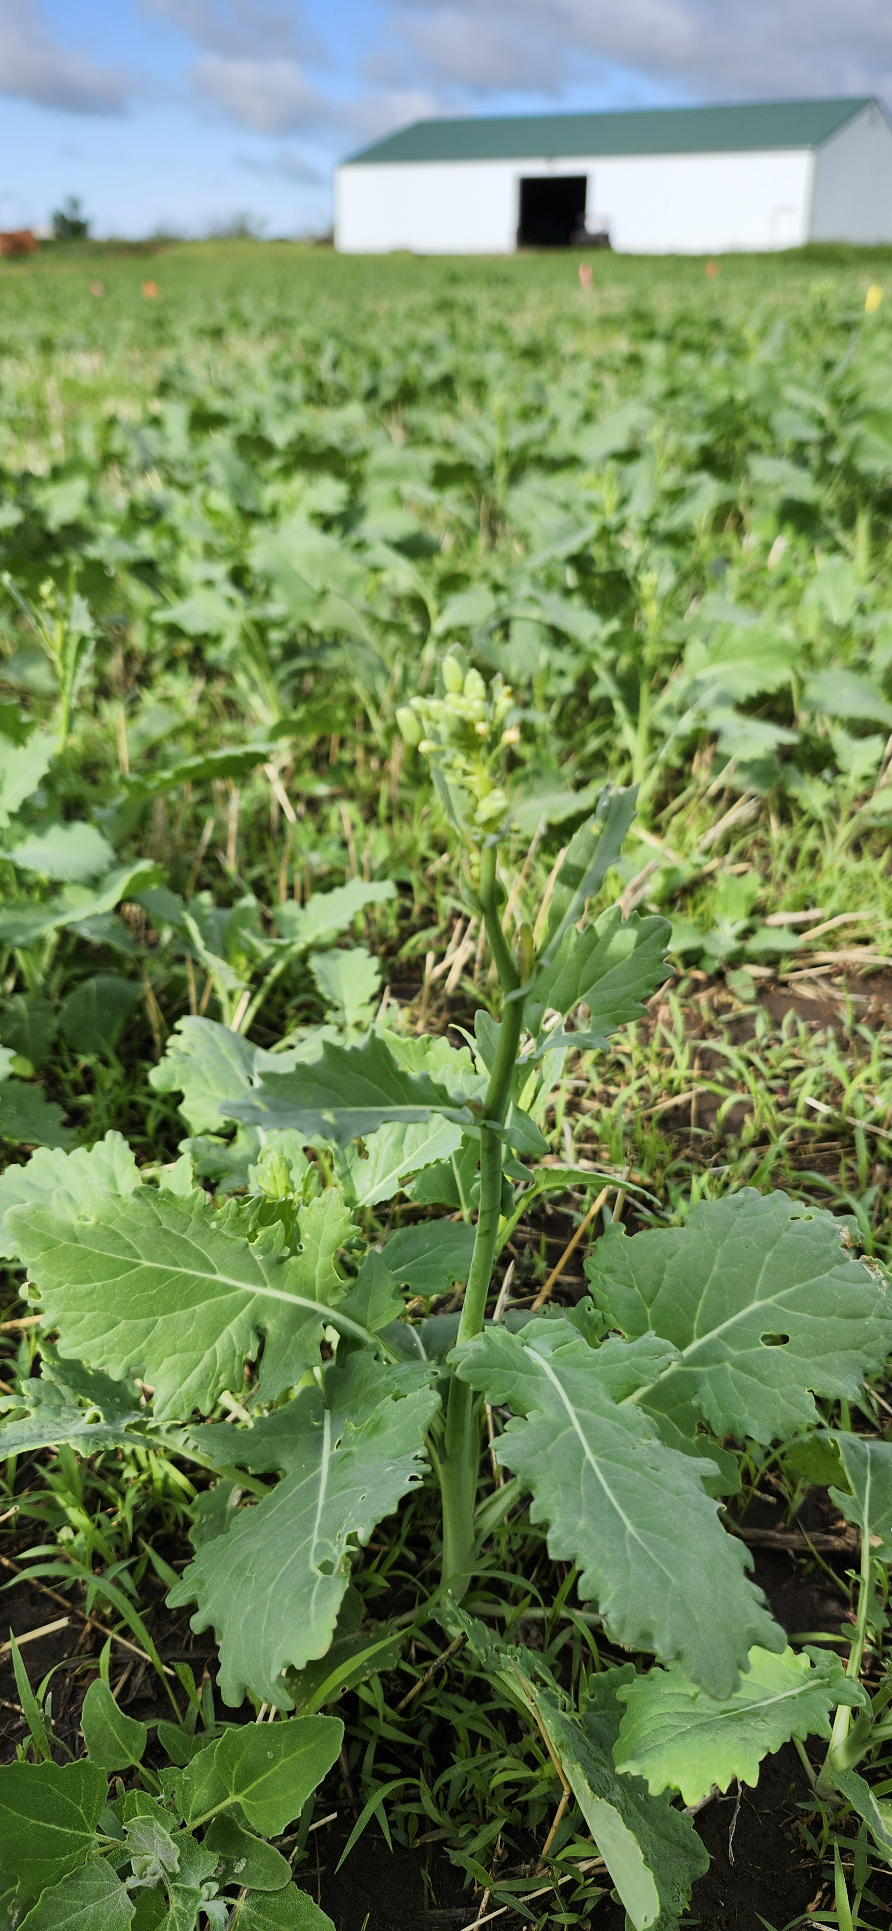
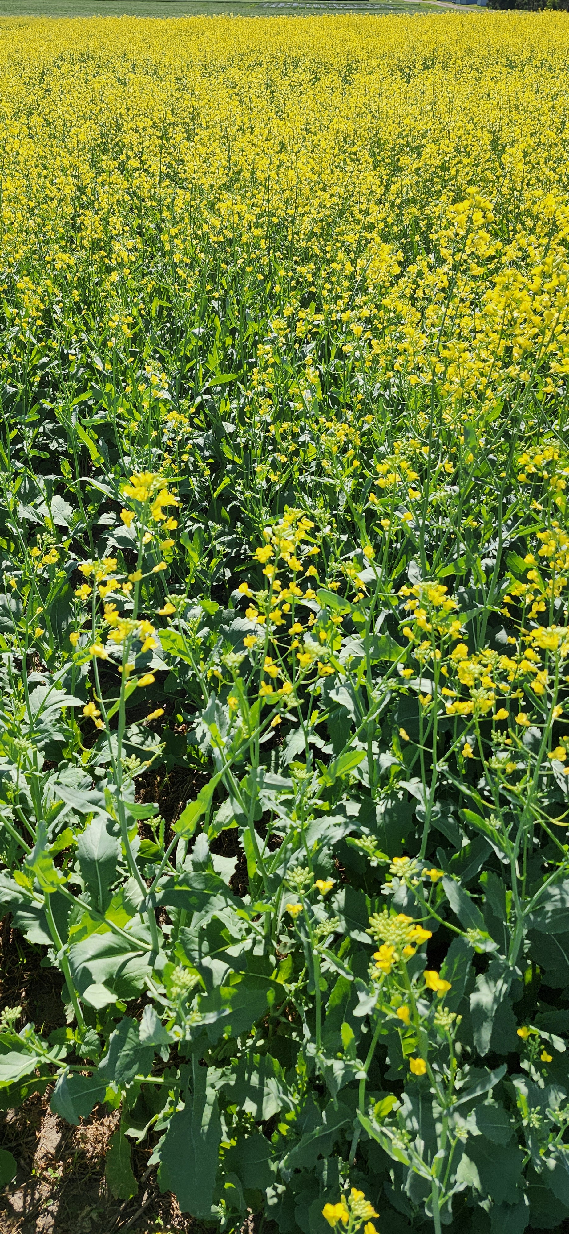

Slide 15
Results – Soil Test
Table 1. Soil chemical analysis
Site | pH | OM | N (nitrate) | P | K | Ca | Mg | S | Soluble Salts | B | CEC
 |  |  |  | (Olsen)
 |  | % | Lbs/ac | ppm | ppm | ppm | ppm | Lb/ac | mmho/cm | ppm | meq
DICKINSON (0-6”) | 5.5 | 4 | 17 | 19 | 332 | 1685 | 435 | 10 | 0.2 | 0.35 | 23
MINOT (0-6”) | 6.5 | 3.3 | 10 | 11 | 356 | 2285 | 395 | 7 | 0.2 | 0.44 | 18
Source: Agvise
Texture: Loam

Slide 16
Table 2. Canola yield and oil content – Dickinson, ND, 2025
Treatment | Yield (lbs/ac) | Oil (%)
1 lb B/ac Granular + 0.25 lb B/ac Foliar | 2,351.27 A | 43.08
1 lb B/ac Foliar | 2,296.42 AB | 42.98
1 lb B/ac Granular + 0.50 lb B/ac Foliar | 2,269.50 AB | 43.01
0.25 lb B/a Foliar | 2,127.21 ABC | 43.46
10 lbs B/ac Granular | 2,088.10 BCD | 42.98
2 lbs B/ac Granular | 2,081.57 BCD | 42.84
5 lbs B/ac Granular | 2,013.86 CD | 43.22
0.50 lbs B/ac Foliar | 1,957.22 CD | 43.24
Untreated Check | 1,873.79 D | 43.24
25%
increase
13.5% increase

Slide 17
Table 3. Canola yield and oil content – Minot, ND, 2025
Treatment | Yield (lbs/ac) | Oil (%)
2 lbs B/ac Granular | 2,399 | 42.2
5 lbs B/ac Granular | 2,337 | 42.0
10 lbs B/ac Granular | 2,328 | 41.9
0.25 lb B/a Foliar | 2,344 | 42.6
0.50 lbs B/ac Foliar | 2,448 | 42.4
1 lb B/ac Foliar | 2,307 | 42.7
1 lb B/ac Granular + 0.25 lb B/ac Foliar | 2,405 | 43.7
1 lb B/ac Granular + 0.50 lb B/ac Foliar | 2,412 | 42.3
Untreated Check | 2,153 | 42.7
13%
increase

Slide 18
ROI (%) - Dickinson
Treatment | Extra yield (lb/ac) | Product cost $/ac | App $/ac | Total cost $/ac | Net return low ($0.1282/lb) | ROI low % | Net return high ($0.1697/lb) | ROI high %
1 lb granular + 0.25 lb foliar | 477.48 | 9.14 | 15.26 | 24.40 | 36.81 | 150.9% | 56.63 | 232.1%
1 lb foliar | 422.63 | 9.51 | 8.01 | 17.52 | 36.66 | 209.2% | 54.20 | 309.3%
1 lb granular + 0.50 lb foliar | 395.71 | 11.52 | 15.26 | 26.78 | 23.95 | 89.5% | 40.38 | 150.8%
0.25 lb foliar | 253.42 | 2.38 | 8.01 | 10.39 | 22.10 | 212.7% | 32.62 | 314.0%
10 lb granular | 214.31 | 67.60 | 7.25 | 74.85 | −47.38 | −63.3% | −38.48 | −51.4%
2 lb granular | 207.78 | 13.52 | 7.25 | 20.77 | 5.87 | 28.2% | 14.49 | 69.8%
5 lb granular | 140.07 | 33.80 | 7.25 | 41.05 | −23.09 | −56.3% | −17.28 | −42.1%
0.50 lb foliar | 83.43 | 4.76 | 8.01 | 12.77 | −2.07 | −16.2% | 1.39 | 10.9%

Slide 19
ROI (%) - Minot
Treatment | Yield (lb/ac) | Extra yield (lb/ac) | App $/ac | Total cost ($/ac) | Net low ($0.1282/lb) | ROI low (%) | Net high ($0.1697/lb) | ROI high (%)
2 lb granular | 2,399 | 246 | 7.25 | 20.77 | 10.77 | 51.8% | 20.98 | 101.0%
5 lb granular | 2,337 | 184 | 7.25 | 41.05 | 6.43 | 24.0% | 17.18 | 64.1%
10 lb granular | 2,328 | 175 | 7.25 | 74.85 | −47.38 | −63.3% | −38.48 | −51.4%
0.25 lb foliar | 2,344 | 191 | 8.01 | 10.39 | 14.10 | 135.7% | 24.72 | 237.9%
0.50 lb foliar | 2,448 | 295 | 8.01 | 12.77 | 22.83 | 178.8% | 40.95 | 320.7%
1 lb foliar | 2,307 | 154 | 8.01 | 17.52 | 1.78 | 10.2% | 13.63 | 77.8%
1 lb granular + 0.25 foliar | 2,405 | 252 | 9.50 | 22.38 | 8.38 | 37.5% | 28.88 | 129.1%
1 lb granular + 0.50 foliar | 2,412 | 259 | 15.26 | 24.76 | 8.63 | 34.9% | 30.96 | 125.1%

Slide 20
Conclusions
The effects of Boron fertilization in canola yield were positive.
The combination of a granular B application at planting + a foliar B application at 10-20% bloom produced the best yield results.
A standalone foliar application at 10-20%, however, is more profitable.
The best boron rates are location specific.

Slide 21
Conclusions
Boron sources, rates and timing of application do not affect seed oil content in canola.
The study needs to be repeated at least for one more year (ideally two) to confirm the results and to provide more sound recommendations to canola growers.

Slide 22





Thank you!
QUESTIONS?
victor.gomes@ndsu.edu
701-761-9436
701-456-1102
@CropSystemsDREC

