Slide 1

Sulfur Fertilizer for Canola Production in Southwest North Dakota
Krishna B Katuwal, Ph.D.
Agronomist
Dickinson Research Extension Center
North Dakota State University

Slide 2
Background
Sulfur is the fourth most important macronutrient after Nitrogen, Phosphorous and Potassium
Essential component of amino acids such as cysteine and methionine that serve as building block of proteins and enzymes

Slide 3
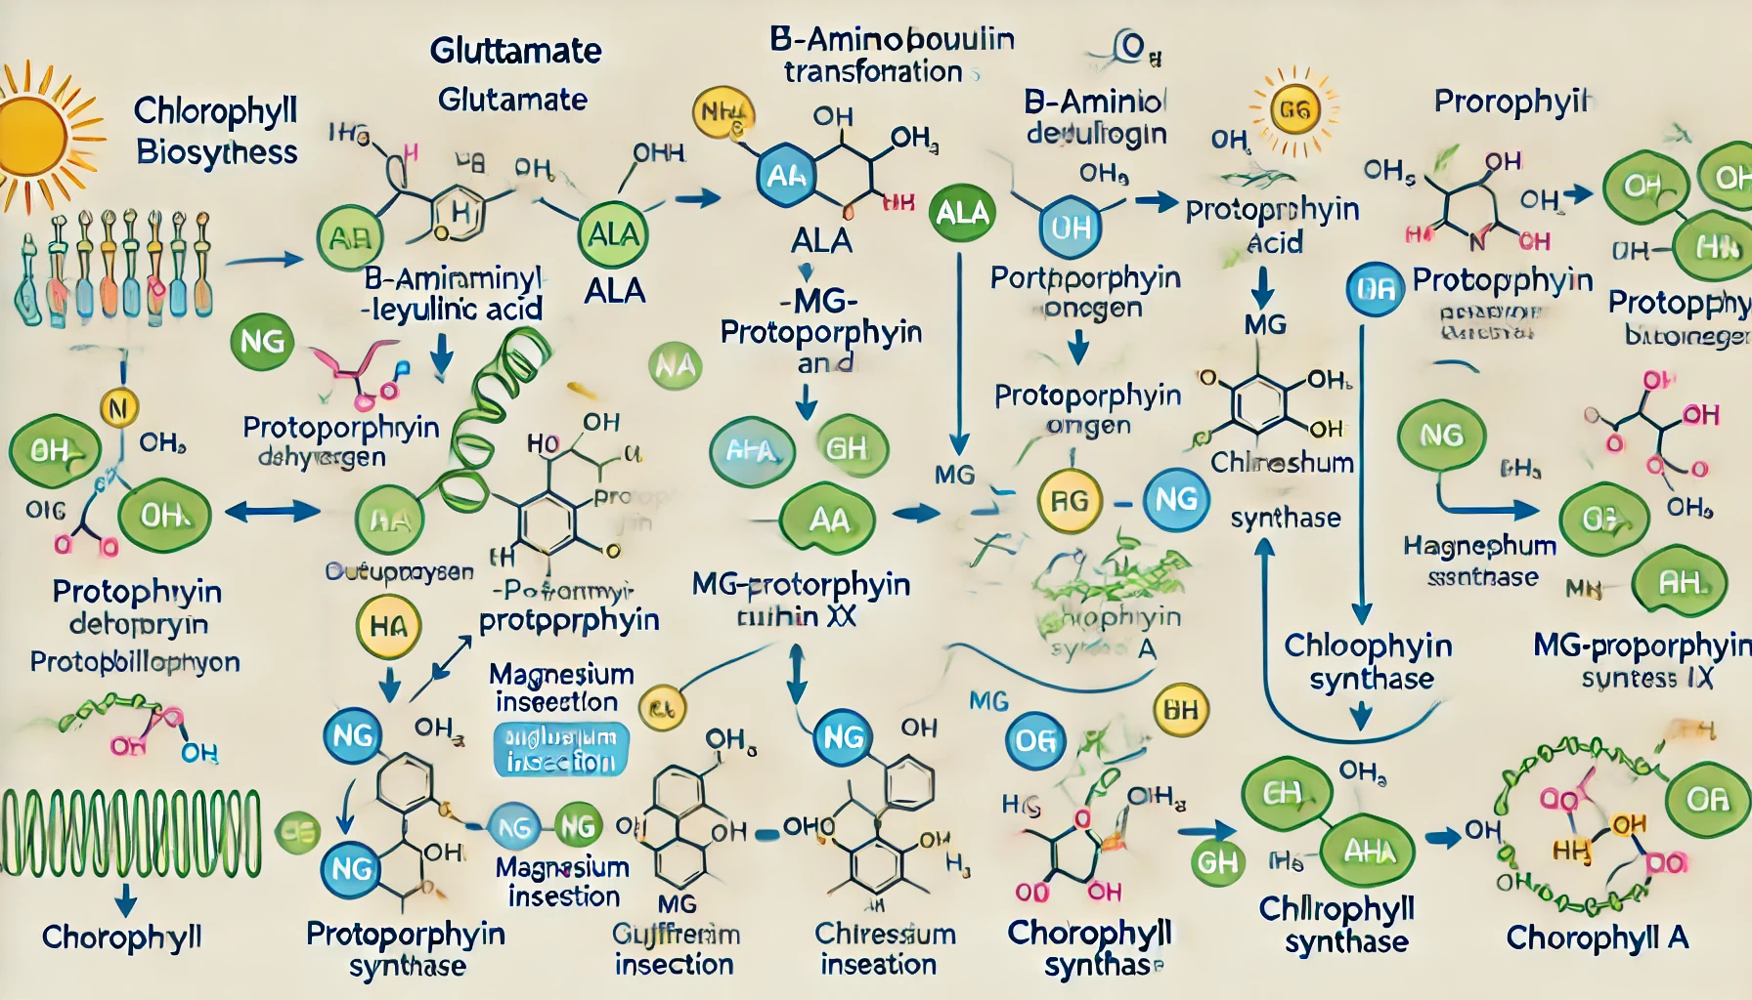
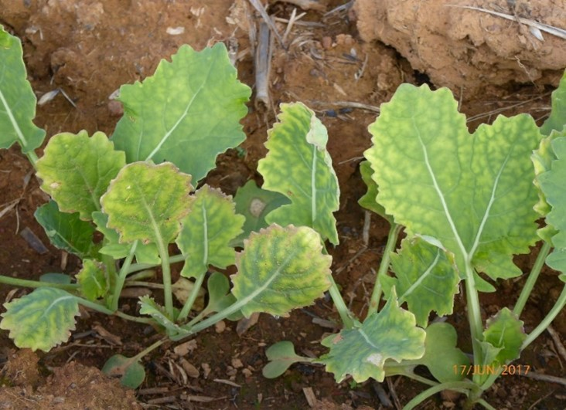
Sulfur is crucial for chlorophyll production
Sulfur deficient canola

Slide 4
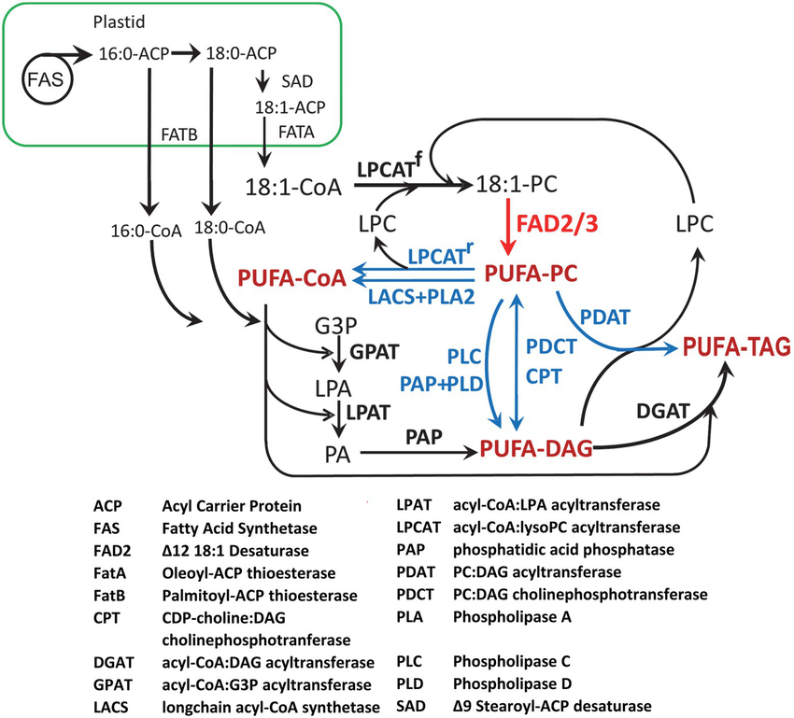
Sulfur helps in oil formation

Slide 5
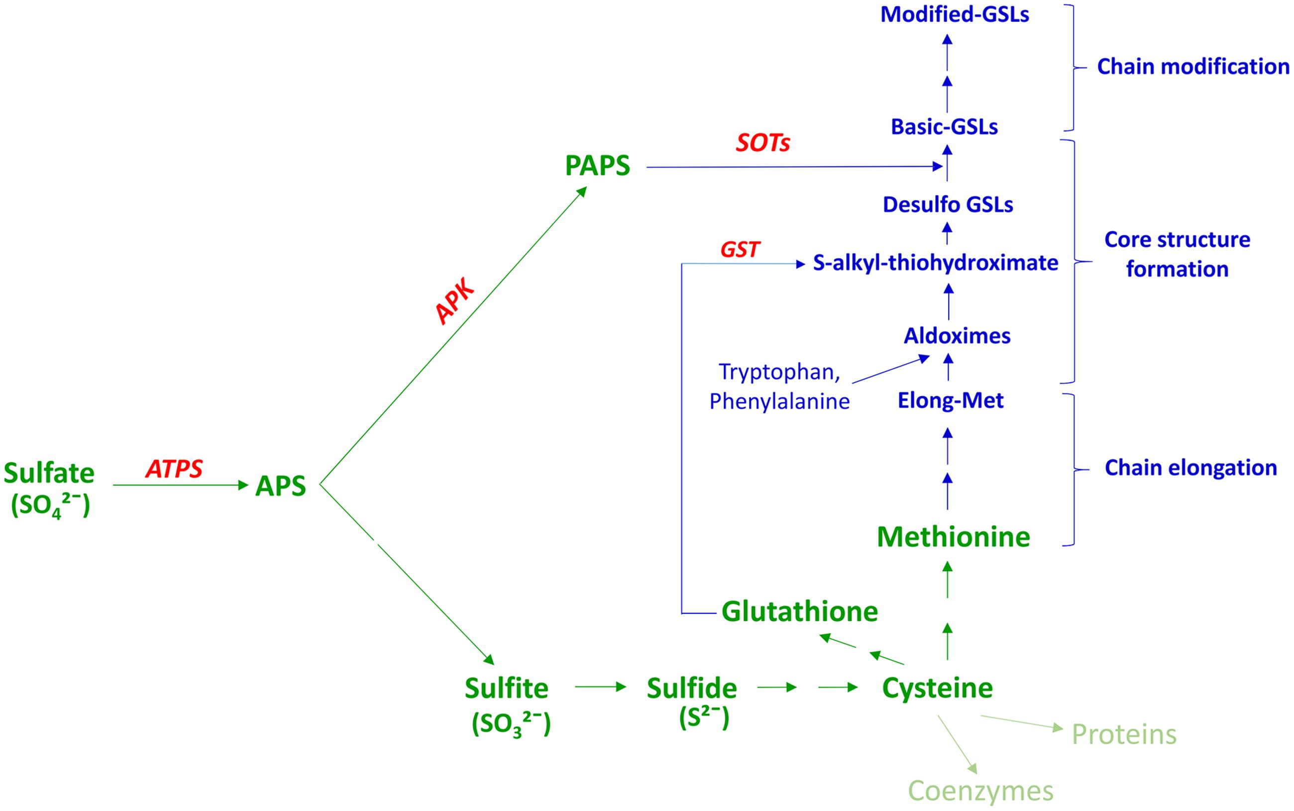
Driver of tolerance to biotic pests (Glucosinolates or GSLs)

Slide 6
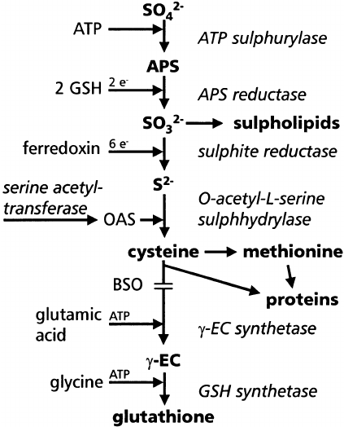
Driver of tolerance to abiotic stressors (Glutathione)

Slide 7
Current statewide sulfur recommendation for canola in North Dakota is 20-30 lb/ac
Recommendation was made from research conducted two decades ago

Slide 8
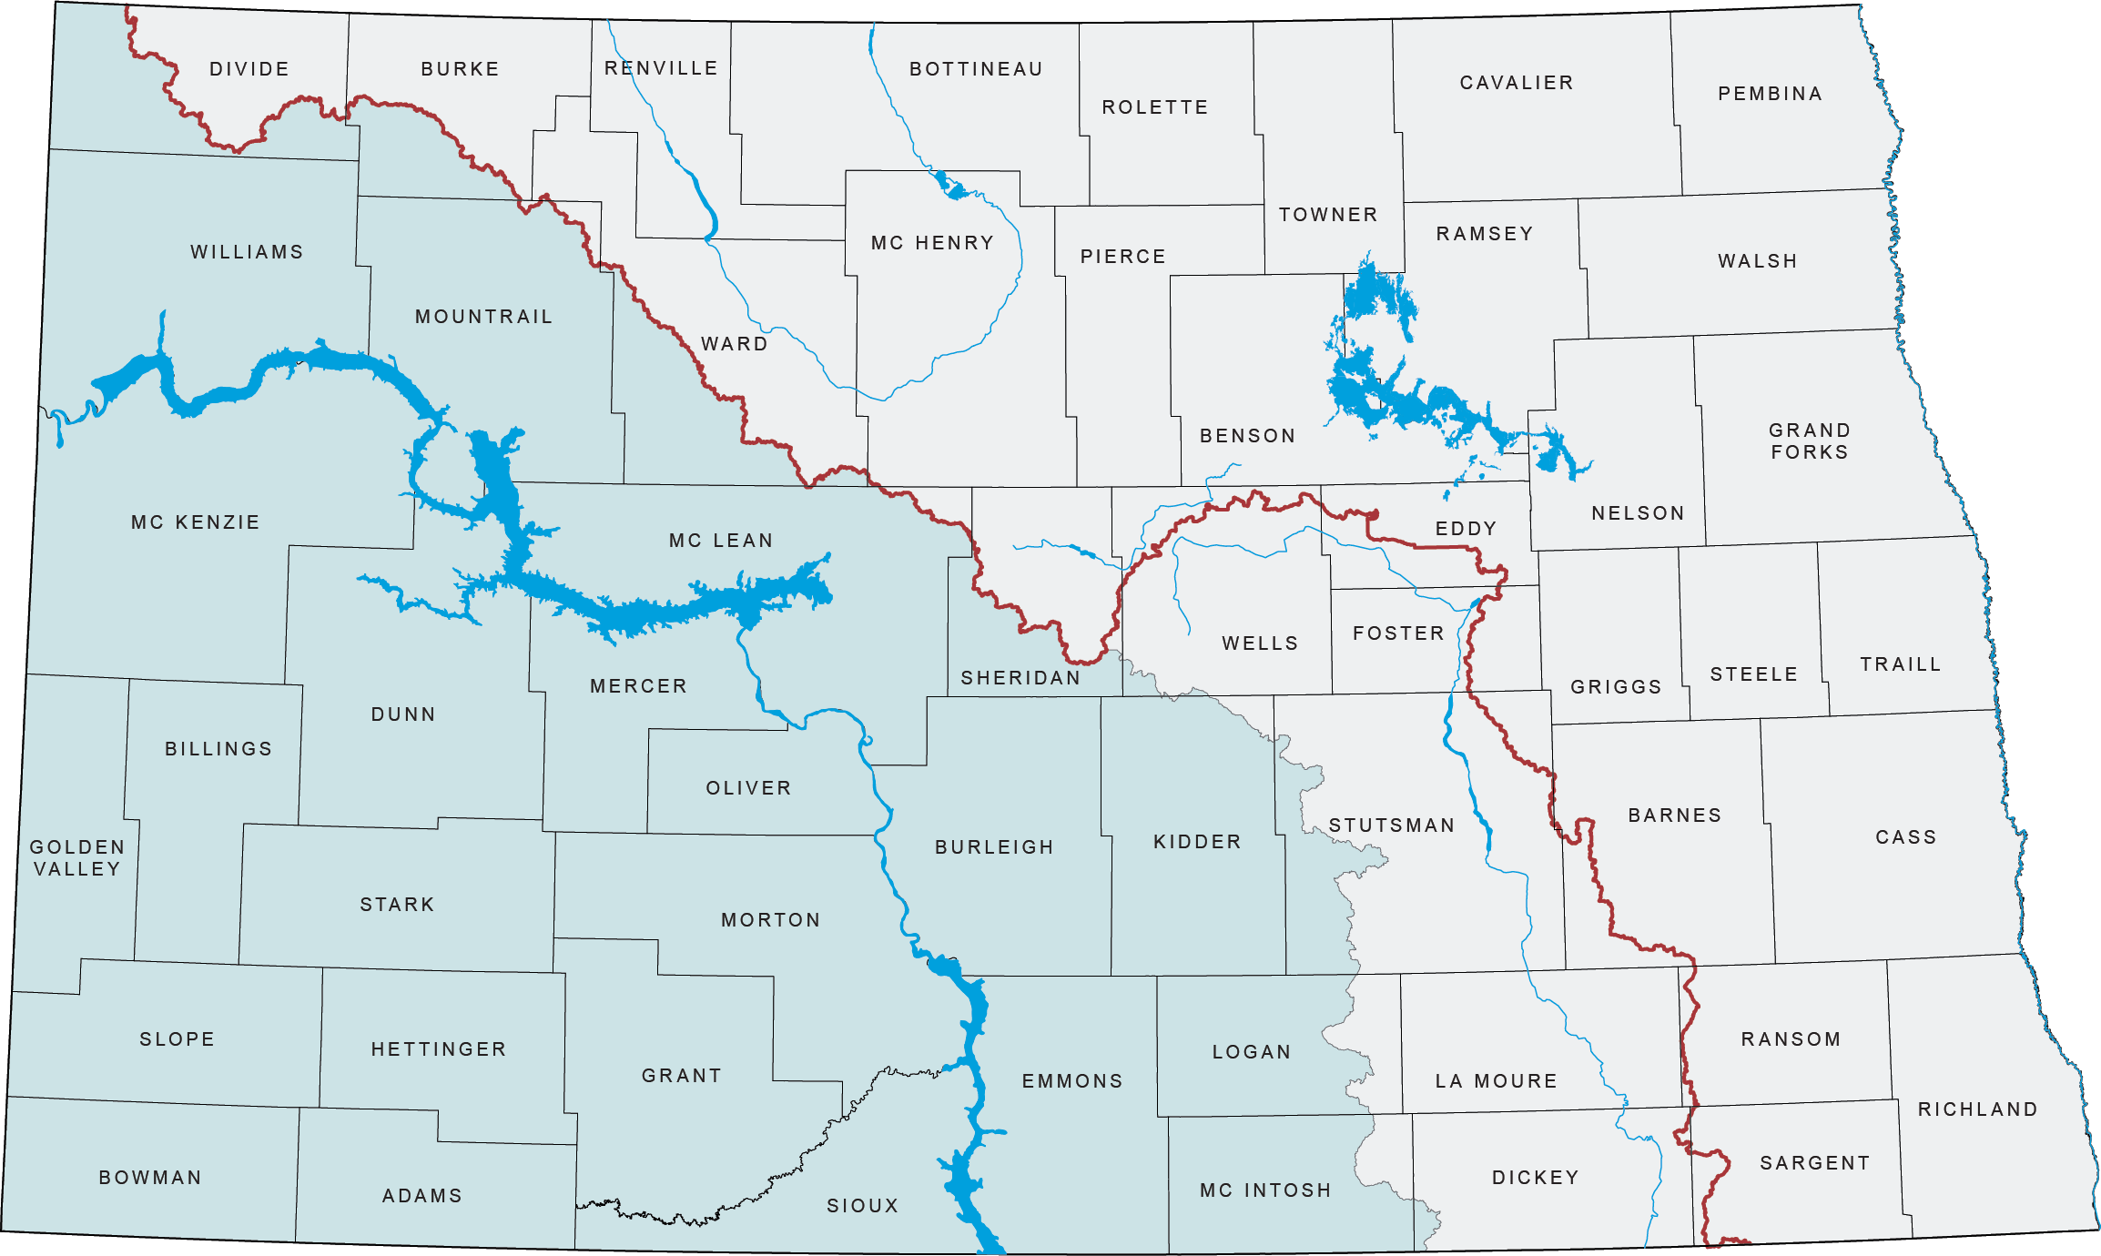
Research was conducted in north/east of the Missouri Coteau

Slide 9
Sulfate-sulfur soil test is inadequate to predict sulfur requirement
Highly mobile
Sulfate test does not account for organic sulfur

Slide 10
Objectives
Evaluate effects of different sulfur fertilizer sources and application rates in canola yield and quality in southwest North Dakota
Assess combination of these sulfur sources and rates with different nitrogen management (rates) in canola yield and quality in the region

Slide 11
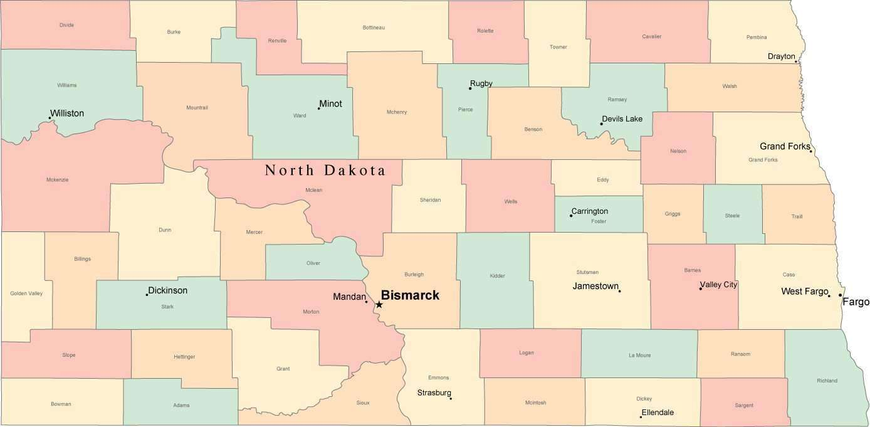
Materials and Methods
Three different locations (Dickinson, Hettinger and Minot) during 2024 and 2025 growing seasons

Slide 12
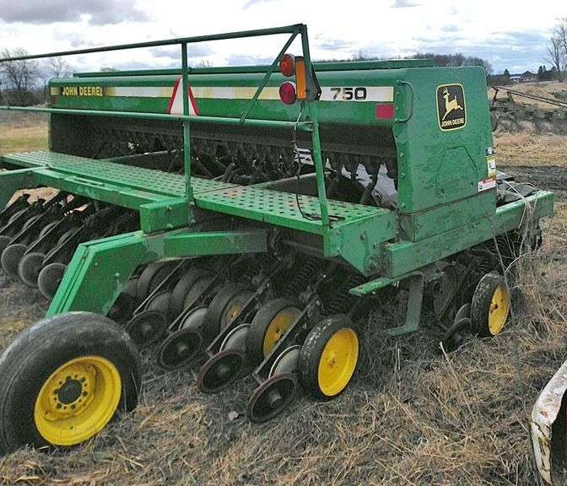
Canola cultivar: ‘L345PC’ in Dickinson and Hettinger, and ‘DK400TL’ in Minot
No-till seed drill

Slide 13
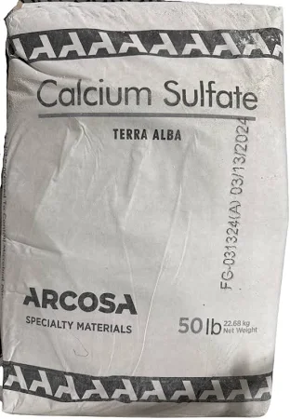
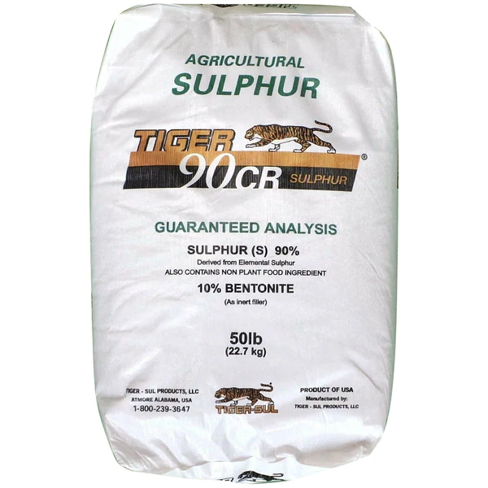
Treatments
Sulfur fertilizer sources: Ammonium sulfate, gypsum and elemental sulfur

Slide 14
Treatments
Sulfur rates: 0, 10, 20 and 30 lb/ac
Nitrogen rates: 0, 100 and 150 lb/ac

Slide 15

Hand-broadcasted in 2024
Tractor-mounted fertilizer broadcaster in Dickinson and Hettinger in 2025

Slide 16
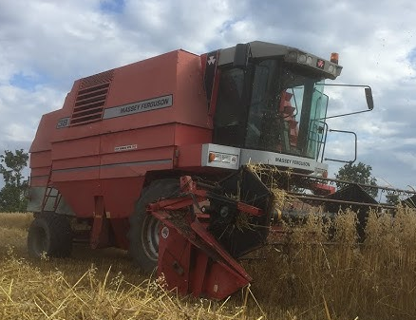
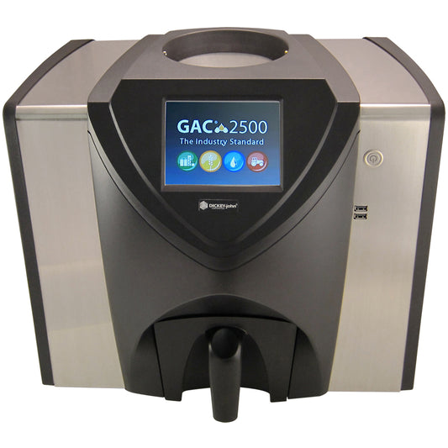
Measurements
Seed yield
Seed moisture and test weight
Plot combine
Commercial grain tester

Slide 17
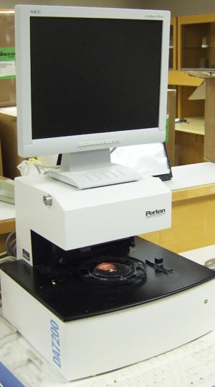
Oil content
Perten DA7200 NIR analyzer

Slide 18
Experimental design and statistical analysis
Split-split plot (4 replications)
Sulfur fertilizer sources – whole plot
Sulfur rates – split-plot
Nitrogen rates – split-split-plot
Data were subjected to ANOVA using PROC GLIMMIX procedure of SAS software
Location and replicate (random effect)
Sulfur fertilizer sources, sulfur rates and nitrogen rates (fixed effect)

Slide 19
Results
2024
2025

Slide 20
Results
2024
2025
2024
2025
2024
2025

Slide 21
Results
Seed yield
Ammonium sulfate

Slide 22
Gypsum

Slide 23
Elemental sulfur

Slide 25
Test weight
Ammonium sulfate

Slide 26
Gypsum

Slide 27
Elemental sulfur

Slide 29
Oil content
Ammonium sulfate

Slide 30
Gypsum

Slide 31
Elemental sulfur

Slide 33
Oil yield
Ammonium sulfate

Slide 34
Gypsum

Slide 35
Elemental sulfur

Slide 37
Conclusions/Recommendation
This study identified significant interactions among sulfur fertilizer source, sulfur fertilizer rates and nitrogen rates for canola production
Regardless of such interactions, sulfur rate of 20 lb/ac outyielded other rates for canola seed yield
Sulfur rates of 20 lb/ac also had greater test weight compared to other rates in many cases
Although sulfur rate of 20 lb/ac performed better than other in many cases, farmers should consider sulfur fertilizer source and nitrogen rate as well when deciding appropriate sulfur rate for canola production in southwest North Dakota
Repetition In future, how these fertilizers rates and sources compared when applied in fall and how fall application compared with spring one for canola production in southwest North Dakota

Slide 38

Acknowledgements
Technical Help
Summer research crew members

Slide 39


